Slide 1
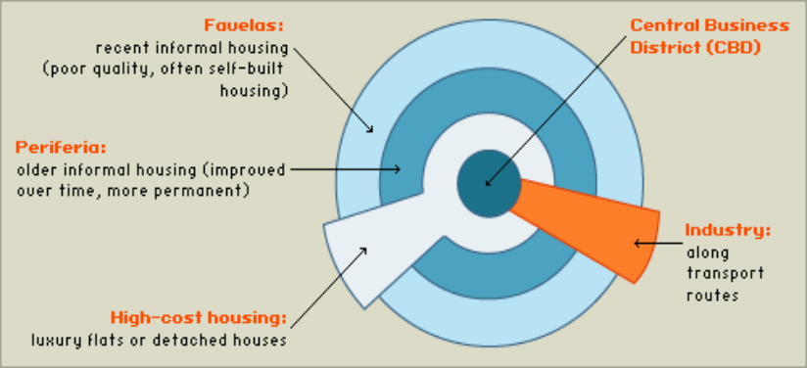
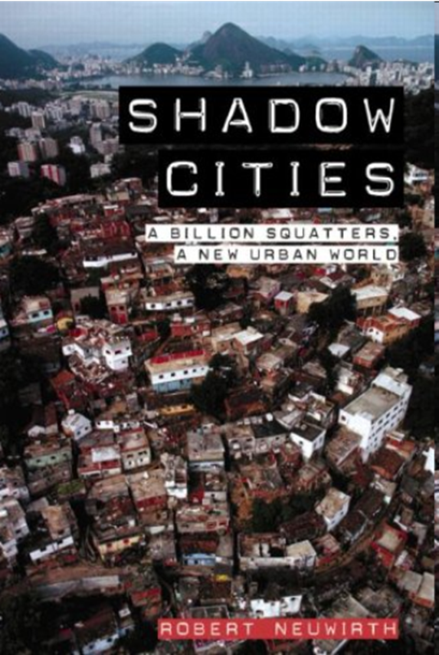
Basic urban model for an LEDC city.
Higher cost housing and higher class residential areas located centrally. Historical core of colonial city. Rapid urban growth expanding the peripheral areas.
Literature Link
Richard Neuwirth’s
book Shadow Cities

Slide 2
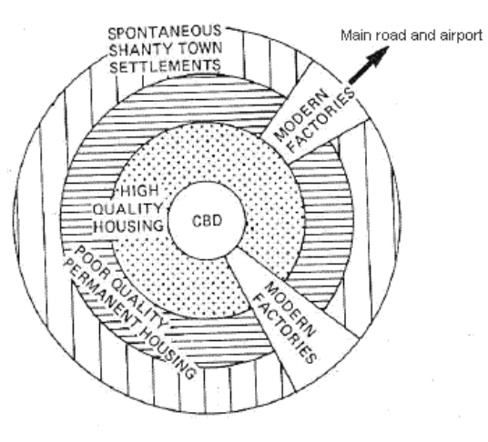
Basic urban model for an LEDC city.
The land use model for Zomba may be simplified as follows :
1. The main recreational zone is found in the centre of the urban area. This was once the Gymkhana Club, where the colonial rulers played polo.
2. The Central Business District contains the main businesses and market of the urban area. This is found close to the centre, the most accessible location where the main roads meet.
Industrial area along the airport road
Zomba's limited industrial district close to the main road and CBD
3. High status housing surrounds Zomba's CBD. This pattern is the opposite to that of cities in MEDCs. Inner city districts of MEDCs date back to the factories and tenement blocks of the Industrial Revolution, whereas the area surrounding Zomba's CBD dates from colonial times when it housed the colony's administrators and Governor. It consequently has the infrastructure - electricity, telephones, sewerage, water, etc. not found in other parts of the urban area.
4. Surrounding the high-quality residential area is medium quality housing which started out as low class housing. It has now been provided with some basic amenities.
5. Low class housing is found on the lower land to the south-east. This land is at risk from flooding, and contains the sewage works.
6. Factories are found along the main road and also close to the CBD.
Urban growth is too rapid for planners and for the city to provide basic urban infrastructure, housing and services. Peripheral areas characterized by poor quality housing and spontaneous settlements as immigrants attempt to satisfy their basic needs of housing and employment through the informal economy.

Slide 3
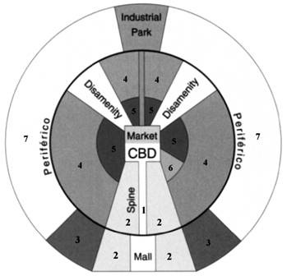
Basic urban model for an LEDC city (Griffin -Ford Model)
General Definition: The Latin American City Model combines elements of Latin American Culture and globalization by combining radial sectors and concentric zones. Includes a thriving CBD with a commercial spine. The quality of houses decreases as one moves outward away from the CBD, and the areas of worse housing occurs in the disamenity sectors.
1. Commercial
2. Elite Residential Sector
3. Middle-class Residential
4. Zone of situ accretion
5. Zone of maturity
6. Gentrification
7. Zone of peripheral squatter settlements

Slide 4
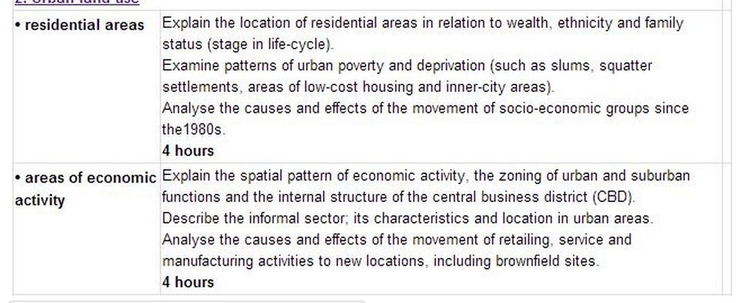
Urban Environments

Slide 5
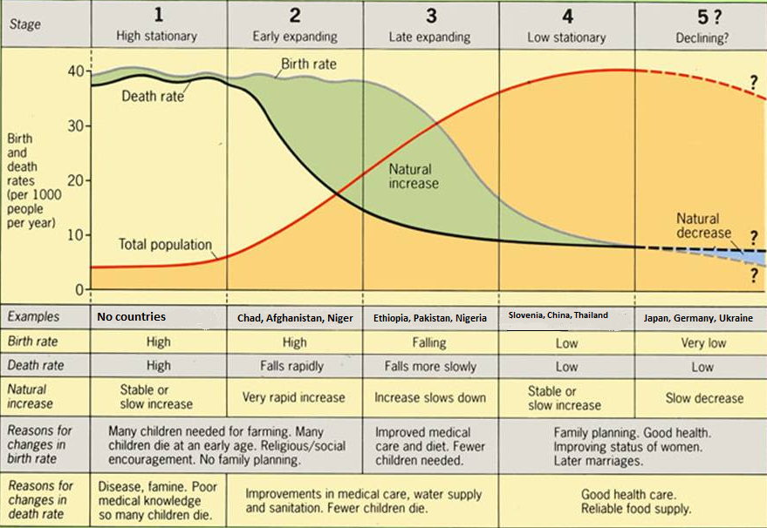
Revision:
Revision: Draw a labelled diagram of the Demographic Transition Model

Slide 6
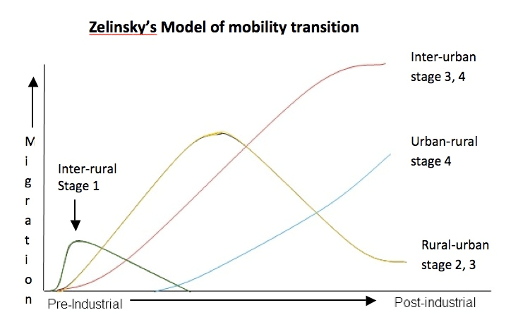
Zelinsky’s Model (Making Links)
Migration linked to the country’s development and its demographic transition.
Rural to urban migration during industrialization and stages 2/3 of Demographic transition Model.
Wilbur Zelinsky (1921-2013)
Zelinsky (1921-2013) Model of mobility transition
Demo: Ensure to make a sketch of the Zelinsky Model
TOK ALERT! The tools we use in our analysis shape the way we think. We will compare Zelinsky's model with mathematical and behavioural models of migration.

Slide 7
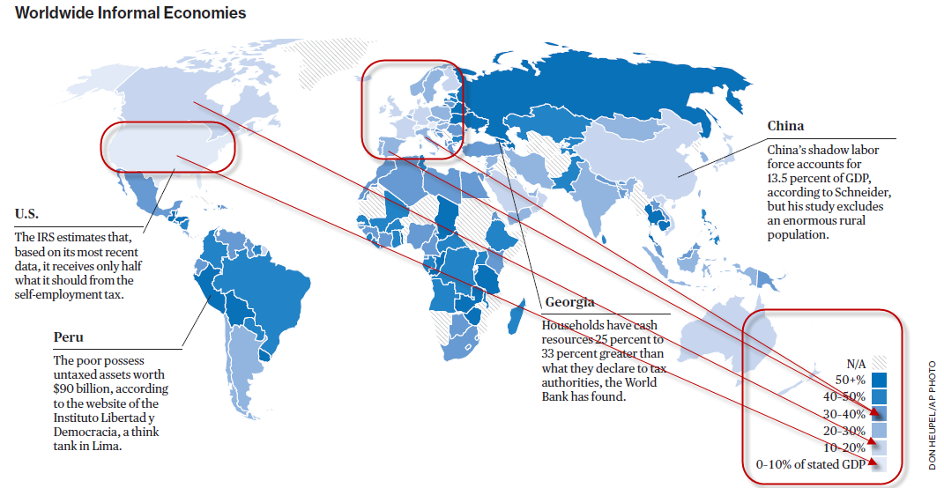
The role of the Informal Sector
Demo: Look at the source below and describe the pattern of informal economies.

Slide 8
No Money
No Investment
Low output
Low Profit
Problems of the informal economy
Key Language:
Informal Sector-"The informal sector refers to those workers who are self employed, or who work for those who are self employed. People who earn a living through self employment in most cases are not on payrolls, and thus are not taxed. Many informal workers do their businesses in unprotected and unsecured places.
This whole process of urbanization and urban growth is a sum of millions of people’s individual decisions, aspirations, hopes and desire to provide for their loved ones.
As the governments are unable to provide solutions, then these individuals, faced with these problems are struggling to find their own solutions to their housing and employment needs. This is why squatter settlements play such a vital role in the process of urban growth we are witnessing now in the world.

Slide 9
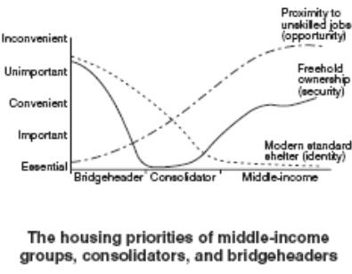
Changing Priorities of the urban poor in LEDC cities
Turner’s Model
Fits the profile of a traditional rural to urban migrant.
For a young male bridgeheader location near employment is the only priority. They are prepared to live in overcrowded central tenements or squatter settlements often with extended families.
Successful bridge headers need to establish themselves and consolidate their status. They seek more space and permanence and become consolidators often building their own home or paying for a more permanent residence, coinciding with starting their own families. Tenure and ownership priority.
As an established inhabitant of the city the status seeker will then seek to improve their dwelling and demand more urban services such as health care and education. Amenities priority.

Slide 10
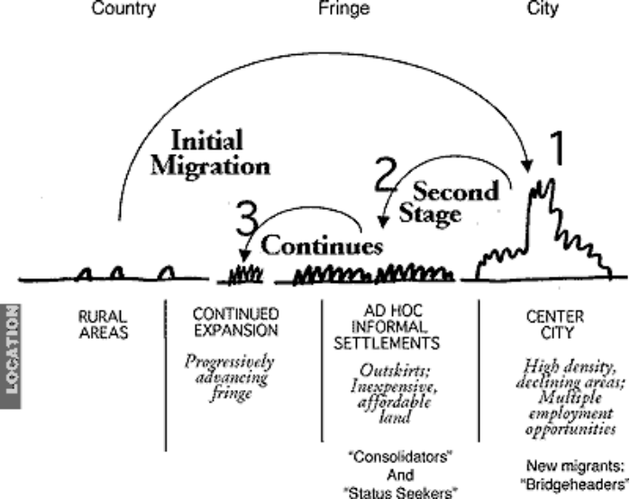
Turner’s model can linked to a intra-urban movement of migrants

