Slide 1
Megacities Research Project
Learning Objective: To be able to explain the growth and change of a megacities, through the use of a case study.
Location -
Growth and change over time-
Demographic-
Problems and Solutions -
Poverty vs affluence -

Slide 2

Mexico City
Starter: Use the Map Below to write a descriptive paragraph to explain the location of Mexico City.
Scale
Global
Continental
National
Local

Slide 3

Mexico City
Demo: How might Topography help and hinder the creation of n
Mexico can be divided into nine major topographic regions: the Mexican Plateau, the Sierra Madre Oriental, the Sierra Madre Occidental, the Cordillera Neo-Volcánica, the Gulf Coastal Plain, the Pacific Coastal Lowlands, Baja California, the Southern Highlands, and the Yucatán Peninsula.
The largest and most densely populated region is the Mexican Plateau.

Slide 4
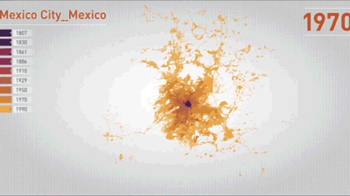
Mexico City Change over Time
Demo: How has Mexico city changed over time?
Key Data
The population of the past 5 years. They are as per the following:
2012 – 8.4 million
2013 – 8.57 million
2014 – 8.69 million
2015 – 8.8 million
2016 – 8.91 million
Urban Sprawl
Rural to Urban Migration
Periphery

Slide 5
Mexico City(Source work)
Demo: Look at Source A and B. What can you infer from the Source?
Source A
Source B

Slide 6
Source A

Slide 7
Source B

Slide 8
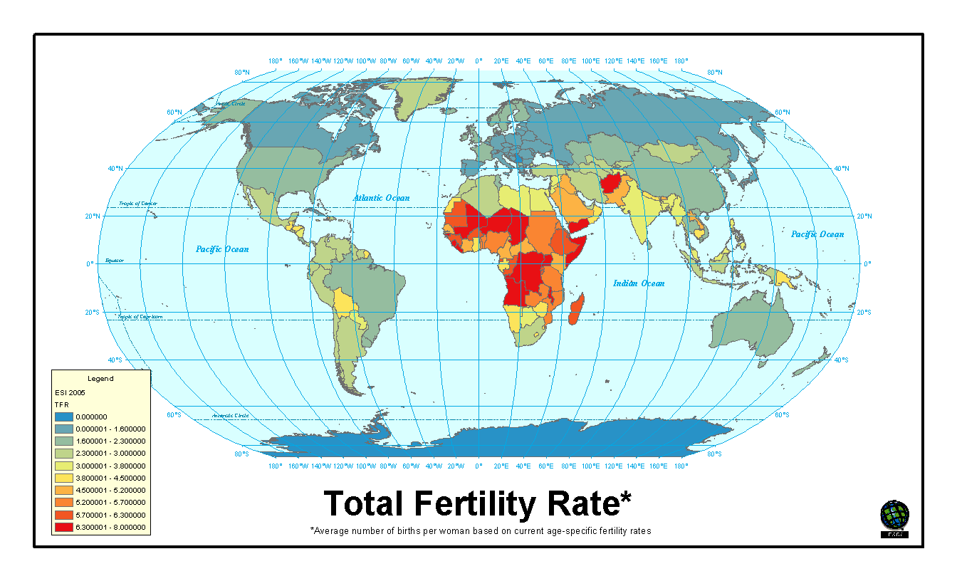
Total Fertility Rate
Fig 1.1
Total Fertility Rate-Average number of births per women based on current age-specific fertility rates.
Demo: Use your atlas and Fig 1.1 to complete your table
1. High Fertility Rate
2. Neutral
3. Low Fertility Rate
High Fertility Rate
Neutral
Low Fertility Rate

Slide 9
How do you calculate TFR?
In this example we have taken the data from Canada:
Divide the number of Live Births/Female population in the Age Group to determine the Age Specific Birth Rate
Sum the Age Specific Birth Rates
Multiply by 5 to calculate the Total Fertility Rate
Demo: Look at the table below and calculate the Age specific Birth Rate.
0.0373805
0.0759268
0.106304
0.0875835
0.0369894
0.0061251
0.0002274

Slide 10
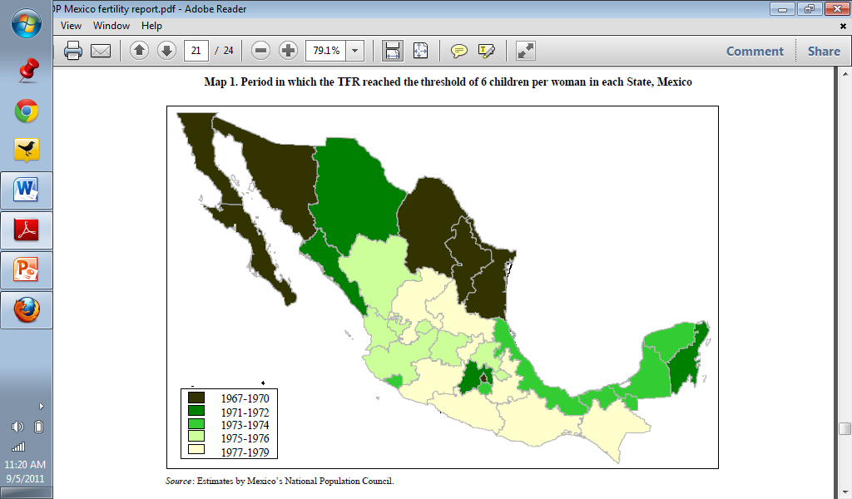
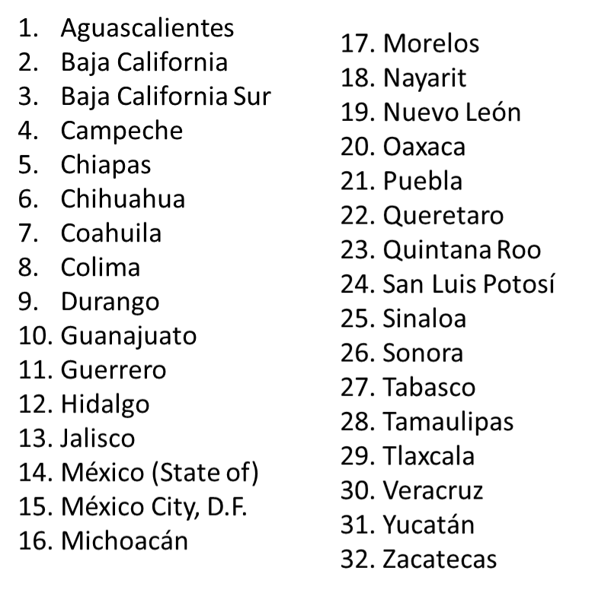

Map 1. Period in which TFR reached the threshold of 6 children per women in each State Mexico
2
26
6
3
7
25
19
9
32
28
22
24
12
18
10
31
13
15
16
23
30
4
27
8
11
20
5
14
21

Slide 11
Map 2. Total fertility rate by municipality, Mexico 2000
2
26
6
3
7
25
19
9
32
28
22
24
12
18
10
31
13
15
16
23
30
4
27
8
11
20
5
14
21
Municipality-a town or district that has local government.

Slide 12
Mexico Video Source Work
Demo: What are the problems and solutions that might be found within Mexico City?

