Slide 1
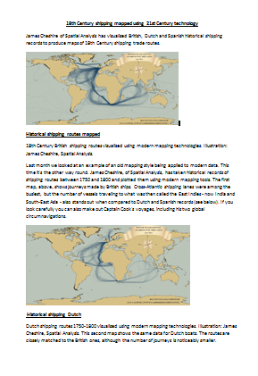
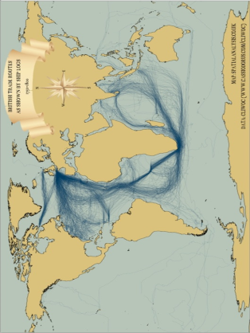
CONTAINERIZATION /OCEAN TRANSPORT
Learning Objective: To examine the relative changes in the speed and capacity of ocean/Air transport and its responsibity for the flow of goods, materials and people.
Starter: What were the main purposes of voyages in the 18th century?
Key Question: How has the reduction in the friction of distance resulted in time-space convergence?
What have been the relative changes in the speed and capacity of two types of transport responsible for the flow of goods materials and people?
Your Article
Your Map
Extension: Compare the maps in the Guardian article with the 2010 image below. Are there still areas of similarities? What are the major differences? Can you account for these?

Slide 3
Success Criteria
Learning Objective: To examine the relative changes in the speed and capacity of ocean/Road transport and its responsibity for the flow of goods, materials and people.
If you are going to achieve a 1 you will be able to:
If you are going to achieve a 3 you will be able to:
Give a developed and well-substantiated explanation of how information and communication technology and transport has helped form global interactions.
Analyse the effects this has had on the world.
Give an accurate,
Structured geographical description of how information and communication technology and transport has helped form global interactions.

Slide 4
Ocean Transport
Notes:
http://www.smithsonianmag.com/innovation/interactive-50-largest-ports-world-180947915/

Slide 5
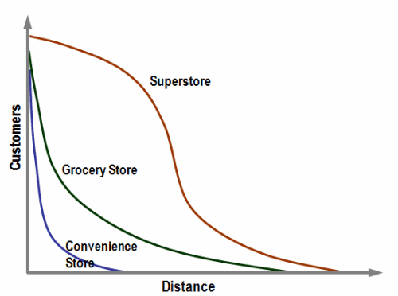
Distance-decay curve
Demo A: Create a title for the graph.
Large stores tend to have a lower distance decay function as they offer a wider range of goods, often at lower prices (mainly due to economies of scale). While a customer is unlikely to travel a long distance to go to a convenience store, a superstore (Wal-Mart type) is likely to draw customers from a substantial distance. The area under the curve represents the number of customers patronizing a store.
Fig .1
Conventional Distance Decay Curves for Retail Activities
Demo B: Describe the findings of the graph found in Fig .1 Ensure to conclude your findings.

Slide 6
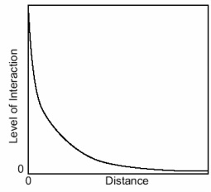
Distance-decay curve
Strength of this model:
Weakness of this model:
It explains why there are very close relationships between financial investors in large cities separated by long distance. You would expect two large cities far apart to have a greater "pull" than two small villages far apart. Larger cities have better employment, education, and entertainment provided for citizens than smaller cities.
This model does not take into account other variables apart from population size and distance. For example, it expects you to understand the level of interactions between Paris and London be the same as the interactions between Paris and a place of similar distance and population, but located in an Less Developed Country.
The distance decay is used to calculate the transportation flow between two points. The curve shows that as the interaction decreases, the distance increases.
Demo: What are the strengths and weaknesses of the distance decay theory?

Slide 7
Time Space convergence
Demo: Produce another example of your own to illustrate time-space convergence. Make sure that you include a calculation to show the average time-space convergence.
Time-Space convergence(TSC) = Travel time difference
Time difference
= 240 minutes
50 years
= 4.8 minutes per year
on average
The working outs

Slide 8
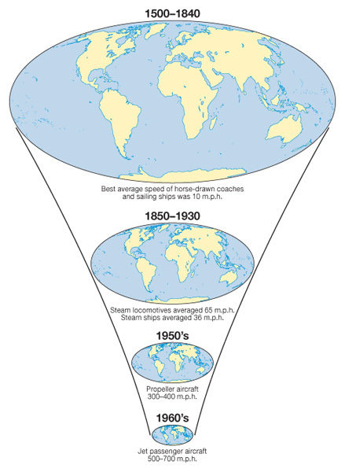
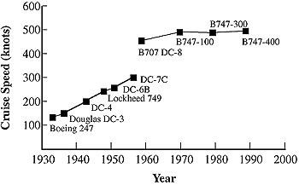
Air Transport (Growth in air travel and speed)
The cruise speed of 1940s propeller-driven aircraft increased from about 100 to 300 knots over a period of 20 years, for Boeing and Douglas aircraft. At the start of the commercial jet age, at the end of the 1950s, cruise speeds were about 450 knots. The majority of turbofan-powered aircraft in today's world fleet have average cruise speeds of about 500 knots.

Slide 9
Investigating Air transport
Demo: Divide your page into six parts.
Stage 1
Demo: Read you information to become an expert
Stage 2
Demo: Share the information with your class mates.
Stage 2

Slide 10
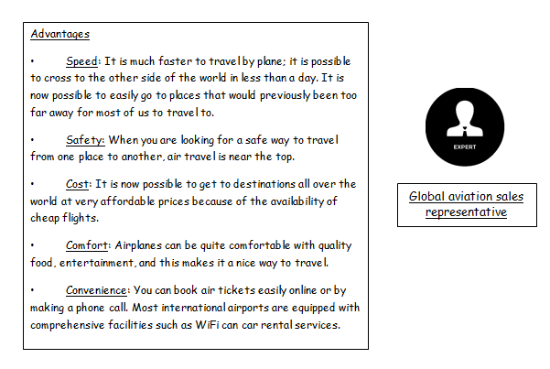
Investigating Air transport
Demo: Divide your page into six parts.
Demo: Read you information to become an expert
Demo: Share the information with your class mates.
Your Position
Your Material

Slide 11
Assessment 1 (Exam Question)
Describe and explain the changes in speed and capacity of one type of transport (choose either aeroplane or container ship). (10)
Demo:
Created a detailed Plan for your essay, make sure to use the planning tool provided.
Ensure to Research the topic thoroughly and provide data and statistics to back up any explanation or description.
Make sure to the Harvard referencing system when that data is used.
Any Geographical terminology needs to be defined.

Slide 12
Mark scheme
Level | Knowledge and understanding / case studies | Organization
2 | Task has been completely misinterpreted. No relevant facts No examples | No structure, unprepared No citation system used
3 | Poor, ignores important aspects of the task. Little knowledge Irrelevant examples | Little attempt to organize material Havard not used but sources referenced
4 | Partially addresses the task Some relevant knowledge but there are significant omissions Relevant examples are included but limited | Few diagrams/photographs included, little organization Havard only used for limited sections
5 | Competent knowledge for all 3 areas Relevant knowledge but minor omissions Generalized examples | Some indication of structure and organization Havard for some parts
6 | Developed with all 3 areas covered and includes some examples Accurate knowledge with some minor omissions Some detail to the examples provided | Acceptable maps and diagrams; appropriate structure and organization Havard but some minor errors
7 | Developed examples Accurate, specific, well-detailed knowledge | Very well structured, clear maps and diagrams Havard throughout

