Slide 1
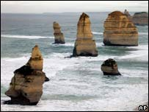
What is produced by erosion?
Learning Objective: To be able to name and draw coastal features produced by erosion.
Starter: What are the four types of erosion?
Hydraulic action
Abrasion
Attrition
Solution
Challenge: Write an explanation as to how longshore drift occurs.

Slide 2
Polly Parrots tale
Polly the pebble is being out at sea being carried by the sea. She is carried by a wave towards the beach from an angle. When the wave and Polly reach the beach they travel up the beach an at angle, in a diagonal line. But Polly is not left on the beach, instead she is carried by the water back to the sea, but in a straight line because this is the quickest way. Polly is not taken right out to sea but is caught by the next wave and taken up the beach again in a diagonal line. And again she is taken back by the water back to sea straight down the beach, the quickest way. This zig-zag pattern continues all along the beach until Polly reaches the other end.

Slide 3
Coastal processes – transportation

Slide 4
Headlands and bays

Slide 5
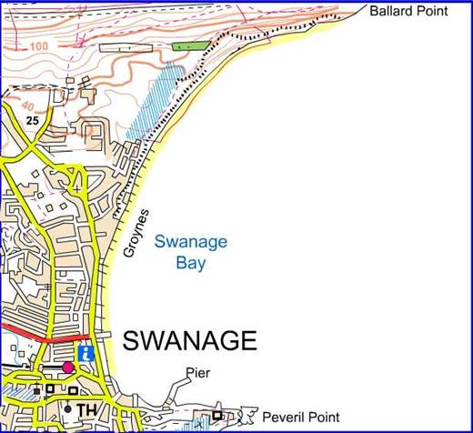
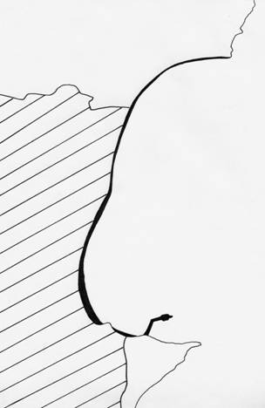
An example of headlands and bays on the Dorset coastline…
chalk
clay
Swanage Bay
limestone
A04 Geographical skills

Slide 6
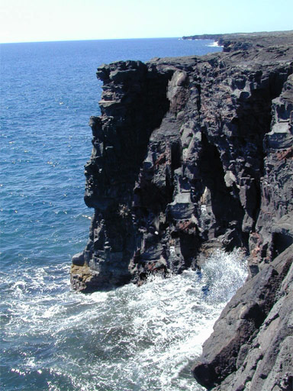
cliff
Features of erosion

Slide 7
crack
Features of erosion

Slide 8
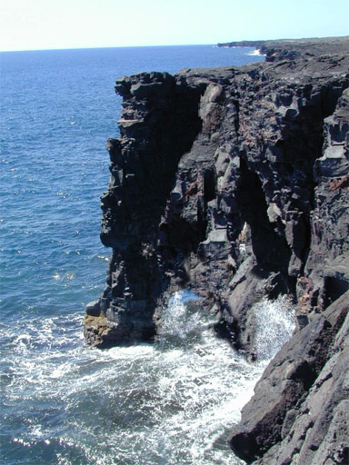
cave
Features of erosion

Slide 9
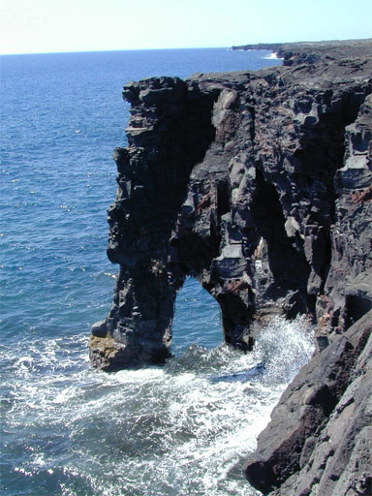
arch
Features of erosion

Slide 10
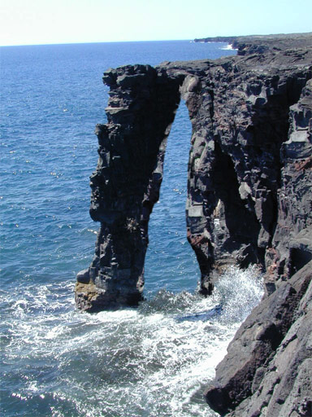
Features of erosion

Slide 11
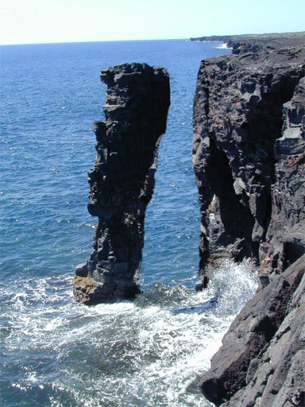
stack
Features of erosion

Slide 12
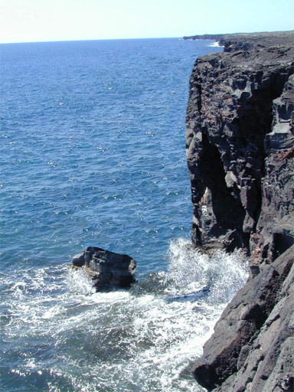
stump
Features of erosion

Slide 13
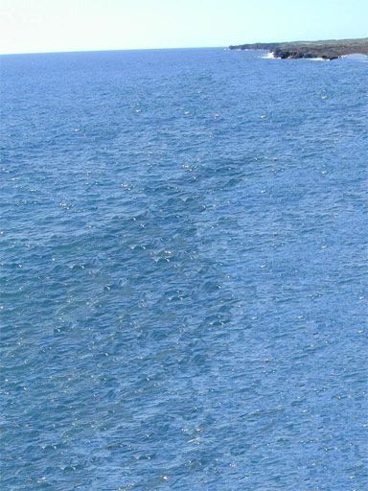
coastal retreat
Features of erosion

Slide 14
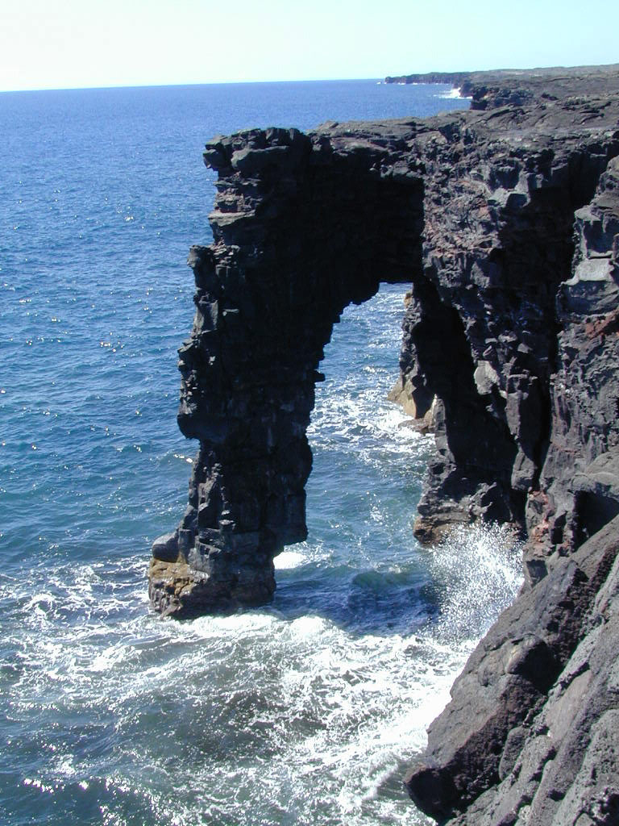
original photo http://www.leler.com/hawaii/
Features of erosion

Slide 15
Caves, arches, stacks and stumps

Slide 17
Caves, arches, stacks and stumps
Demo: Write an explanation as to how features of erosion are formed.
The crack gets wider and grows into a cave. The arch erodes and collapses. It leaves a stack standing in the sea. The cave erodes right through the headland to form an arch. The Stack will eventually be eroded at the bottom, and then will collapse leaving a stump. The sea finds a crack in the rock and starts to erode.

Slide 18
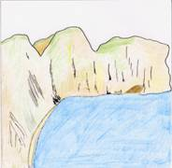
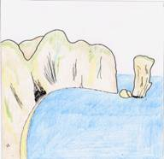
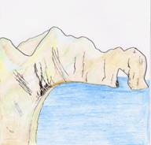
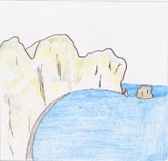
Caves, arches, stacks and stumps
Demo: Match the image with the most appropriate label.
A
B
C
D
1. The waves erode FAULTS (cracks) in the headland.
2. The waves eventually erode through the headland to form an ARCH.
3. The arch becomes unsupported and collapses to form a STACK.
4. A STUMP is formed from the collapsed stack.

Slide 19
Caves, arches, stacks and stumps
Demo: Match the image with the most appropriate label.
A
B
C
D
1
3
2
4
1. The waves erode FAULTS (cracks) in the headland.
2. The waves eventually erode through the headland to form an ARCH.
3. The arch becomes unsupported and collapses to form a STACK.
4. A STUMP is formed from the collapsed stack.

Slide 20
Deposition: Spit formation

Slide 21
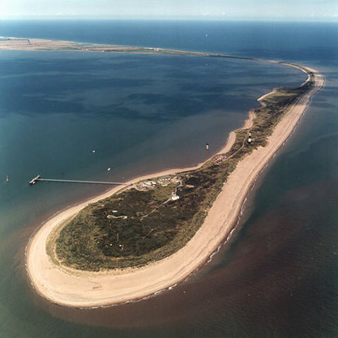
Explain how the feature was formed.
Describe the image of a coastal feature

Slide 22
Plenary (Individual Learning Task)
Learning Objective: To be able to explain the process of deposition and what features it forms.
Demo: Read through pages 122-125. Then complete the questions and tasks below.
What is deposition?
What features are formed because of deposition.
3. How are those featured formed? Ensure to give an explanation for each feature.
4. Can you identify these features on the map on page 124?

