Slide 1
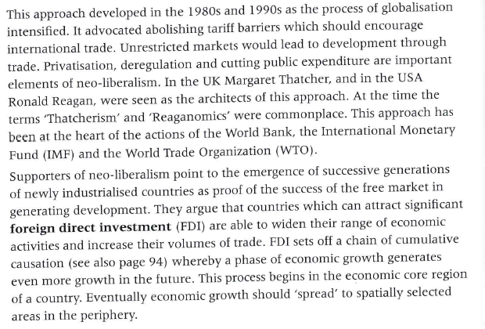
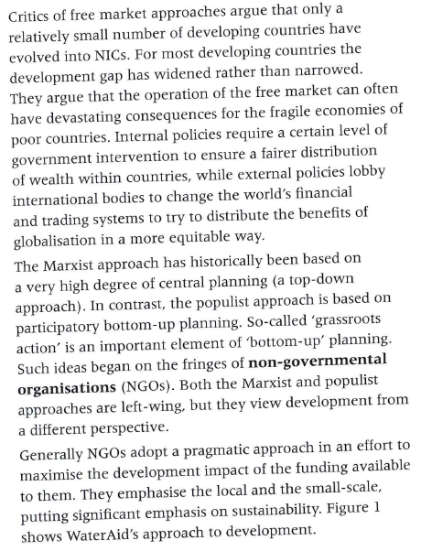
Closing the Development Gap
Learning Objective: To be able to explain how disparities in wealth and development can be reduced, focusing on trade, market access, debt relief, aid and remittances.
Starter: What theories have we studied that have been adopted in the past to help reduce disparities?
Marxist and populist approaches
Neo-liberal economic theory

Slide 2
Starter: What are the key concepts of this theory?
Neo-liberal economic theory

Slide 3
Starter: What are the key concepts of this theory?
Marxist and populist approaches

Slide 4
Disparities and Change
The age of high mass consumption
The drive to maturity
W.W.Rostow (Modernisation Theory)
Take-off
A rise in the rate of productive investment to over 10% of national income
The development of one or more substantial manufacturing sectors with a high rate of growth
The emergence of administrative systems that encourage development
The preconditions for take off
The traditional Society
Decades

Slide 5
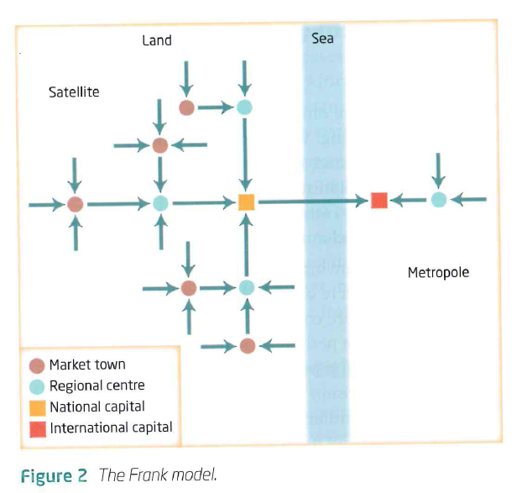
Dependency Theory
Andre Gunder Frank 1966
Took a historical approach:
poverty in the developing world arose through the spread of capitalism and that many countries had been prosperous before the arrival of European colonists
The process of absorption into the capitalist system sowed the seeds of underdevelopment
The development of the rich world was achieved by exploiting the raw materials of the developing world
Developing countries became even more dependent on the rich countries by farming export crops where once local food crops prevailed
The stronger the links to the developed world the worse the level of development

Slide 6
Dependency Theory
Frank used a simple model to explain how the “metropolis” (the developed world”) exploited the “periphery”(the developing world). The model shows a chain of exploitation which begins with small towns in the periphery expropriating surplus from the surrounding rural areas. This process of exploitation works its way up the urban hierarchy in the periphery until, finally, the largest settlements are exploited by cities in the metropolis. The intensity of poverty increases with the number of stages down the chain of exploitation.
Frank and others saw socialist systems of government as providing a better basis than capitalism for fairer society, both between countries and within countries.

Slide 7
Reducing Disparities
Learning Objective: To be able to explain hoe disparities in wealth and development can be reduced, focusing on trade, market access, debt relief, aid and remittances.
Discuss the different ways in which disparities can be reduced with an emphasis on the following:
Trade
Market Access
Debt Relief
Aid
Remittances
This report has been compiled by all Y11 IB Geography students and aims to form a case study of how the global disparities as highlighted in the Millennium Development Goals are being reduced. Each student has contributed to their own section of the document and work should be checked by others for accuracy and reliability. It is after all a case study that will be used in the final examinations.

Slide 8
Reducing Disparities Case Studies
Learning Objective: To be able to explain hoe disparities in wealth and development can be reduced, focusing on trade, market access, debt relief, aid and remittances.
Area of Focus | Summary and Case Studies
Trade
Market access
Debt Relief
Aid
Remittances

