Slide 1
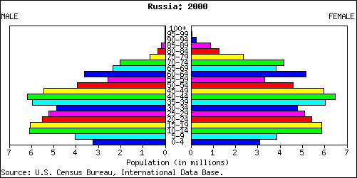
Population Pyramid
Starter: Analyse the population pyramid below. (Bullet point your ideas)
Challenge?
Challenge: What nation may be represented by this population pyramid? Justify your answer.

Slide 2
Population Pyramid (Russia)
Higher death rates especially among working-age males due to poverty, abuse of alcohol and other substances along with disease and stress. Decline in healthcare also contributed.
Loss of young men and women who emigrate in search of a higher standard of living
Starter: Analyse the population pyramid below. (Bullet point your ideas).
No large baby boom post-war unlike many countries after the second world war
High abortion rates amongst young women in particular – fear of poverty, pollution, alcoholism

Slide 3
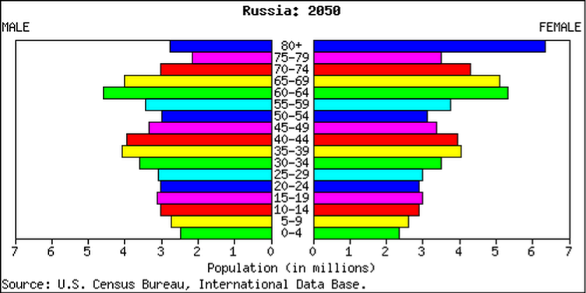
Population Pyramid (Russia)
Demo: Compare your population pyramid with the one on the board. What changes can you see?
Challenge: What problems might Russia face in the Future?

Slide 4
Population Decline in Russia(Case Study 2)
Learning Objectives: To be able to explain and analyse reasons as to why population decline is occurring in Russia.
Starter: Create two hypotheses as to why population may be declining in Russia?
Writing Frame:
Challenge: Create a null hypothesis as to why population may be declining in Russia.
The null hypothesis usually refers to a general statement or default position that there is no relationship between two measured phenomena, or no difference among groups.
Class Hypotheses:
1.
2.
3.

Slide 5
Population Decline in Russia(Case Study 2)
Learning Objectives: To be able to explain and analyse reasons as to why population decline is occurring in Russia.
Language for Learning:
Decline- become smaller, fewer, or less.
Emigration- is the act of leaving one's native country with the intent to settle elsewhere.
Natural Decrease-Natural increase in a population occurs where Birth rate is greater than death rate.
Soviet Union-The Union of Soviet Socialist Republics abbreviated to USSR.
Sparsely-thinly scattered or distributed.
Sociological Survey- Sociology is the scientific study of social behaviour, including its origins, development, organization, and institutions.
Crude- measuring out of a 1000

Slide 6
Population Decline in Russia(Case Study 2)
Demo: Read through your Case study sheet.
Stage: 2 Highlight and Label the following information.
Change in Population Structure (Birth rates/Death Rates/Fertility Rates/Change over time
Reasons for Population Decline
Cause and Effects
Social
Economic
Environmental
Political
Solutions to the problem

Slide 7
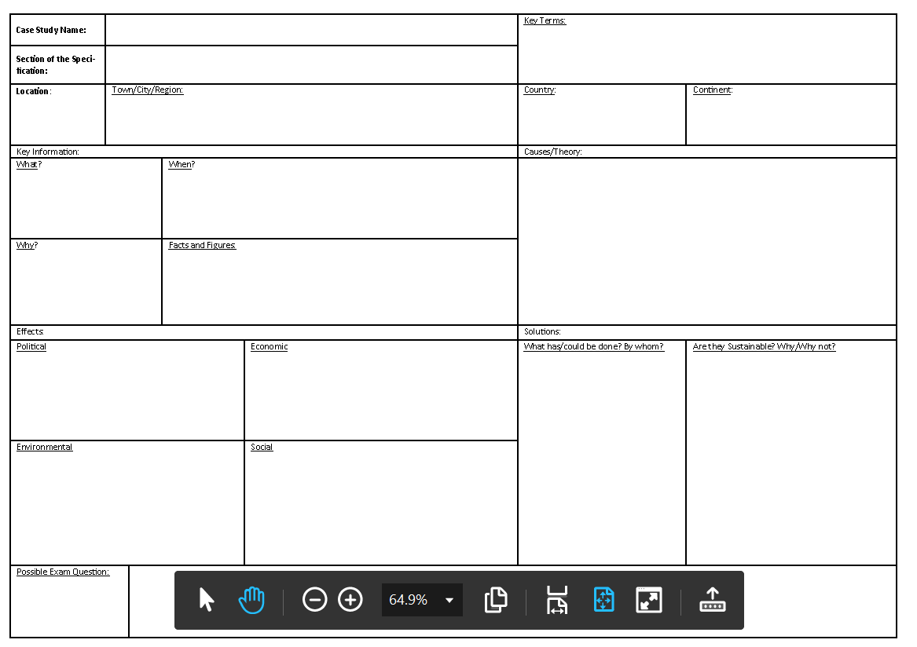
Population Decline in Russia(Case Study 2)
Demo: Transfer the information from your handout into your Case Study sheet.
Transfer

Slide 8
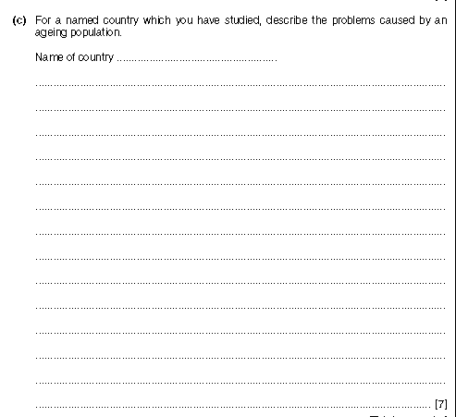
Exam Plenary
Demo: Look at the Exam question below. What revision methods can be used to answer this question?
For a named country which you have studied, describe the problems caused by a declining population. (7 marks)
Level 1 (1-3 marks)
Statements including limited detail on describing the problems caused by a declining population.
Level 2 (4-6)
Uses named example
More developed statements on problems, with links starting to be made.
Level 3 (7 marks)
Comprehensive and accurate statements on the problems faced by the country (i.e Russia), includes specific detail, references.

