Slide 1
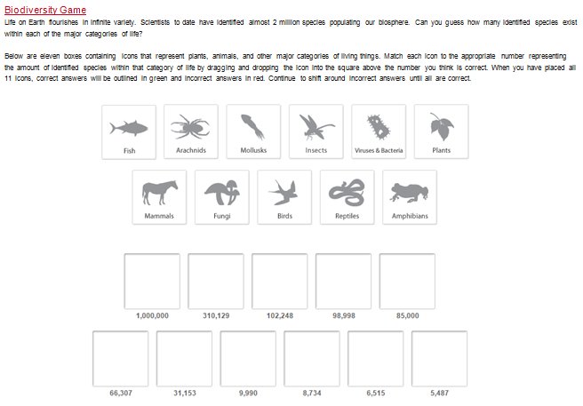
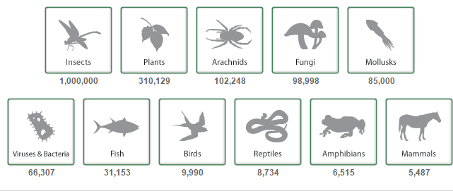
Biodiversity and change
Learning Objective: To explain the concept and importance of biodiversity in tropical rainforests.
Starter: Match each icon to the appropriate number representing the amount of identified species within that category of life by dragging and dropping the icon into the square above the number you think is correct.
Worksheet
Check your Answers
Challenge: Define biodiversity. [2 marks]
Biodiversity involves plants, animals and microorganisms. It refers to species diversity, genetic diversity and the interdependence of species within the ecosystem. Accept two valid points.

Slide 2
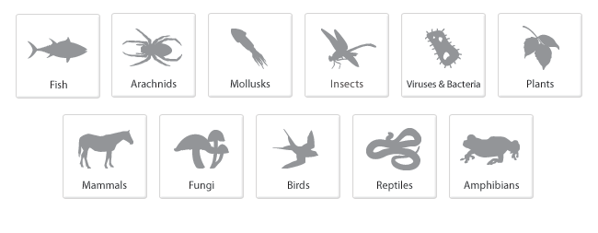
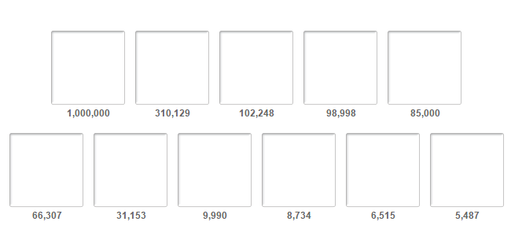
Starter Sheet
Starter: Match each icon to the appropriate number representing the amount of identified species within that category of life by dragging and dropping the icon into the square above the number you think is correct.

Slide 3
Glossary
Success Criteria
Learning Objective: To explain the concept and importance of biodiversity in tropical rainforests.
Learning Outcome:
Biodiversity – the variety of genes, species and ecosystems in an area.
Biosphere – the thin veneer of living material on the planet’s surface
Biome – a global scale ecosystem e.g. tropical forest
Biomass - the total weight of living matter per unit area (dry)
Biotic-the living components of an ecosystem such as plants.
Ecosystem- a dynamic complex of plant, animal and micro-organism communities and their non-living environment interacting as a functional unit.
Biodiversity Hotspot- area with particularly high level of biodiversity.
Recolonise- The re-establishment of organisms into habitats that they previously occupied.
To be able to explain the concept and importance of biodiversity in tropical rainforests using named case study examples.

Slide 4
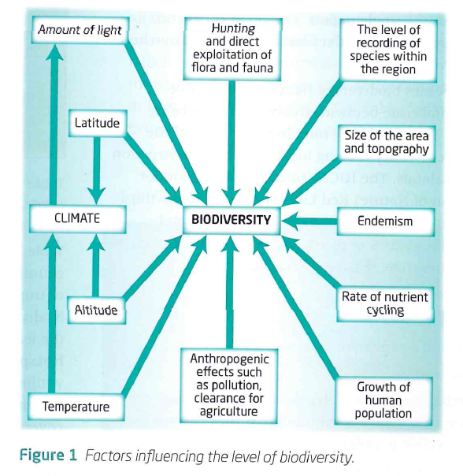
The concept of Biodiversity
Demo: What factors may influence the level of Biodiversity?
Factors Influencing Biodiversity

Slide 5
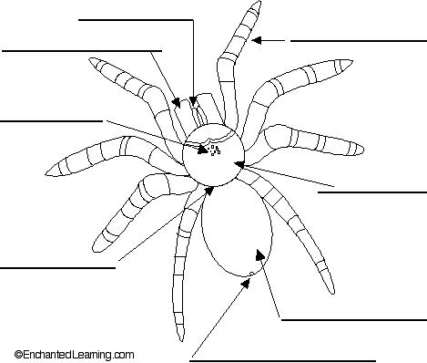
The Importance of Ecosystems
Demo: Create a spider diagram in your book that lists five goods and five services provided by ecosystems.
Cultural services: The non-material benefits people obtain from ecosystems through spiritual enrichment, cognitive development, reflection, recreation and aesthetic experiences – thereby taking account of landscape values;
Supporting services: The services that are necessary for the production of all other ecosystem services including soil formation, photosynthesis, primary production, nutrient cycling and water cycling.
Goods: The products obtained from ecosystems, including food, fiber, fuel, genetic resources, biochemicals, natural medicines, pharmaceuticals, ornamental resources and fresh water;
Regulating services: The benefits obtained from the regulation of ecosystem processes, including air quality regulation, climate regulation, water regulation, erosion regulation, water purification, disease regulation, pest regulation, pollination, natural hazard regulation;

Slide 6
Global Biomes
Demo: Use the Atlas and the Global Biomes Map to create a table on the different Biomes and examples of Countries within those Biomes.

Slide 7
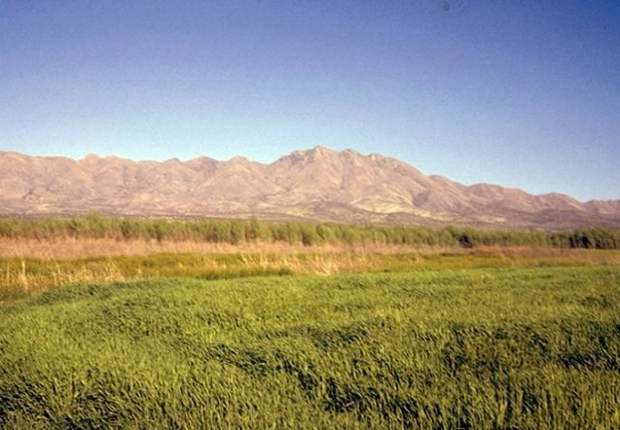
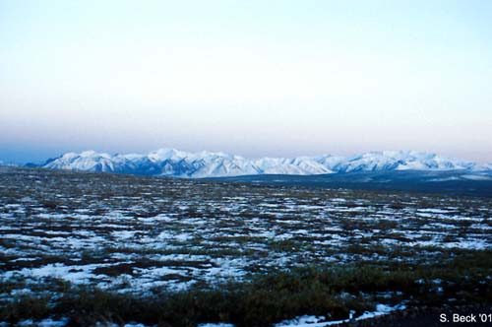
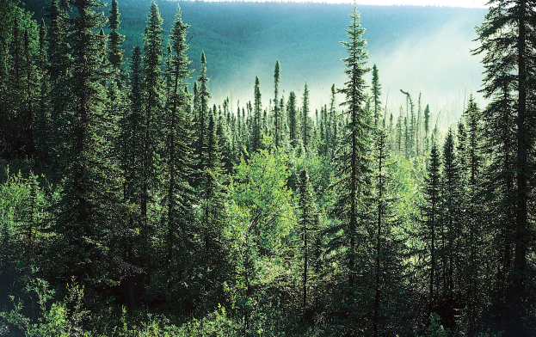
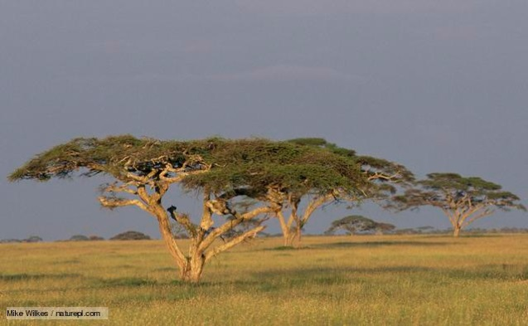
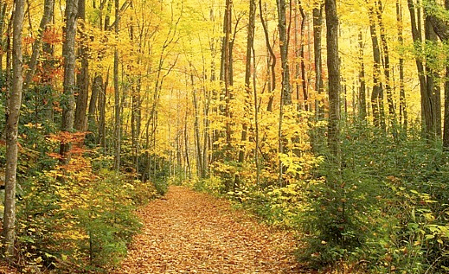
Global Biomes
Global Biomes
Tundra
Coniferous Forest
Temperate Deciduous
Temperate grassland
Mediterranean
Desert
Tropical Rainforest
Savanna Grassland
Other

Slide 8
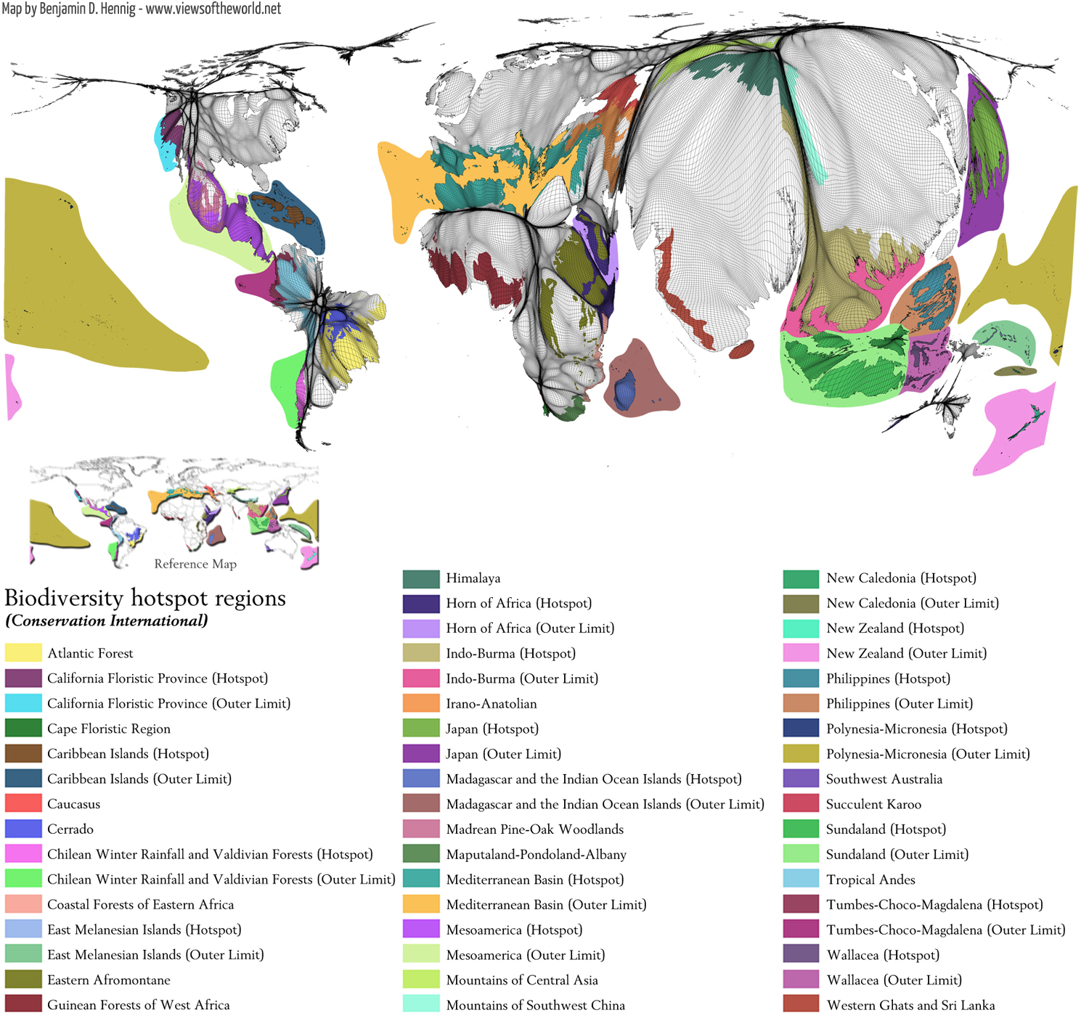
Demo: Why are Biodiversity hotspot so important?

Slide 9
Plenary
Suggest one social and one economic reason for conserving tropical rainforest.
[4 marks]
Social – the preservation of indigenous forest inhabitants.
Economic – conservation of gene pools for economic use as food
and medication and sustained yield of forest commodities such as
timber, rubber and fruit.

