Slide 1
Volcanoes (Comparative Case Study)
Learning Objective: To be able to compare two volcanic eruptions and discuss there difference between risk, Vulnerability, Scale, Place, Process, Power, Possibility, spatial interaction,
Starter :Add the exam question AND key terms to the bottom of your case study sheet.
Case Study 1
Vulnerability-The susceptibility of a community to a hazard or to the impact of a hazard event.
Resilience-The capacity of individuals, societies, organisations or environments to recover and resume business as usual functions and operations following a hazard event or other system shock.
Disaster-“A disaster is a sudden, calamitous event that causes serious disruption of the functioning of a community or a society causing widespread human, material, economic and/or environmental losses which exceed the ability of the affected community or society to cope using its own level of resources.” (UN International Strategy for Disaster Reduction)
Montserrat
VS
comparative Case Study
Key Terms
Case Study 2
Eyjafjallajökull
Exam Question
Examine the role of plate margin type in determining the severity of volcanic hazards. [10]

Slide 2
Montserrat [Place]
Demo: Ensure to NOTES to your case study sheet under place. Add as much detail as possible.
ADD TO CASE STUDY SHEET
Place

Slide 3
Montserrat (Process)
Demo: Add the explanation of the process to your worksheet.

Slide 4
Montserrat Process

Slide 5
Montserrat (Scale)
Demo: Add the effects to the Case Study sheet and ensure to think about SEEP.
Effects
Social
Economic
Environmental
Political

Slide 6
Montserrat (Responses)
Demo: Add the explanation of the process to your case study sheet.
Short Term
Long Term
An exclusion zone was set up in the volcanic region. This extends from the south coast of the island and was imposed because of the size of the existing volcanic dome and the resulting potential for pyroclastic activity.
A volcanic observatory was built to monitor the volcano. It has been relatively quiet since 2010
New roads and a new airport were built.
Services in the north of the island were expanded.
The presence of the volcano resulted in a growth in adventure tourism.
6. Out migration - in 1998 the people of Montserrat were granted full residency rights in the United Kingdom, allowing them to migrate if they chose. British citizenship was granted in 2002. People have returned to the island more recently.
Large scale evacuation by the British Navy
Abandonment of the capital city, Plymouth
Compensation and redevelopment money donated by the UK government
Unemployment rose due to the collapse of the tourist industry.
Diskussion: What are the solutions to this problem?

Slide 8
Volcanoes - Eyjafjallajökull
Demo: Ensure to NOTES to your case study sheet under place. Add as much detail as possible.
Eyjafjallajokull is in Iceland, and is an example of a major volcanic eruption. The name is a description of the characteristics of the volcano, namely Eyja meaning island; fjalla meaning mountain; and jokull meaning glacier.
Place

Slide 9
Eyjafjallajökull (Process)
Demo: Ensure to be able to talk about the different plate boundaries and there movement.
Model Answer
Here, convection currents are driving apart the North American plate (moving West) and the Eurasian Plate (moving East) along a constructive or divergent plate boundary. This is creating the Mid Atlantic ridge, along which the age of the rocks either side of the ridge and paleomagnetism have been used as evidence of Plate Tectonics theory. The plates are moving apart at a rate of 1cm to 5 cm per year. This has created a chain of volcanoes along the SE Rift zone of Iceland, which runs from NE to SW across Iceland, even passing underneath some of the countries Ice caps.

Slide 10
Eyjafjallajökull (Effects)
Demo: Add the effects to the Case Study sheet and ensure to think about SEEP.
Short Term
Long Term
Diskussion: What are the solutions to this problem?
Challenge: Read the Information and add the short term and long term effects to your T-Chart

Slide 11
Plenary
Answer either part (a) or part (b). Either 8.
Examine the role of plate margin type in determining the severity of volcanic hazards. [10]
(b) Evaluate the success of attempts to predict tectonic hazard events and their possible impacts. [10]

Slide 12
Examine the role of plate margin type in determining the severity of volcanic hazards. [10]
Marks should be allocated according to the markbands. Different processes operate at destructive and constructive margins, resulting in different hazard events for inhabited areas. Possible applied themes (AO2) demonstrating knowledge and understanding (AO1):
• destructive margins are usually more dangerous due to viscosity of lava and explosive events. Constructive margins are usually associated with less violent, effusive eruptions
• important aspects of eruptions also include pyroclastic flows, tephra ejection and gas release
• many additional factors affect severity of hazards. Secondary hazards (snow melt, mass movements) may play a role. The scale of the eruption also matters (including “super volcano” events at volcanic hotspots)
• human factors may be most important however: the number of people affected, their vulnerability, the presence of mitigation measures and use of technology all play a role. Good answers may be well-structured (AO4) and may additionally offer a critical evaluation (AO3) which examines the statement in a way that shows understanding of the relative power of physical and human factors to determine outcomes in different contexts, places and over varied time scales. Another approach might be to examine who technology is creating new possibilities for monitoring volcanoes (GPS sensors on cones), meaning that access to technology is becoming the most important factor. For 5–6 marks, expect some weakly evidenced outlining of two plate margin types, and a relevant hazard for each type. For 7–8 marks, expect a well-structured account which includes: • either well-evidenced explanation of two plate margin types and their relevant hazards
• or a discursive conclusion (or on-going evaluation) grounded in geographical concepts and/or perspectives. For 9–10 marks, expect both of these traits.

Slide 13
(b) Evaluate the success of attempts to predict tectonic hazard events and their possible impacts.(10)
Marks should be allocated according to the markbands. Tectonic hazard events include volcanoes, earthquakes, mass movements and secondary hazards that follow from any of these. There are also different types/aspects of volcanic hazards to consider. Possible applied themes (AO2) demonstrating knowledge and understanding (AO1):
• prediction can range from long-term (using recurrence intervals to consider the likelihood of an event in a given year) to short-term attempts (spotting signs that suggest an event is immanent). Events in places that are extensively monitored are more likely to be predicted than events in places that are less populated/studied
• in recent years, some events have been successfully identified using technology such as GPS crater monitoring. Signals such as minor earthquakes, gas release and possibly animal behavior have some track record of success. “Swarms” of small earthquakes may help suggest the arrival a large earthquake (eg L’Aquila in Italy)
• a distinction can be drawn between predicting an event and predicting what its impacts will be in terms of damages and losses. Good answers may be well-structured (AO4) and may additionally offer a critical evaluation (AO3) of the statement that shows critical understanding of what “success” might mean in different geographic contexts and places (e.g. it might be measured by the number of lives saved or the value of property saved). Another approach might be to evaluate the success of attempts to calculate statistical probability compared with the success to pinpoint the exact day when an event may occur (process complexity). Another approach might be to evaluate how far perspectives may differ on what constitutes a “success” especially in relation to events of varying scale. For 5–6 marks, expect some weakly evidenced outlining of two attempts to predict a valid hazard event should be described. For 7–8 marks, expect a well-structured account which includes:
• either well-evidenced explanation of a range of relevant attempts to predict hazards • or a discursive conclusion (or on-going evaluation) grounded in geographical concepts and/or perspectives. For 9–10 marks, expect both of these traits.

Slide 14
Factors that increase/decrease vulnerability
Proximity to a possible hazardous event
Population density in the area proximal to the event
Scientific understanding of the hazard
Public education and awareness of the hazard
Existence or non-existence of early-warning systems and lines of communication
Availability and readiness of emergency infrastructure
Construction styles and building codes
Cultural factors that influence public response to warnings

Slide 15
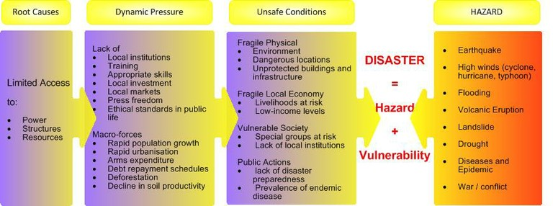
Vulnerability

Slide 16
Vulnerability
Physical dimensions
Intensity
Exposed
population
Age of the
infrastructure
Frequency
Technology
Location
Exposure
Demo-
graphy
Age and
income of the
population
Exposed
res-
ources
Sensitivity
VULNERA-
BILITY
Number
Res-
ponse
Level of
education
Capacity
to adapt
Management
structure
Access to
information and
technology
Wealth and
well being
Information
services
Tax
revenues
Emergency
plans

Slide 17
Spectrum of vulnerability
Low Vulnerability
High Vulnerability

Slide 18
What’s a Risk?
Relationship between degree of risk posed and probability of event occurring, the predicted losses and a community’s preparedness
Why do individuals and communities underestimate events occurring
What factors determine an individual’s perception of the risk posed by hazards

Slide 19
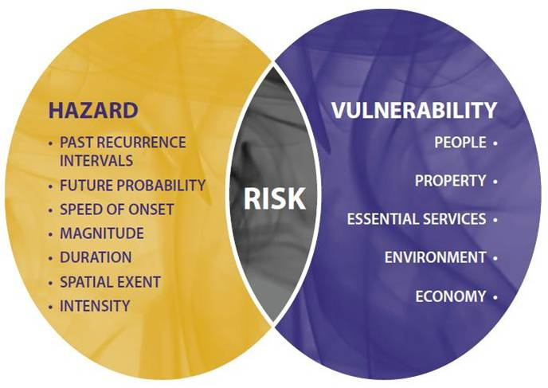
How do we measure risk?

