Slide 1
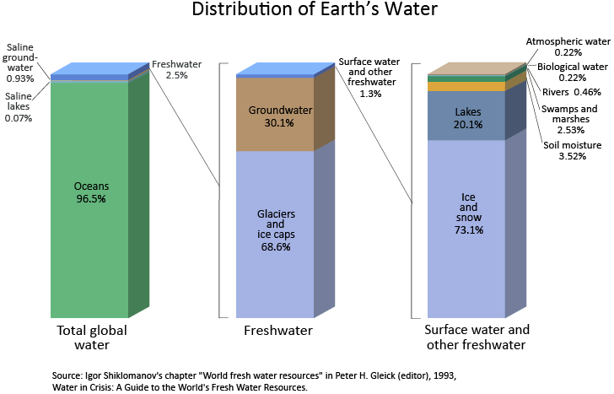
Water scarcity

Slide 2
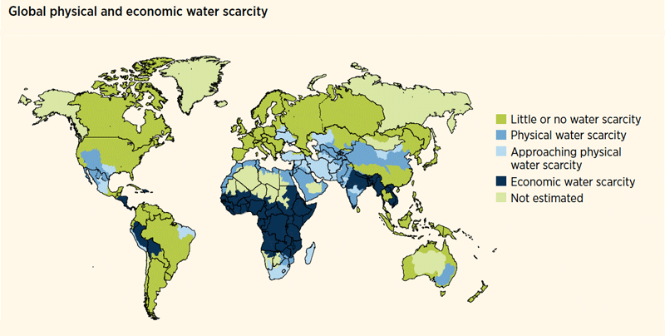
Water Scarcity
Starter: Describe the global distribution of water scarcity. [3]

Slide 3
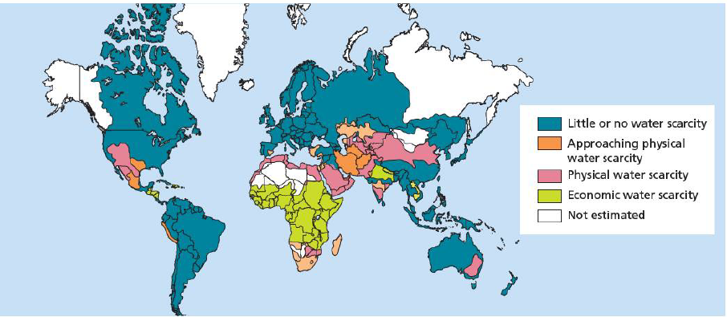
Water Scarcity
Demo: Ensure to describe the locations of physical and economic water scarcity. (4)
Economic Water scarcity- exists when a population does not have the necessary monetary means to utilise an adequate source of water. The unequal distribution of resources is central to economic water scarcity where the crux of the problem is lack of investment.
Physical Water scarcity-is when a physical access to water is limited. This is when demand outstrips a region’s ability to provide the water needed by the population.

Slide 4
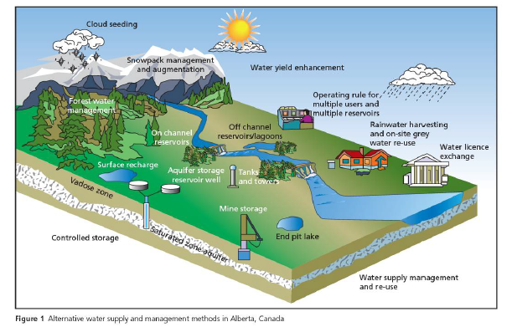
Learning Objective: To be able to explain the Environmental consequences of agricultural activities on water quality, to include pollution (eutrophication) and irrigation (salinization) the methods of water supply and use.
Water Quality and Quantity
Starter: Turn to pages 29-35 and make notes on the below listed subtopics.
Key Language: Water Supply-is the provision of water by public utilities, commercial organisations or by community endeavours.

Slide 5
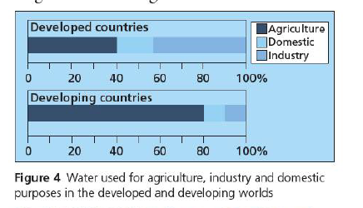
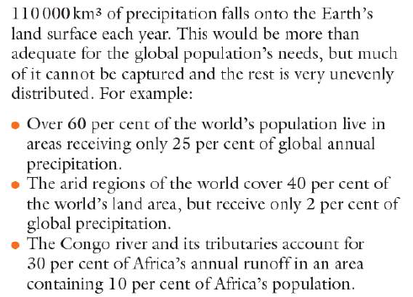
Water
Demo: How is water used? Look at Figure 4 and describe the water used. (5 marks)

Slide 6
Management of Water
Learning Objective: To find out how areas could manage the supplies of their water effectively.
Plenary: How can we manage water?

Slide 7
Past Paper Questions
Water Quality Quiz
1. Outline one environmental problem caused by eutrophication. [2]
2. Explain one human reason and one physical reason why some areas of a freshwater
lake such as this experience high levels of eutrophication. [3+3]
November 2017
(b) (i) Explain how irrigation can lead to salinization. [2]
(ii) Explain two consequences of salinization for farmers. [2+2]

