Slide 1
NATION STATES AND TNCS
Learning Objectives:
1. To be able to discuss the shift of power from nation state to TNCs as a result of their economic size and dominance.
2. To compare the wealth of TNCs with that of nation states
Starter: What examples of the creation of a nation state do we know?
Language for learning
Nation-state: An independent state inhabited by all the people of one nation and one nation only.
Sovereignty: The state of being independent and being able to make your own decisions.
Trade bloc: A group of countries that share trade agreements between each other.
Immobility of labour: The effect of barriers to the movement of workers between jobs and geographical regions.
Challenge: Look at the statement below is this positive or negative?
"Of the 100 largest economies in the world, 51 are corporations; only 49 are countries (based on a comparison of corporate sales and country GDP)"

Slide 2
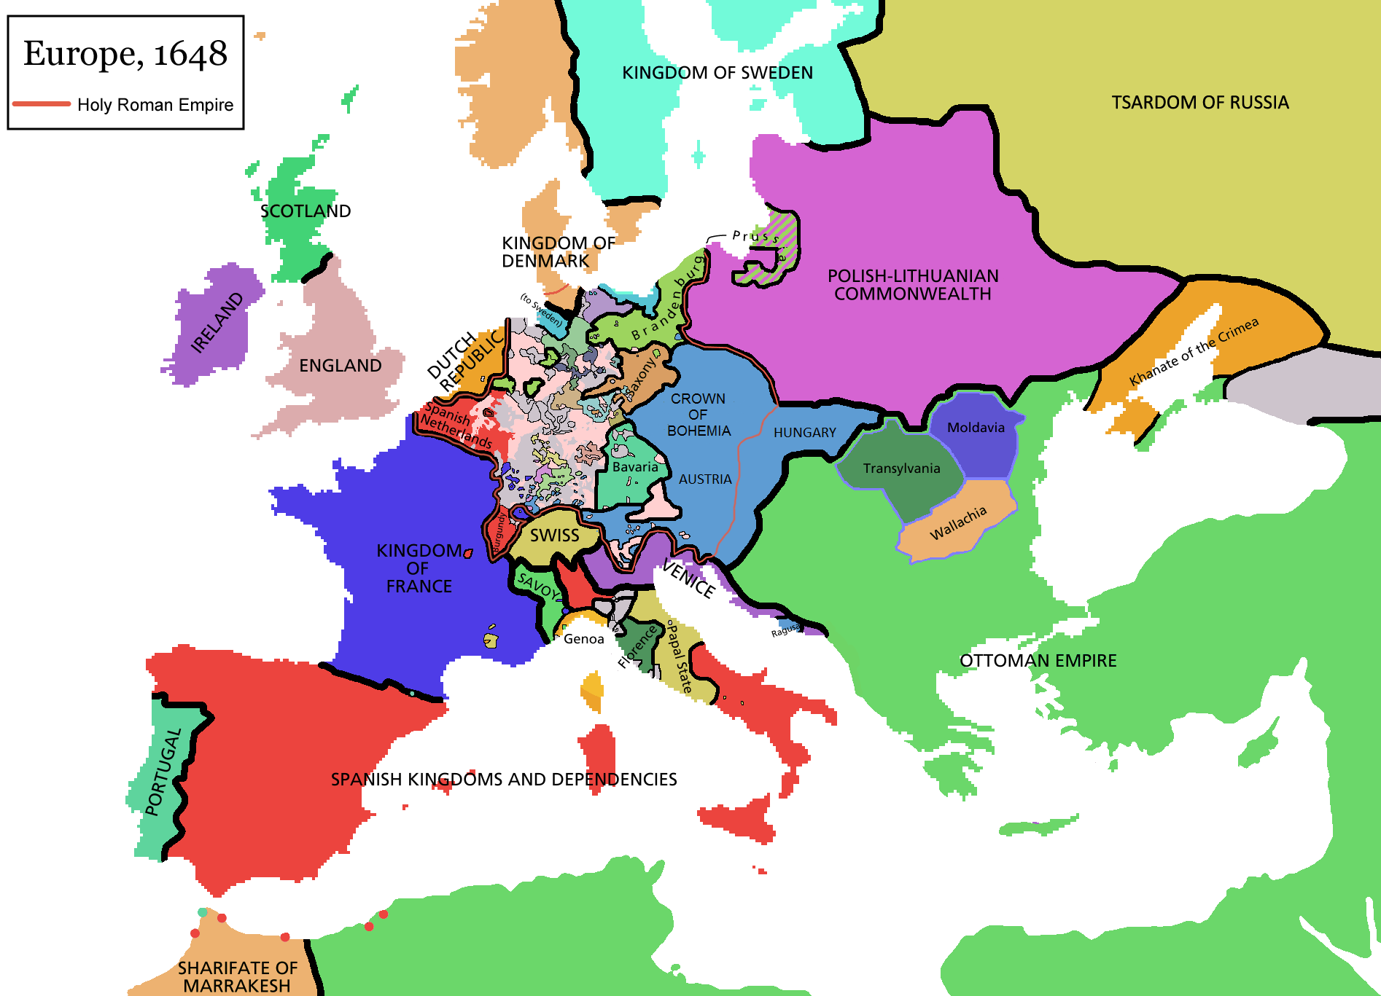
NATION STATES AND TNCS
Treaty of Westphalia
1713

Slide 3
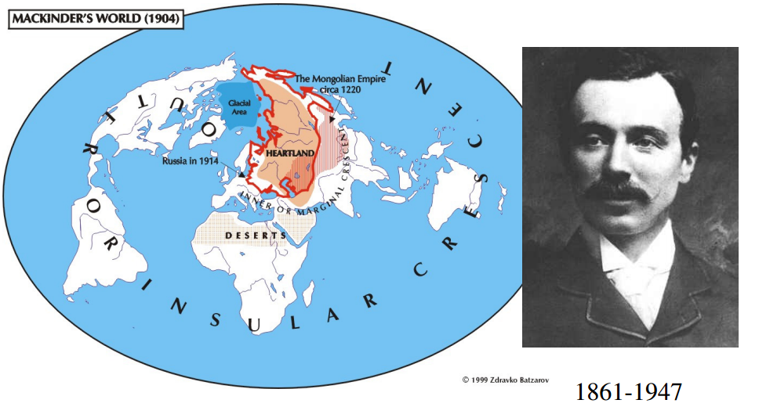
Mackinder's Heartland Theory
Sir Halford John Mackinder was a British geographer who wrote a paper in 1904 called "The Geographical Pivot of History." Mackinder's paper suggested that the control of Eastern Europe was vital to control of the world. He formulated his hypothesis as:
Who rules East Europe commands the Heartland
Who rules the Heartland commands the World-Island
Who rules the World-Island commands the world
Mackinder's Heartland (also known as the Pivot Area) is the core area of Eurasia, and the World-Island is all of Eurasia (both Europe and Asia).

Slide 4
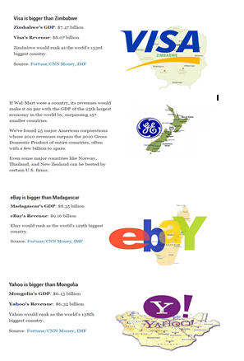
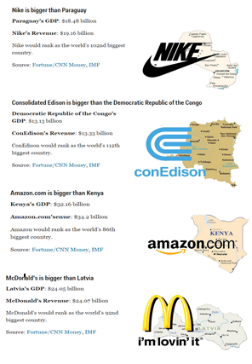
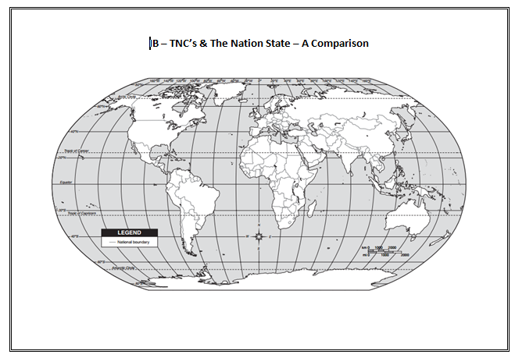
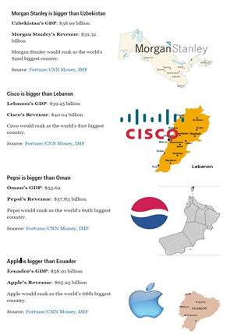
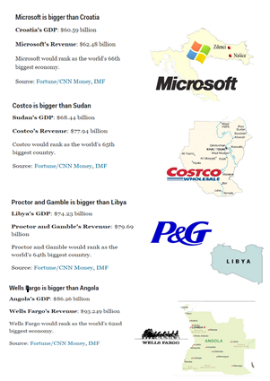
Nation states vs TNC’s
Demo: Use the information cards to gather at least 5 examples of TNC’s where its revenue is more than a nation state.
Worksheet
Example Exam Question: Explain how one multi-governmental organization has led to a loss of sovereignty.

Slide 5
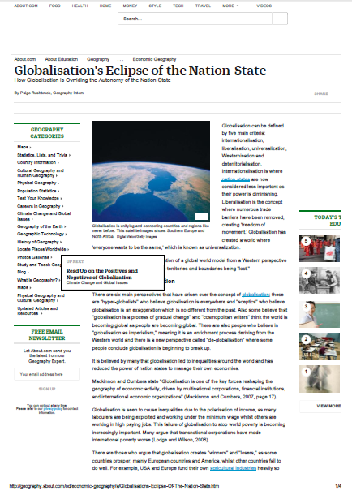
Globalization and the Nation State
Demo: What links the nation state with globalisation?
Globalisation's Eclipse of the Nation-State
Geographical skill:

Slide 6
Globalization
Globalisation describes the trend of national borders and nation states becoming less important economically, politically and culturally
Economic globalisation is characterised by the growth of massive transnational corporations (TNCs) beyond the control of national governments
TNCs with brands logos and ‘lifestyles’ shape a ‘global culture’ which is breaking down national culture
The global age is characterised by global problems – pollution, HIV which do not respect national boundaries
Globalisation has resulted in politic protest and political action becoming globalised e.g. the anti global capitalist movement.
Political
Economic
Globalisation
Cultural

Slide 7
David Held
Hirst and Thompson
In “Democracy and the New Global Order” Held supports the idea that the powers of nation states have declined significantly and points out that this has issues for democracy with voters voting for governments who do not hold the real power over economic policy that they used to.
Held calls for a new global approach to democracy and the setting up of a world parliament which could hold powerful TNCs to account and restore democratic control over important decisions.
Such a world parliament he argues would be able to tackle the sort of global problems facing the world – the environment, disease, food supply and distribution and health
In “Globalisation in Question” (1996) Hirst and Thompson acknowledge that there has been some decline in the power of the nation state due to globalisation but that the extent of it has been overstated. They cite as evidence the considerable power nation states continue to have over foreign policy, the military, the national territory and significantly the power their citizen’s sense of ‘national identity’ gives them. Hirst and Thompson also claim that the extent of economic globalisation has been exaggerated pointing out that many companies labelled as TNCs still operate largely within their ‘home regions’ rather than genuinely globally.

