Slide 1
3. Management issues and strategies
Sub-topic | Development | Teaching hours | Reflection/Notes
Dams and reservoirs | Examine the hydrological changes resulting from the construction of dams and reservoirs. Examine the costs and benefits of dams and reservoirs as part of multi-purpose schemes. | 2 hours
Floodplain management | Explain the stream channel processes (erosion, transport, deposition) and explain the resultant landforms found on floodplains. Examine the human modifications of a floodplain and their effect on the size and probability of floods. Evaluate the costs and benefits of alternative stream management strategies. | 3 hours
Ground water management | Explain the functioning and management of artesian basins and aquifers, distinguishing between natural and artificial recharge. Examine the environmental impacts of groundwater abstraction. | 2 hours
Freshwater wetland management | Describe the role of wetlands as a water resource. Evaluate the effectiveness of the management strategies that have been adopted in a major wetland. | 2 hours
Irrigation and agriculture | Examine the environmental impact of agriculture and irrigation on water quality: salinization, agro-chemical runoff, the pollution of groundwater and the eutrophication of lakes, rivers and wetlands. | 3 hours

Slide 2
Integrated water Basin Management
The seven key elements to a successful IRBM initiative are: A long-term vision for the river basin, agreed to by all the major stakeholders.
Integration of policies, decisions and costs across sectoral interests such as industry, agriculture, urban development, navigation, fisheries management and conservation, including through poverty reduction strategies.
Strategic decision-making at the river basin scale, which guides actions at sub-basin or local levels.
Effective timing, taking advantage of opportunities as they arise while working within a strategic framework.
Active participation by all relevant stakeholders in well-informed and transparent planning and decision-making.
Adequate investment by governments, the private sector, and civil society organisations in capacity for river basin planning and participation processes.
A solid foundation of knowledge of the river basin and the natural and socio-economic forces that influence it.

Slide 3
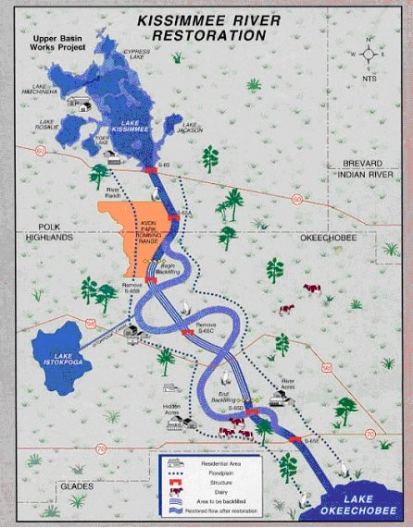
Wetlands
Learning objective: Describe the role of wetlands as a water resource.
(AO1)Demo: Define the term wetland.
A wetland is an area of land whose soil is saturated with moisture either permanently or seasonally. Such areas may also be covered partially or completely by shallow pools of water. Wetlands include swamps, marshes and bogs. The water found in wetlands can be saltwater, freshwater, or brackish (a mixture of fresh and salt water). The world's largest wetland is the Pantanal which straddles Brazil, Bolivia and Paraguay in South America.

Slide 4
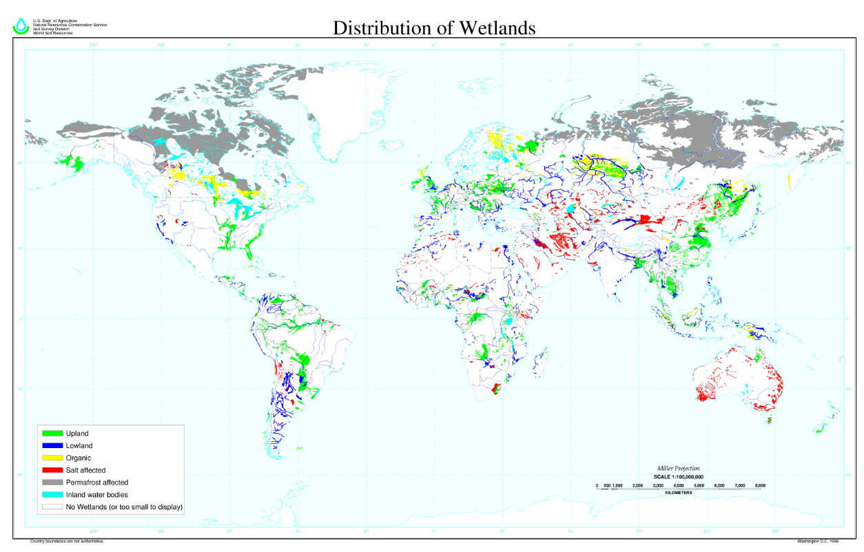
Global distribution of Wetlands

Slide 5
Wetlands now only cover 6% of the earth's surface. This is roughly half the amount of the planet that was covered in wetlands 100 years ago. The most important are:
Fens (26%): Low land that is covered wholly or partly with water unless artificially drained and that usually has peaty alkaline soil.
Bogs (30%): A wetland area that accumulates acidic peat, a deposit of dead plant material. Bogs occur where the water at the ground surface is acidic, either from acidic groundwater, or where water is derived entirely from precipitation Water flowing out of bogs has a characteristic brown color.
Swamps (20%): A swamp is a wetland with some flooding of large areas of land by shallow bodies of water. A swamp generally has a large number of dry-land areas, covered by aquatic vegetation or vegetation that tolerates periodical inundation (being covered by water).
Lakes (2%): Lakes are surface stores that are fed by rivers. Some lakes e.g. Caspian Sea are being drained because of unsustainable use.
Floodplains (15%): All rivers have floodplains. They are the valley floors that get covered in water when a river exceeds bankfull discharge. However, with an increasing amount of rivers being managed e.g. levees and dams, floodplains are spending less time underwater.

Slide 6
Wetlands
(AO2) Demo: What factors cause a loss and degradation to Wetlands?
Increased demand for agricultural land: As the world population grows there is an increasing demand for food. With the amount of viable agricultural land decreasing, increasingly areas of wetland are being artificially drained to make ways for agricultural land e.g. the draining of the fens in East England.
Population growth: As the world's population grows, it demands more water, more food and more land. The increasing demand for water can mean wetlands are drained of their water or their source of water. This problems is made worse as the world's population develops and uses more water e.g. showers and toilets.
Urbanization: With the world population growing, there is a greater demand for housing. Increasingly this demand for housing is in urban areas. With urban areas growing more and more wetland areas are being drained or inhabited. Urbanization on or near wetlands can cause pollution, changes in river flow and river channels and disturbance of wildlife. Land reclamation is the process of reclaiming land from the water.
Sea level rises: Global warming is causing glaciers and ice sheets to melt causing sea levels to rise. These rising sea levels can flood coastal and marine wetland areas. Even if the whole wetland is not flooded, water conditions can be changed from fresh to brackish.
River flow changes: Many rivers have been channelized and straightened, reducing the amount of wetlands. Others have been drained or dams have altered flow. Some have been polluted or redirected. All these natural changes are removing or changing the ecosystems of many wetland areas.
Pollution: Any form of pollution, but particular chemicals and metals can change the delicate ecosystems of wetlands. Process like eutrophication, caused by fertilizer run-off can completely kill whole wetland areas by preventing the wetland oxygenating properly and receiving sunlight.
Infrastructure projects: As populations grow and we become more mobile, there is an increasing demand for new roads, airports, railways. etc. Unfortunately wetlands are often drained or disrupted (bridges, dykes and causeways) to make way for these projects.
Alien species invasion: Many alien species like the cane toad in Australia or the American mink in the UK have been introduced to wetlands and devastated indigenous species. The introduction of any alien, however small can disrupt food webs and ecosystems.
Tropical storms: Although wetlands can be a natural defence against tsunamis and tropical storms, they can also been damaged by them. Freshwater wetlands in particular can be flooded by storms surges associated with tropical storms, changing the salinity of water and damaging vegetation.

Slide 7
Wetlands
(AO2) Demo: What Problems might be caused by river management?
PROBLEMS CAUSED BY RIVER MANAGEMENT | THE RESTORATION AND ITS BENEFITS
The Kissimmee River floodplain dried up after channelisation. The river no longer exceeded bankfull discharge. The reduction of the floodplain reduced waterfowl habitat by 90% Egret, heron and wood stork populations declined by two-thirds. Catches of largemouth bass (types of fish) reduced after channelisation Pollution levels from the Kissimmee flowing into Lake Okeechobee after channelisation. The Kissimmee after channelisation accounted for 25% of nitrogen pollution and 20% of phosphorous pollution. Fishing, bird watching and hunting tourism declined after channelisation | The aim is to restore over 100km2 of river and wetland floodplain by 2015 The restoration project started in 1999 The river is being dechannelised, by refilling the flood canal and reestablishing the old natural course of the river. Restored sections now flood naturally The nutrient loads in Lake Okeechobee should be reduced as more is absorbed in the wetland. Wading birds have returned to the restored sections Dissolved oxygen levels have doubled in restored sections Increased revenue from tourism potential of restored river Reestablishment of natural ecosystem

Slide 8
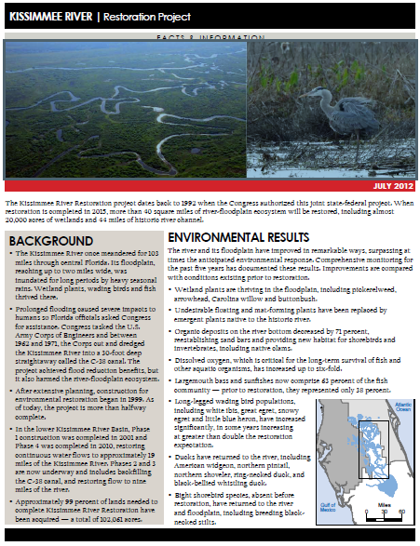
Kissimmee River Restoration
Demo: Read your Case study information.

Slide 9
Wetlands
Learning Objective: To examine the environmental impacts of agriculture and irrigation on water quality: salinization, agro-chemical runoff, the pollution of ground water, the eutrophication of lakes, rivers and wetlands.
Salinization
Agro Chemical Runoff
Groundwater Contamination
Eutrophication of Rivers, Lakes & Wetlands

