Slide 1
Freshwater
Starter: Why do we study freshwater?
1. The water system
Sub-topic | Development | Teaching hours | Reflection/Notes
The hydrological cycle | Examine the inputs, outputs, stores and transfers of the hydrological cycle. Discuss the causes and consequences of the changing balance between water stored in oceans and ice. | 3 hours
The water balance | Explain the concept of maximum sustainable yield of freshwater in terms of a balance between inputs and outputs.

Slide 2
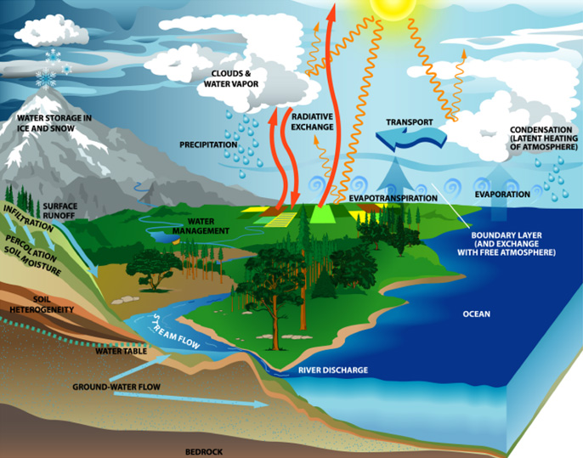
The hydrological cycle
Inputs - precipitation including rain and snow, and solar energy for evaporation.
Outputs - evaporation and transpiration from plants (evapotranspiration), runoff into the sea, percolation of water into underlying rock strata.
Stores - puddles, rivers, lakes (surface storage), soil, groundwater storage and water stored in vegetation.
Transfers or Flows - infiltration, Percolation, overland flow, through flow, groundwater flow.

Slide 3
Systems Theory-Hydrological Cycle [closed]
Demo: Make notes on system theory.
Learning objectives: To Examine the inputs, outputs, stores and transfers of the hydrological cycle. Discuss the causes and consequences of the changing balance between water stored in oceans and ice.
An aspect of systems theory can be used to explain the hydrological cycle. Systems can be classified into three types:
Isolated: no input or output of energy, the universe is an example of this.
Closed: there is input, output and transfer of energy but not of matter or mass - a planet for example.
Open: inputs and outputs of both energy and matter. Most environmental systems are examples of open systems.
When inputs and outputs of the system are balanced, they are said to be in dynamic equilibrium, because in reality most basins are continuously changing to reach, but rarely achieving balance.

Slide 4
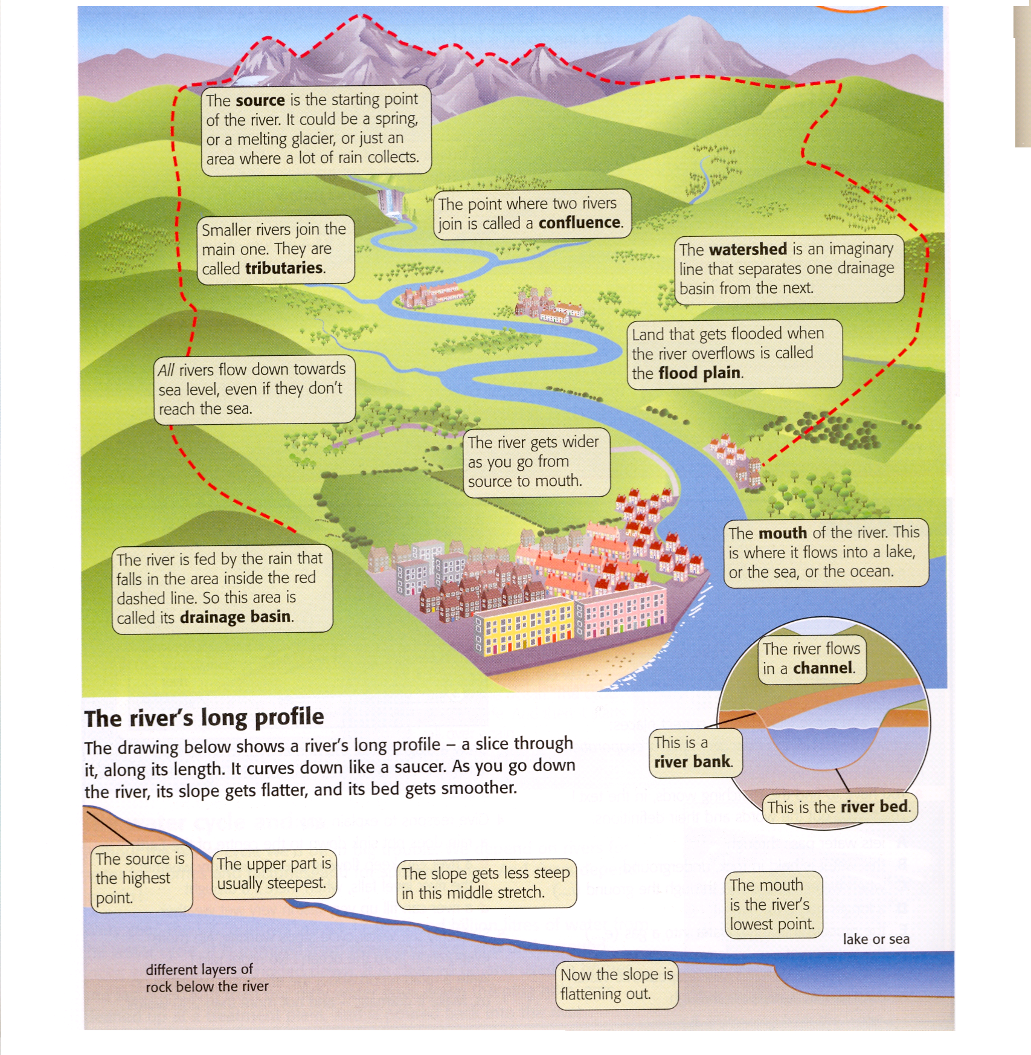
The Drainage Basin

Slide 5
Key Terms Quiz
Demo: Match the term with the definition.
Source
The point where two rivers meet.
Tributary
Imaginary line that separates one drainage basin from the next.
Confluence
The starting point of the river.
Watershed
Land that gets flooded when the river overflows.
Flood plain
A bend in a River.
Mouth
The river flows into a lake or the sea.
Meander
A river which joins a larger river.

Slide 6
Key Terms Quiz
Demo: Match the term with the definition.
Source
The point where two rivers meet.
Tributary
Imaginary line that separates one drainage basin from the next.
Confluence
The starting point of the river.
Watershed
Land that gets flooded when the river overflows.
Flood plain
A bend in a River.
Mouth
The river flows into a lake or the sea.
Meander
A river which joins a larger river.

Slide 7
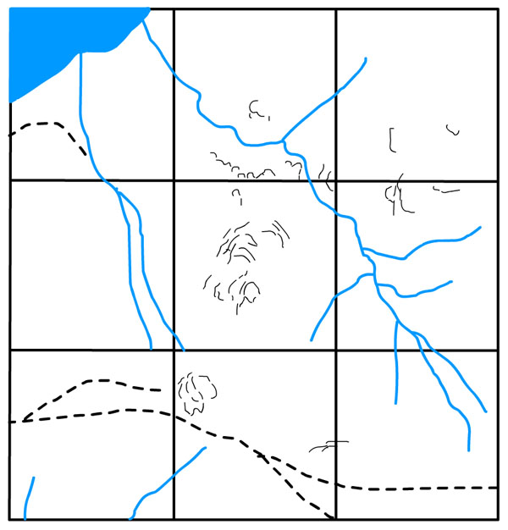
Spotting these on a Map
Demo: Label the following 6 geographical features found on the map. The Mouth/A Tributary/ The Watershed/The Catchment/ A confluence and the Source.

Slide 8
Spotting these on a Map
Tributary
A river which joins a larger river.
Mouth
Where the river flows into the sea, or sometimes a lake.
Catchment
The area from which water drains into a particular drainage basin.
Watershed
The boundary dividing one drainage basin from another- a ridge of high land.
Source
The upland area where the river begins.
Confluence
The point at which two rivers join.

Slide 9
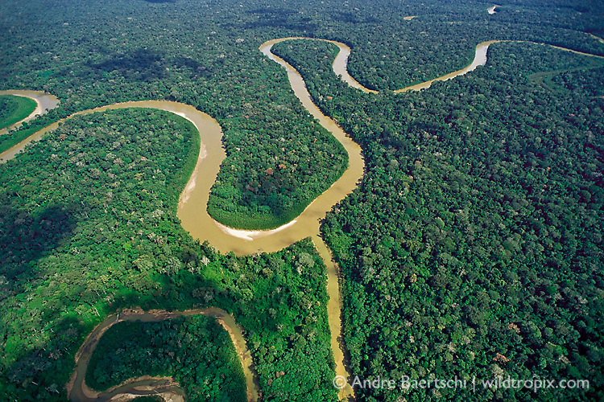
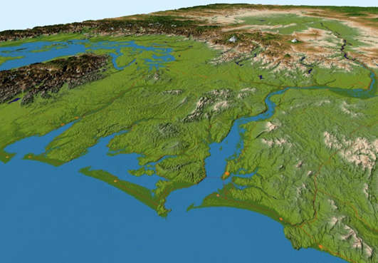
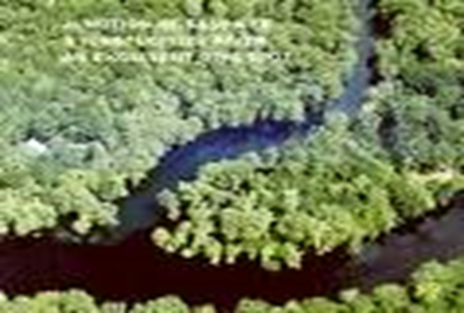
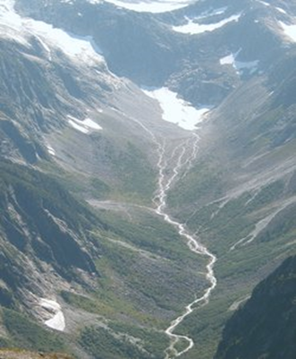
Spotting these on a Map
Mouth
Tributary
Catchment
Watershed
Source
Confluence

Slide 10
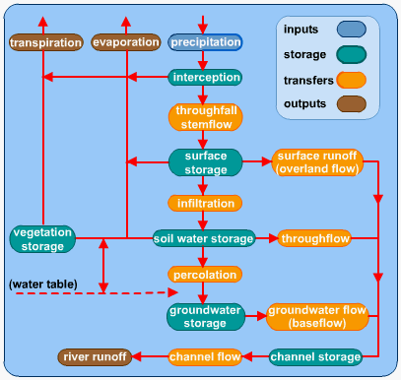
IB Style Question: Draw a labelled diagram to show the inputs, stores, processes and outputs of a drainage basin system. [4 marks]
Draw it.
Learn it.
Know it.

Slide 11
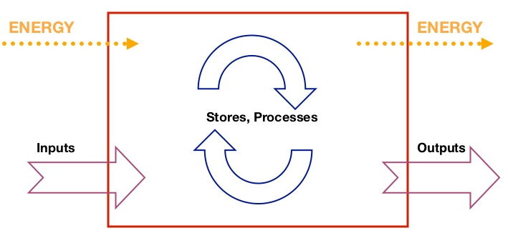
Systems Drainage Basin [Open]
Whilst the river shows the flow of water over land, there are two other key features of a drainage basin.
Infiltration - which is affected by the following: The nature of the precipitation (duration, total, area), vegetation interception, depression storage, Evapotranspiration, slope length and angle and the nature of the soil.
Groundwater - water collects in permeable rocks, known as aquifers. Variations in the level of the water table reflect surface topography. It is high in the valley and deep in the hills. The surface topography affects the flow of the groundwater, and this is known as the Hydraulic Gradient. Velocity ranges between 1mm/year and 1mm/day. Most rivers gain their water and flow from a combination of surface run-off and groundwater flow. Groundwater having a bigger influence in summer and autumn, run-off in winter and spring.

Slide 12
Soil moisture budget
Demo: With reference to the diagram, describe the graph ensuring to use some of the language below.
Soil moisture budget
Language to incorporate into your work
Substantial significantly fluctuations exception slight (e.g. slight increase, slight decrease or decline) rapid (e.g. rapid increase) peak
Year
Challenge: What might the numbers 1-5 represent?

Slide 13
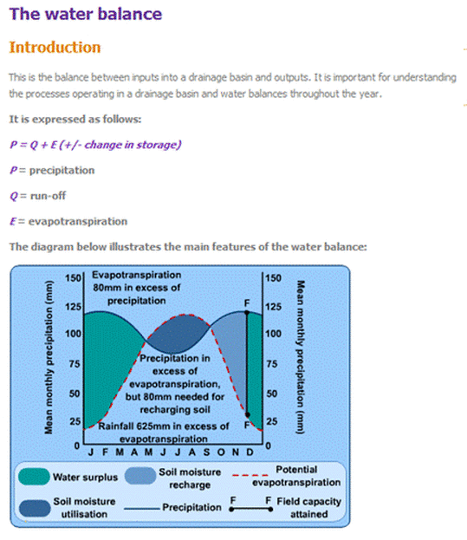

Slide 14
Maximum Water Yield (Water balance)
Texture Class | Field Capacity | Wilting Point
Sand | 0.12 | 0.04
Example
WATER BALANCE = shows the equilibrium between inputs and outputs to the drainage basin system where:
P= Q + E ± change in storage (P=Precipitation, Q= Runoff and E= Evapotranspiration)

Slide 15
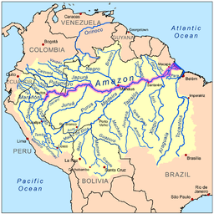
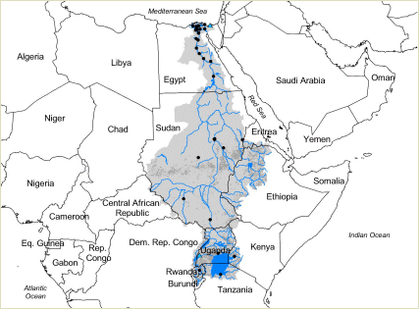
Demo: Use your understanding to compare two of the worlds Drainage Basins. Match the facts on the next slide to the appropriate drainage basin in the world
Building Geographic Knowledge
Amazon River Basin
Nile River Basin

Slide 16
The Facts
Largest drainage basin in the world, accounts for approximately one-fifth of the world's total river flow. | The drainage area of the it is equivalent to approximately 10% of the area of Africa and ten countries share the river basin: | Ends in a large delta that empties into the Mediterranean Sea.
Covers about 40 percent of South America, an area of approximately 7,050,000 square kilometres (2,720,000 sq mi | Flow through the countries of Peru, Bolivia, Venezuela, Colombia, Ecuador, and Brazil before emptying into the Atlantic Ocean | The bulk of the river flows through tropical rainforest, where there are few roads and even fewer cities, so there is no need for crossings.
Watershed includes the largest tropical rainforest in the world as well as areas of savannah. | It has two major tributaries, the White ........and Blue ....... | River has over 3,000 recognized species of fish and that number is still growing.
Egyptians still live in the valley, but construction of the Aswan High Dam (completed in 1970) to provide HEP ended the summer floods and their renewal of the fertile soil. | The Sudd wetlands in Sudan also form an obstacle for navigation and flow of water, to the extent that Sudan had once attempted to dig a canal (the Jonglei Canal) to bypass the swamps. | The source of the river is sometimes considered to be Lake Victoria, but the lake itself has feeder rivers of considerable size.
Amazon River Basin
Nile River Basin
Notes:
1, 4, 5, 6, 7, 9 are the Amazon. Pupils cut out the statements and stick on to the corresponding map
16

Slide 17
The Facts: purple = The Amazon
Largest drainage basin in the world, accounts for approximately one-fifth of the world's total river flow. | The drainage area of the it is equivalent to approximately 10% of the area of Africa and ten countries share the river basin: | Ends in a large delta that empties into the Mediterranean Sea.
Covers about 40 percent of South America, an area of approximately 7,050,000 square kilometres (2,720,000 sq mi | Flow through the countries of Peru, Bolivia, Venezuela, Colombia, Ecuador, and Brazil before emptying into the Atlantic Ocean | The bulk of the river flows through tropical rainforest, where there are few roads and even fewer cities, so there is no need for crossings.
Watershed includes the largest tropical rainforest in the world as well as areas of savannah. | It has two major tributaries, the White ........and Blue ....... | River has over 3,000 recognized species of fish and that number is still growing.
Egyptians still live in the valley, but construction of the Aswan High Dam (completed in 1970) to provide HEP ended the summer floods and their renewal of the fertile soil. | The Sudd wetlands in Sudan also form an obstacle for navigation and flow of water, to the extent that Sudan had once attempted to dig a canal (the Jonglei Canal) to bypass the swamps. | The source of the river is sometimes considered to be Lake Victoria, but the lake itself has feeder rivers of considerable size.
Notes:
1, 4, 5, 6, 7, 9 are the Amazon. Pupils cut out the statements and stick on to the corresponding map
17

Slide 18
The Facts
Largest drainage basin in the world, accounts for approximately one-fifth of the world's total river flow. | The drainage area of the it is equivalent to approximately 10% of the area of Africa and ten countries share the river basin: | Ends in a large delta that empties into the Mediterranean Sea.
Covers about 40 percent of South America, an area of approximately 7,050,000 square kilometres (2,720,000 sq mi | Flow through the countries of Peru, Bolivia, Venezuela, Colombia, Ecuador, and Brazil before emptying into the Atlantic Ocean | The bulk of the river flows through tropical rainforest, where there are few roads and even fewer cities, so there is no need for crossings.
Watershed includes the largest tropical rainforest in the world as well as areas of savannah. | It has two major tributaries, the White ........and Blue ....... | River has over 3,000 recognized species of fish and that number is still growing.
Egyptians still live in the valley, but construction of the Aswan High Dam (completed in 1970) to provide HEP ended the summer floods and their renewal of the fertile soil. | The Sudd wetlands in Sudan also form an obstacle for navigation and flow of water, to the extent that Sudan had once attempted to dig a canal (the Jonglei Canal) to bypass the swamps. | The source of the river is sometimes considered to be Lake Victoria, but the lake itself has feeder rivers of considerable size.
Amazon River Basin
Nile River Basin
Notes:
1, 4, 5, 6, 7, 9 are the Amazon. Pupils cut out the statements and stick on to the corresponding map
18

Slide 20
Key Terms Quiz
Demo: Match the term with the definition.
Source
The point where two rivers meet.
Tributary
Imaginary line that separates one drainage basin from the next.
Confluence
The starting point of the river.
Watershed
Land that gets flooded when the river overflows.
Flood plain
A bend in a River.
Mouth
The river flows into a lake or the sea.
Meander
A river which joins a larger river.

