Slide 1
Climate and natural Vegetation
Learning Objective: To describe and explain the characteristics of two climates equatorial vs hot deserts.
STARTER: Create a T-chart like the one below and use the data to identify the main characteristics for each climate.
Partner 1
Equatorial Climate
Partner 2
Desert Climate
Data
Data

Slide 2
Climate and natural Vegetation
Demo: What factors affect climate?
Altitude
Ocean currents
Cloud cover
Pressure
Winds
Proximity to the sea
Latitude
Challenge: Turn to page 148-149 and read through the information affecting climate. Ensure to add notes to your worksheet.

Slide 3
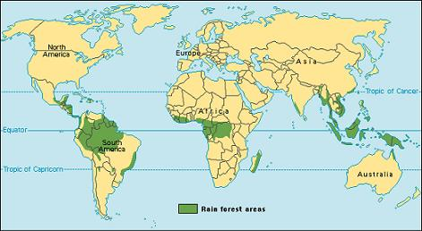
Tropical Rainforests
Demo: Describe the distribution of tropical rainforests.

Slide 4
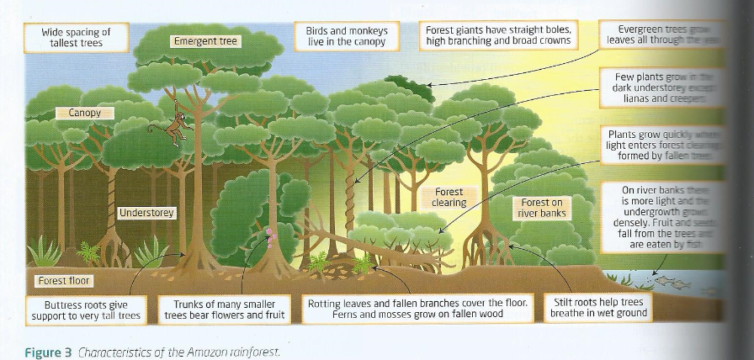
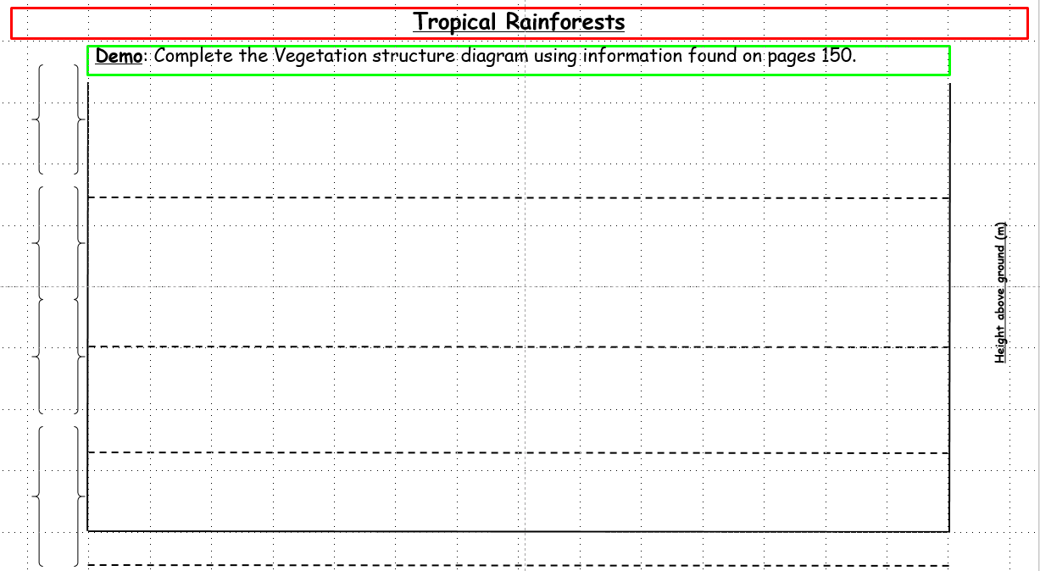
Tropical Rainforests
Demo: Complete the Vegetation structure diagram using information found on pages 150.
Language for learning:
Biodiversity: Biological diversity, a measure of the variety of the Earth’s plant and animal species, of genetic differences within species, and of the ecosystems that support those species.

Slide 5
Tropical Rainforests
Demo: Complete the Vegetation structure diagram using information found on pages 150.
Height above ground (m)

Slide 6
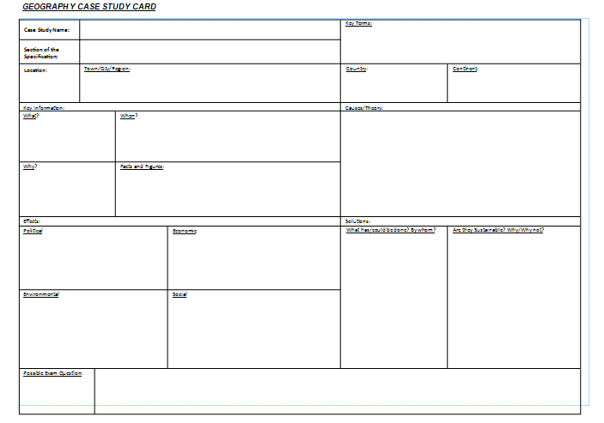
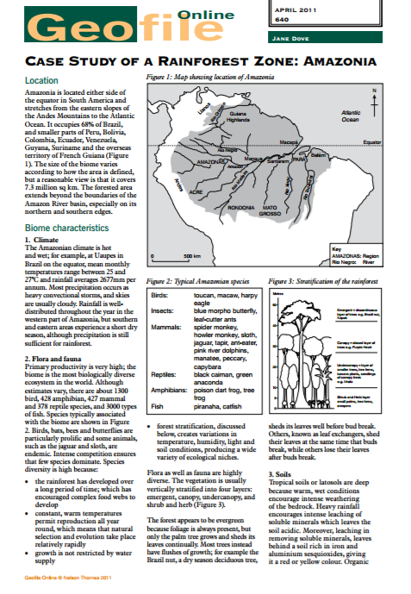
Case Study Rainforest
Plenary: Read through the Geofile and transfer the information to the Geography case study card.

Slide 7
Case Study Rainforest
Learning Objective: To describe and explain the characteristics of two climates equatorial vs hot deserts.
[A01] Describe/State/outline/Identify Estimate/Determine/Define | [A02] Distinguish/Explain/Suggest/Classify/Analyse
[A03] Compare and contrast/Evaluate/To what extent/Justify/Examine/Contrast/Discuss/Compare | [A04] Construct/Draw/Label/Annotate

Slide 8
Climate and natural Vegetation
Demo: What factors affect climate?

Slide 9
Tropical Rainforests
Height above ground (m)

