Slide 1
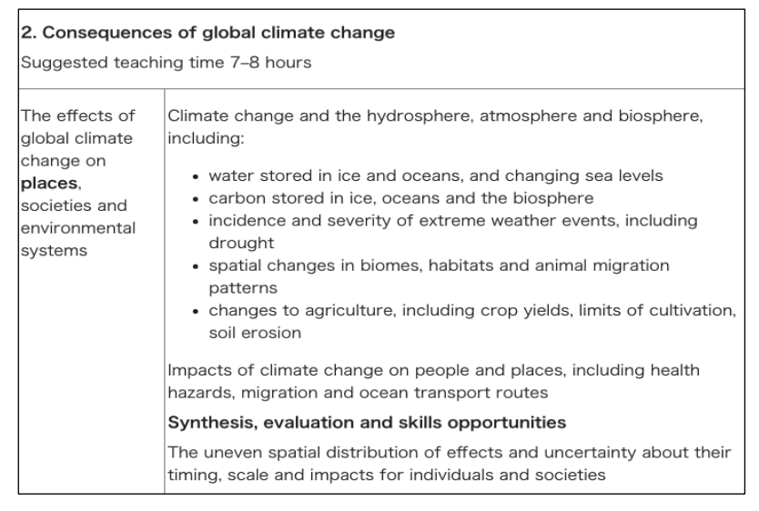
Consequences of Global Climate Change
Unpack the Syllabus
Learning Objectives:
1.To be able to identify the different spheres and explain how climate change may have a negative impact on each.
2. To be able to explain

Slide 2
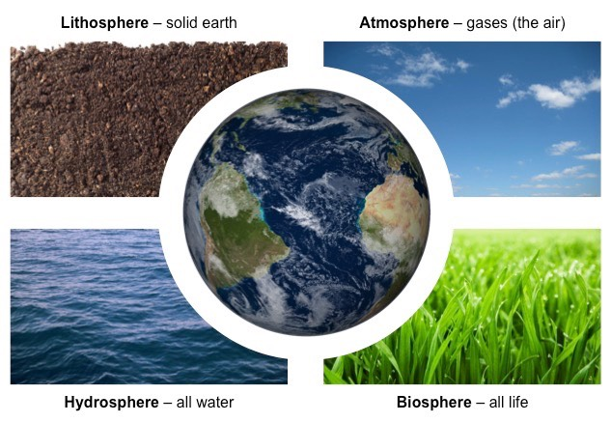
Consequences of Global Climate Change
The atmosphere describes the layer of gases surrounding the Earth and is divided into sections (stratosphere, etc.)
The hydrosphere describes all the water on Earth – including liquid water (oceans, etc.) and vapour (precipitation)
The biosphere is composed of all the living organisms on the planet (including plants, animals, bacteria, etc.)
The four spheres are interconnected, so human impact on one sphere will potentially effect other spheres
The release of plastic pollution into the oceans (hydrosphere) will impact on marine life (biosphere)
The production and release of CFCs into the atmosphere will effect the impact of UV radiation on the biosphere

Slide 3
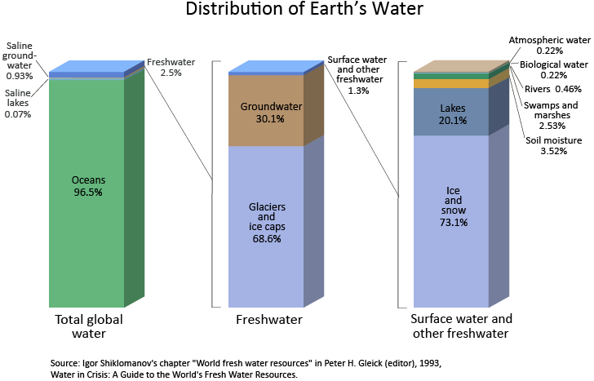
Water stored in ice and oceans
Demo: What patterns of change might there be?

Slide 4
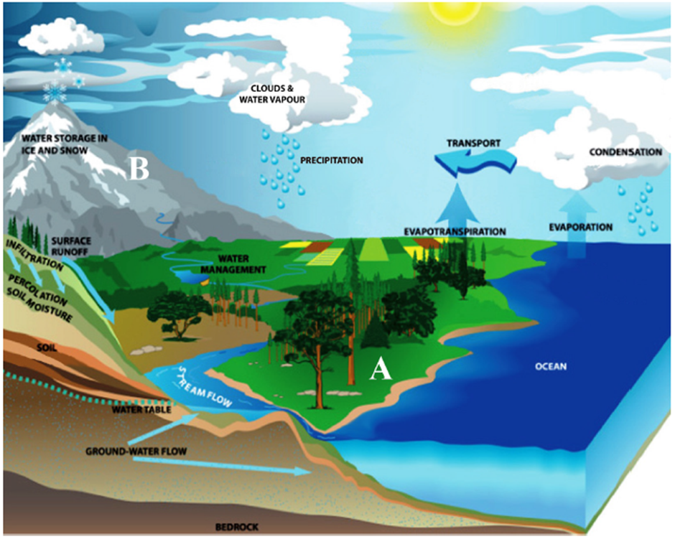
Starter Question:
Starter: Complete the exam question:
Describe two conditions at point A which would make infiltration rates higher than at point B. (5 marks)

Slide 5
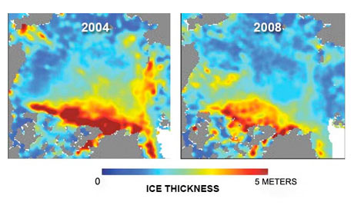
Water stored in ice and oceans
Learning objectives: To Examine the inputs, outputs, stores and transfers of the hydrological cycle. Discuss the causes and consequences of the changing balance between water stored in oceans and ice.
Starter: Complete the exam question:
Describe two conditions at point A which would make infiltration rates higher than at point B.

Slide 6
Sea Level Rise
Demo: Is ’Sea Level Rise’ the biggest threat to developing nations and to mankind?
Synthesis: What effect might rising sea levels have on population and/or population density?
Synthesis: What effect might this have on global development?

Slide 7
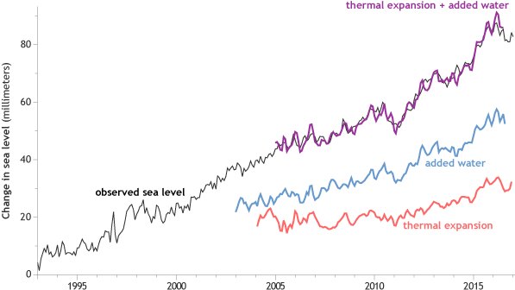
Water stored in ice and oceans
Demo: Describe the changes to sea level rise (3 marks).

Slide 8
Changes to sea level
Demo: So What 5 factors cause changes in sea level?
1.
Terrestrial water storage, extraction of ground water, building of reservoirs, changes in runoff, and seepage into aquifers.
3.
Surface and deep ocean circulation changes and storm surges.
5..
Exchange of water stored on the land by glaciers and ice sheets with ocean water.
4..
Subsidence in river delta region, land movement, and tectonic displacements .
2.
As the ocean warms, the water expands.

Slide 9
Water stored in ice and oceans –consequences
Physical
Human
BIOLOGICAL IMPACTS
Increased coastal erosion
More extensive coastal inundation
Higher storm-surge flooding
Landward intrusion of seawater in estuaries and aquifers
Changes in surface water quality
Reduced sea-ice cover.
SOCIOECONOMIC IMPACTS
Increased loss of property and coastal habitats
Increased flood risk and potential loss of life
Damage to coastal protection works/Infrastructure
Increased disease risk
Loss of subsistence resources
Loss of tourism, recreation, and transportation functions
Loss of non-monetary cultural resources and values
Impacts on agriculture and aquaculture through decline in soil and water quality.
Exam Question
Explain the consequences of a decrease in the amount of water stored in ice in the hydrological cycle at any stage. [6 marks]

Slide 10
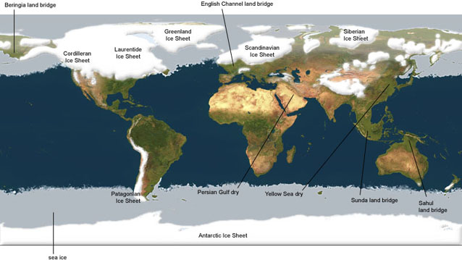
Water stored in ice and oceans

Slide 11
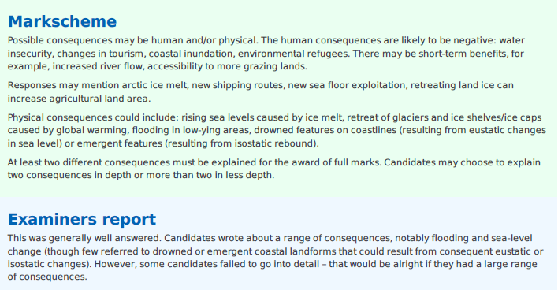
Plenary
Case Study: Carteret Island
Learning objectives: To Examine the inputs, outputs, stores and transfers of the hydrological cycle. Discuss the causes and consequences of the changing balance between water stored in oceans and ice.

Slide 13
Water stored in ice and oceans

