Slide 1
Starter: Do you know the difference between erosion and transport?

Slide 2
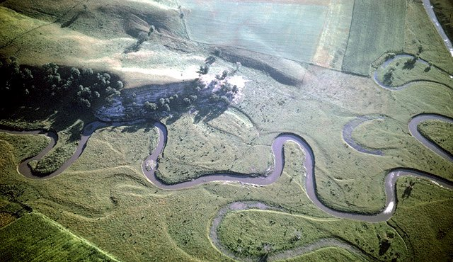
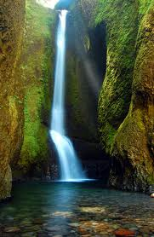
Features of a river
Learning objective: To achieve an A, students will use a rich amount of geographical vocabulary to explain the formation of a specific waterfall over time and use this understanding to infer how an area will have in the future
Starter: List all the features that can be found in a river.
Language for Learning:
Source,
upper course,
interlocking spurs,
gorge,
V-shaped valley.
Challenge: Can these features be categorised?

Slide 3
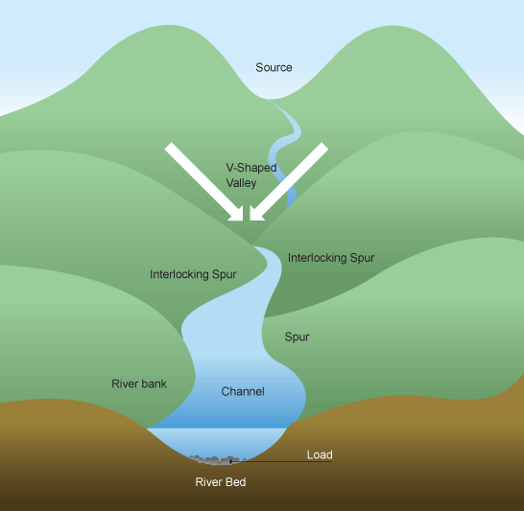
Landforms created by rivers:
UPPER COURSE
A V Shaped Valley:
The river cuts down through the land like a saw.
This is called Vertical EROSION.
Soil and Stones then get carried down stream – the V grows larger and wider over time.

Slide 4
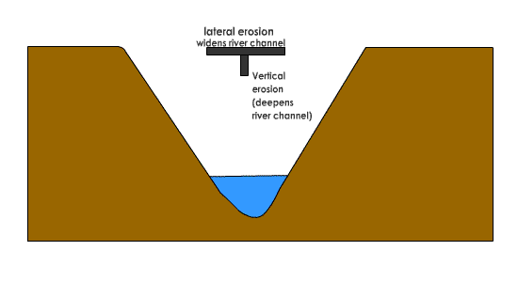
So why do river change shape as we move downstream?
Demo: Watch the video:
What are the erosional processes?
What are the transportation processes?
EROSION, TRANSPORTATION AND DEPOSITION

Slide 5
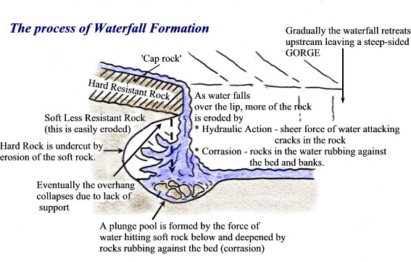
Features of a river (Waterfall)
Demo: 60 second challenge!!!
Look at the diagram and remember as much as you can – you will be tested on it very soon.
You can make rough notes on it if you want.

Slide 6
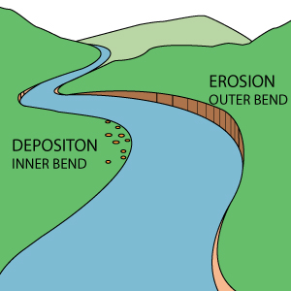
Meander
Meander starts at a slight bend.
Water flows faster on the outer curve of the bend, and slower on the inner bend.
Q: What do you think happens to the material/load the river is carrying?
A: Deposits in on the inner bank and erodes on the outer.
ANNOTATE YOUR HANDOUT WITH THE INFORMATION FROM EACH STEP

Slide 7
Meander starts at a slight bend…
Deposits in on the inner bank and erodes on the outer.
Water flows faster on the outer curve of the bend, and slower on the inner bend.
Over time the outer bank wears away and the inner grows.
As it continues the meander starts to grow into a loop.
http://www.cleo.net.uk/resources/displayframe.php?src=309/consultants_resources%2F_files%2Fmeander4.swf
Notes:
Print off sheet and students annotate each box.
Go through animation.

Slide 8
Meander starts at a slight bend…
Deposits in on the inner bank and erodes on the outer.
Water flows faster on the outer curve of the bend, and slower on the inner bend.
Over time the outer bank wears away and the inner grows.
As it continues the meander starts to grow into a loop.
Notes:
Print off sheet and students annotate each box.

Slide 9
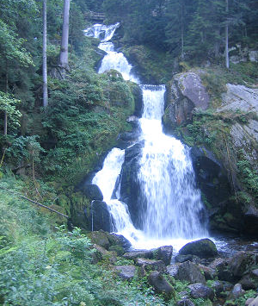
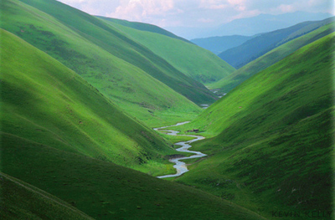
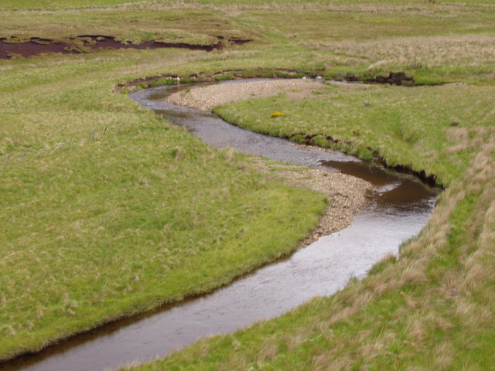
Source Work
A
B
Look at the photos above:
What is happening at A? Why?
What is happening at B? Why?
What would this valley look like in 100 years?

Slide 10
Landform | Created by … | Details
V-Shaped Valley | Erosion | The river cuts down through the land like a saw. ________ and ________ then get carried down stream – the V grows __________ and _________ over time.
Waterfall |  | Erosion starts to happen when the river crosses over a band of ___________ rock. 2. Softer rock erodes much quicker by ___________ and _____________ _________. The erosion continues and __________ the hard rock. Creating a _______ ______ The ledge eventually ________. Creating a gorge as it moves backwards.
Meander |  | Slight bend in the river.

Slide 11
Check your Learning
Demo: Complete the word fill below.

Slide 12
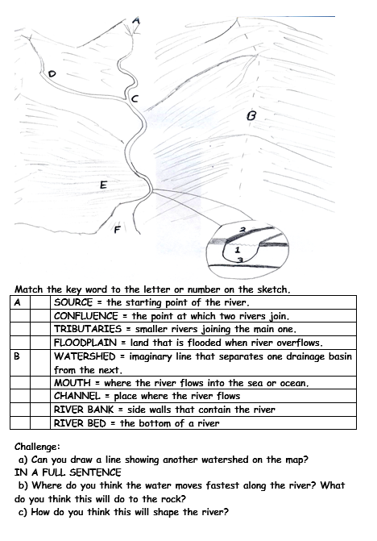
Drainage Basin
Demo: Math the key word to the letter on the sketch.
Mark scheme

Slide 13
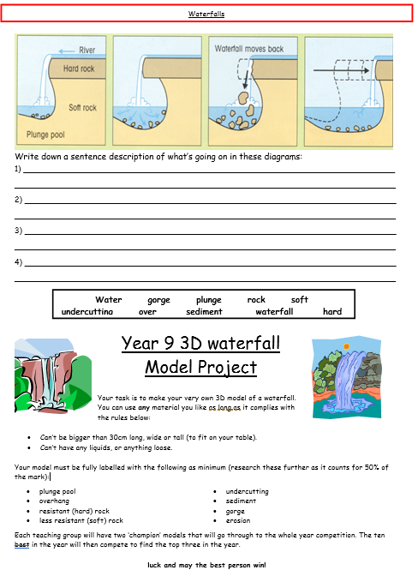
How are waterfall formed?
Demo:
Watch the animation and then put these cards into the correct order.
Complete your worksheet.
Markscheme
Water passes over hard rock and erodes the softer rock below
A plunge pool is formed and the river erodes backward as the water and rock swirl around
Eventually the hard cap rock overhangs and collapses under gravity
This process continues over time and the waterfall moves backwards or recedes to form a gorge
Notes:
Show animation then students put the cards in the correct order.

Slide 14
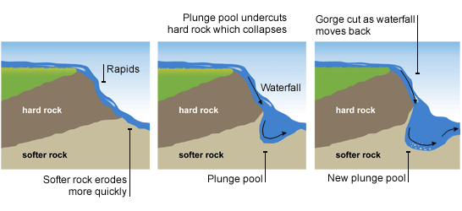
Features of a river

Slide 15
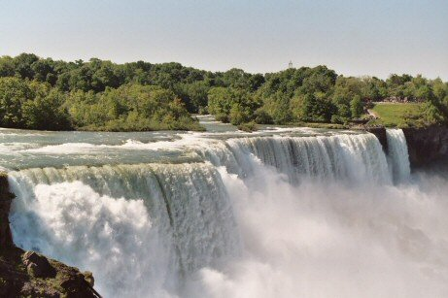
Finally, explain how a waterfall is formed.
Use diagrams to help. (5 marks)
Use firstly…….. Secondly ………. Thirdly…………………
Language for learning
Corrasion,
Plunge pool,
hydraulic action,
hard resistant rock,
overhang,
gorge,
soft rock.

