Slide 1
Settlements
Learning Objective: To be able to explain the Factors, which may influence the sites, growth and functions of settlements and to describe and explain the patterns of settlements.
Starter: Choose the odd ones out.
Language for Learning:
A Settlement-A place where people live. They vary in size from single dwellings to cities.
High | Defence | Low
Fertile soil | Building materials | Crops
Trees | Cattle | Fuel
Water | Light | Heavy
Frequent care | Dairy cattle | Electricity
No swamp land | Distance to walk | Water
Valley | Hill | Shelter
River | Cliff | Trade
Decision | Game | Life/Death
New circumstances | Change | Love
Challenge: Which factor is the most important for the creation of a new settlement. Justify your answer.
____________________________________________________________________________________________________________________________________________________________________________________________________________________________________________________________________________________________________________________________________________________
Site-Location
Situation- Relationship between a particular settlement and its surrounding area.
Language for Learning:

Slide 2
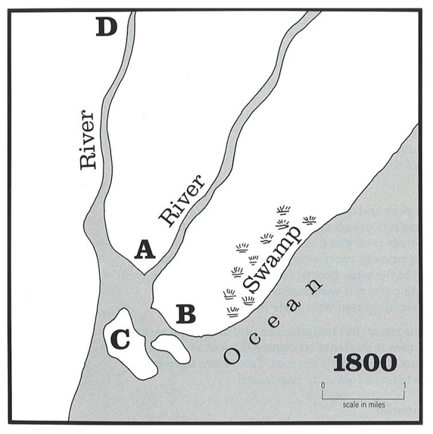
Settlements
Source 1. Location of settlements in 1800
Demo: Look closely at the map. Then write down the letter at the location where you think a settlement was most likely to develop. Ensure to write a reason for your choice.
Markscheme

Slide 3
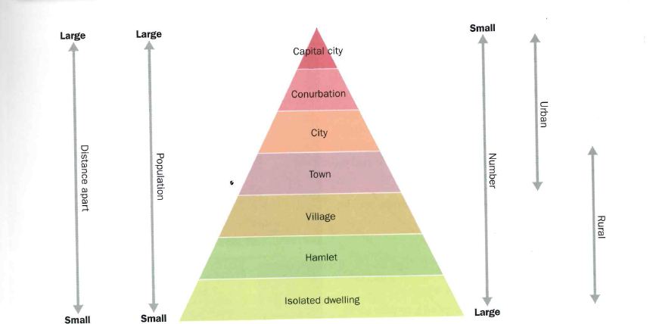
The hierarchy of Settlements
Demo: Complete the worksheet on the hierarchy of settlements.
Mega-cities (population over 10 million) are placed at the top of the pyramid because they have the highest population, a huge range and number of services and will be a long way from any other mega-cities.
MEGACITY
Hamlets are placed at the bottom of the pyramid because they have very few people, possibly no services and they will be close to other hamlets.
Dwellings are a house, flat, or other place of residence.

Slide 4
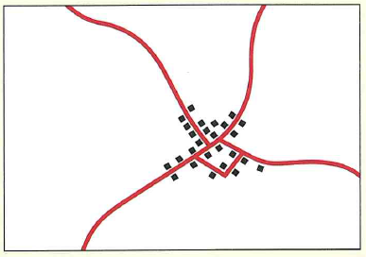
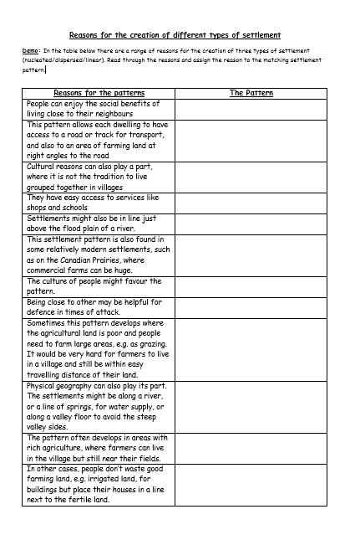
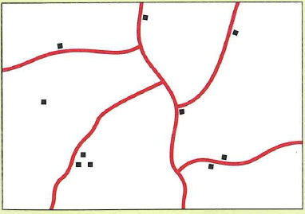
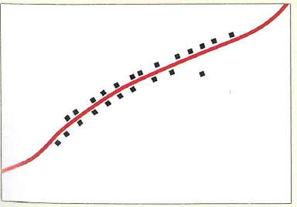
How to construct a settlement?
Settlement Pattern
Description
Reasons for this pattern
Dwellings are clustered together as villages, with fewer isolated dwellings. The shape of the villages is compact and more square or circular
Demo: Complete the provided worksheet.
Nucleated Settlement
Dispersed Settlement
There are scattered isolated dwellings and small hamlets with few villages
Settlements are in long thin rows, often along roads or tracks.
Linear Settlement

Slide 5
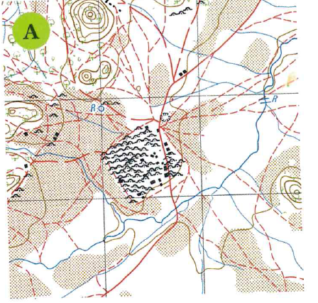
Question 1: What type of settlement is being shown?

Slide 6
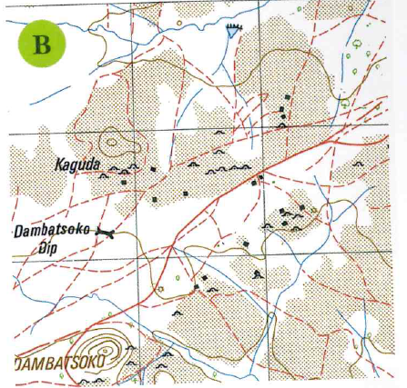
Question 2: What type of settlement is being shown?

Slide 7
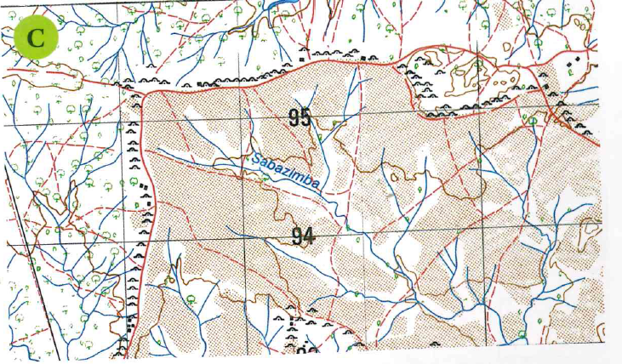
Question 3: What type of settlement is being shown?
Question 4 Suggest reasons as to why this settlement has formed this way.

Slide 8
Plenary
Plenary: Stick the above note into your book and fill in the missing words from the choice below:
transport links/water/ more important/self sufficient/ change/amenities/heavy/bulky/defence
Location/factors
Best site for a settlement summary
1. ______________ ___________ are important when deciding where to build a settlement.
2. Location Factors can be weighted, that is some factors are ______ ________________ than others. _______ will be given a high weighting because it is needed every day, and it is ________ and _______ to carry far.
3. Location Factors will _________over time, for example in the Stone Age villagers had to be _____ ___________ and so factors regarding farming, building materials as well as __________ were very important.
4. Today villagers do not have to be self sufficient nor is defence an important factor, instead good ____________ ________ and a pleasant environment are important together with having a _______________ such as good shopping, hospitals and schools nearby.

Slide 9
How to construct a settlement?
Settlement Pattern
Description
Reasons for this pattern
Revision Task

Slide 10
Settlement Hierarchy
Mega-cities (population over 10 million) are placed at the top of the pyramid because they have the highest population, a huge range and number of services and will be a long way from any other mega-cities.
Hamlets are placed at the bottom of the pyramid because they have very few people, possibly no services and they will be close to other hamlets.

