Slide 1
Unpack the title:
Climate Change and Vulnerability

Slide 2
Global Climate-vulnerability and resilience 2rd part of the Core
Key questions:
What are the causes of Climate Change?
“The Stern Review published in the Uk in 2006 stated that climate change is the greatest challenge facing humankind”

Slide 3
Climate Change and Vulnerability
Demo: What are the causes and consequences of global climate change?
Causes
Consequence

Slide 4
Global Climate Change
Demo: What are the causes and consequences of global climate change?
New Availability of Fossil Fuels
New Trade Routes
Less O₂
Urbanisation
Deforestation
Chloroflourocarbons (CFCs)
Coral Reefs
Greenhouse gases
Soil Degradation
Clouds
Decrease in Albedo
Cause
Consequence
deteriation of Ozone layer
Rising of Sea Levels
Loss of Biodiversity
Industrialisation
Transportation habits
CO₂
Extinction of species
Development of Nations
Desertification
More Natural Hazards
Challenge: Have you taken PPPPSS into consideration ?

Slide 5
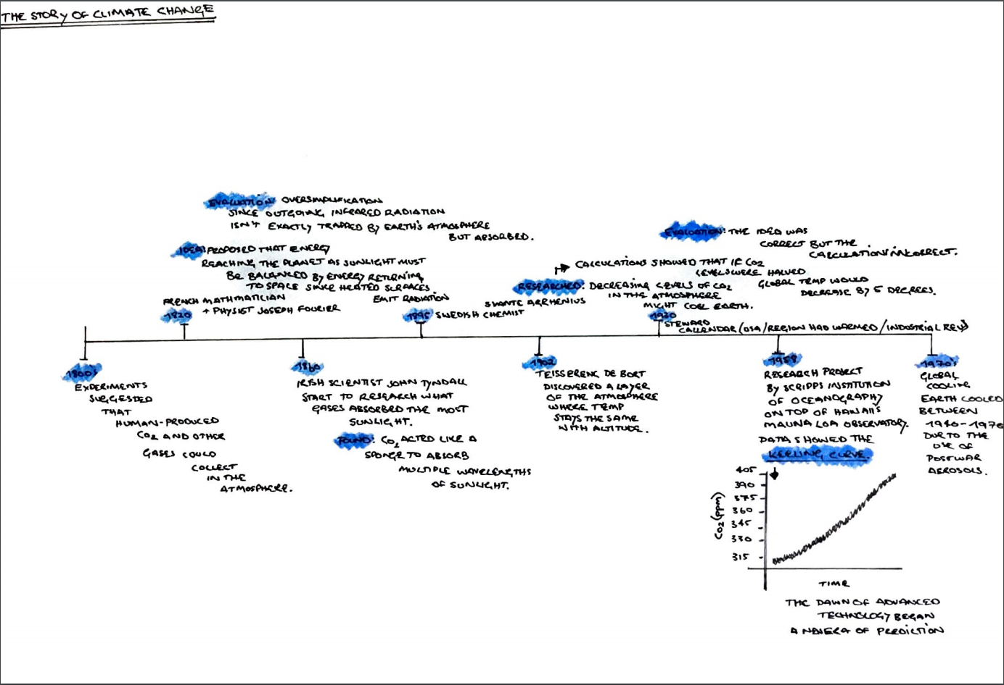
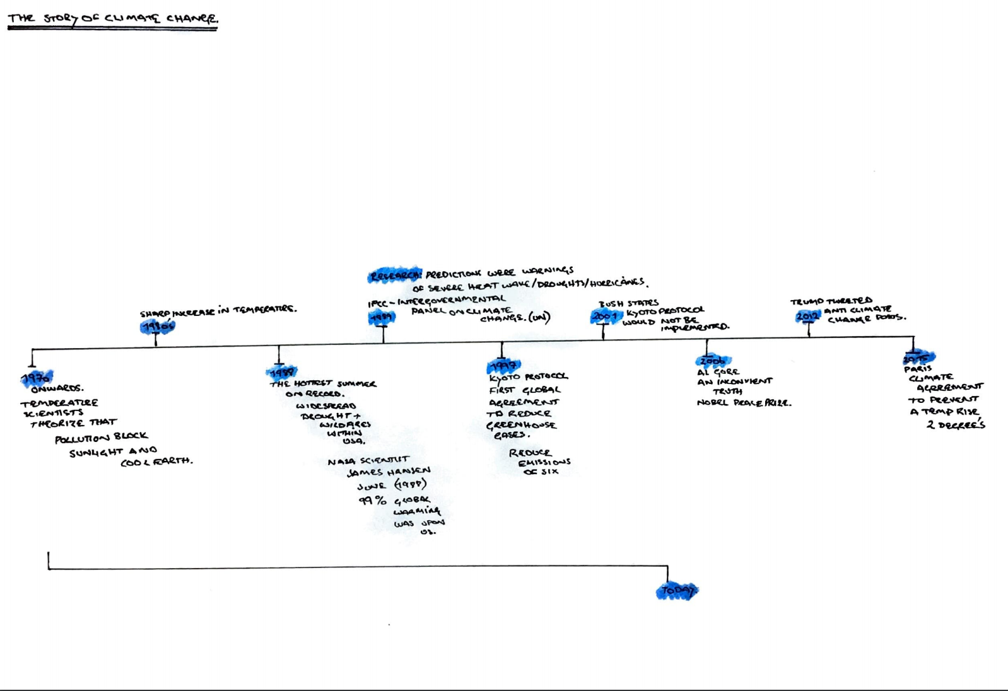
Global Climate Change an idea
Demo: How has the idea of climate change developed over time?
Homework: What events have occurred in the last 5 year to help further develop our understanding of climate change? Due: Monday 2nd November 2020

Slide 6
Atmosphere
Structure
Weather
Exosphere
Thermosphere
Orbit/Tilt
Spin
Oceans
ENSO El Niño Southern Oscillation
Mesosphere
Stratosphere
Seasons
Unequal heating
Coriolis Effect
Ozone
Troposphere
Earth
Cells
Convection
Atmospheric Circulation
Currents
Sun
Climate
Global Climate-vulnerability and resilience 2rd part of the Core

Slide 7
Global Climate-vulnerability and resilience 2rd part of the Core
Key questions:
What is the atmospheric system? (A02)
What is the difference between incoming and outgoing radiation?
What is the Earth’s energy balance?
What is the natural greenhouse effect?

Slide 8
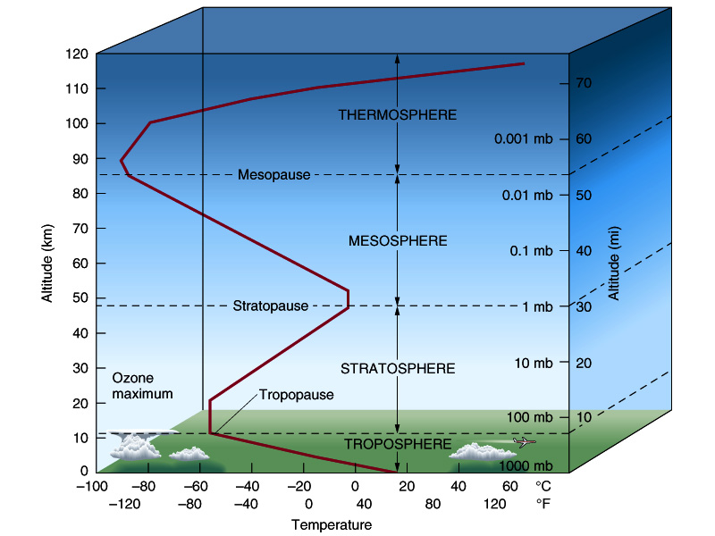
Our atmosphere
The atmosphere is an open energy system receiving energy from both sun and earth.
The structure of our atmosphere
Incoming short wave radiation and outgoing longwave radiation
Demo: Construct an (AO4) illustrative diagram of the atmosphere that you can replicate in the exam?
-86.5° to 1200C
Possible Exam Question:
Describe two differences between the Stratospheric Ozone and the Tropospheric Ozone
(2 Marks).
-2.5 to -86.5C
-56.5 to-2.5°C
15 to -56.5°C
Notes:
Shortwave radiation (visible light) contains a lot of energy; longwave radiation (infrared light) contains less energy than shortwave radiation (shortwave radiation has a shorter wavelength than longwave radation). ... Once in the Earth's atmosphere, clouds and the surface absorb the solar energy.

Slide 9
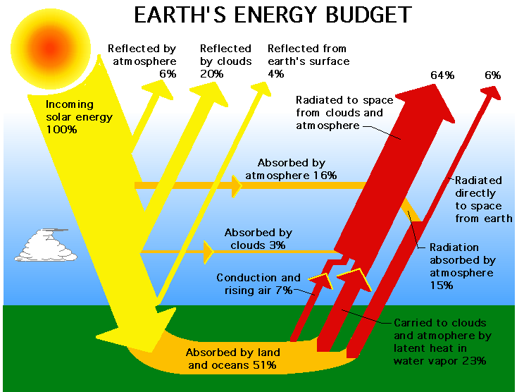
The Earths Energy Budget
Demo: Construct an (AO4) illustrative diagram of the Earths Energy Budget that you can replicate in the exam?
Key questions:
What are the causes of Climate Change?

Slide 10
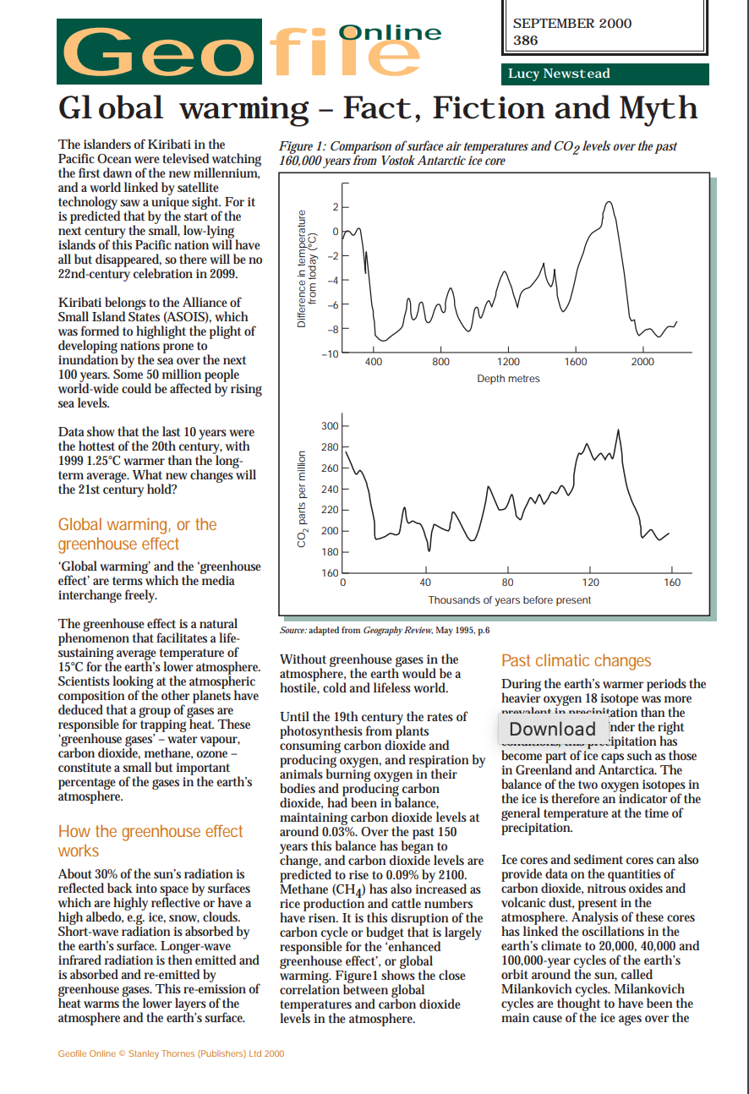
Greenhouse effect
Demo: Read the Geofile on the Greenhouse effect.
Possible Exam Question:
Explain the relationship between atmospheric greenhouse gases and the temperature of the Earth’s surface. [5 marks]
Greenhouse gases in the atmosphere include carbon dioxide, water vapour, methane, nitrous oxide, and tropospheric ozone. Award 1 mark for correctly identifying two or more greenhouse gases. Award a further 1 mark for correctly identifying the relationship between greenhouse gases and the Earth’s surface temperature. Award 3 marks for an accurate explanation of how the greenhouse effect works: incoming solar/short-wave radiation; outgoing terrestrial/long-wave radiation; absorbed/trapped by the greenhouse gases.
There may be alternative valid approaches, for example, a historical analysis of the relationship, or an annotated diagram. These should also be awarded marks appropriately.

Slide 11
Global Climate-vulnerability and resilience 2rd part of the Core
Key questions:
What is the atmospheric system? (A02)
What is the difference between incoming and outgoing radiation?
What is the Earth’s energy balance?
What is the natural greenhouse effect?
Possible Exam Question “The causes of global climatic change are essentially human.” Discuss this statement. (10 marks)

