Slide 1
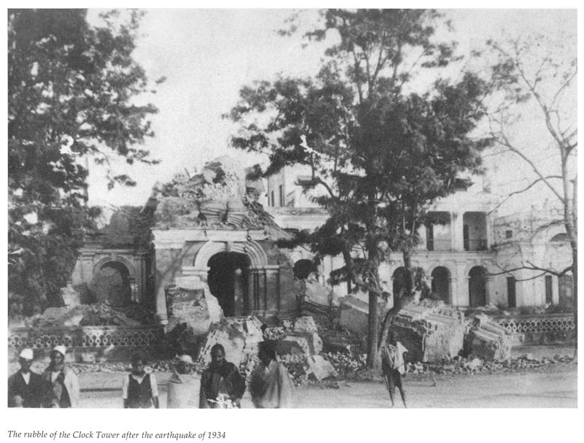
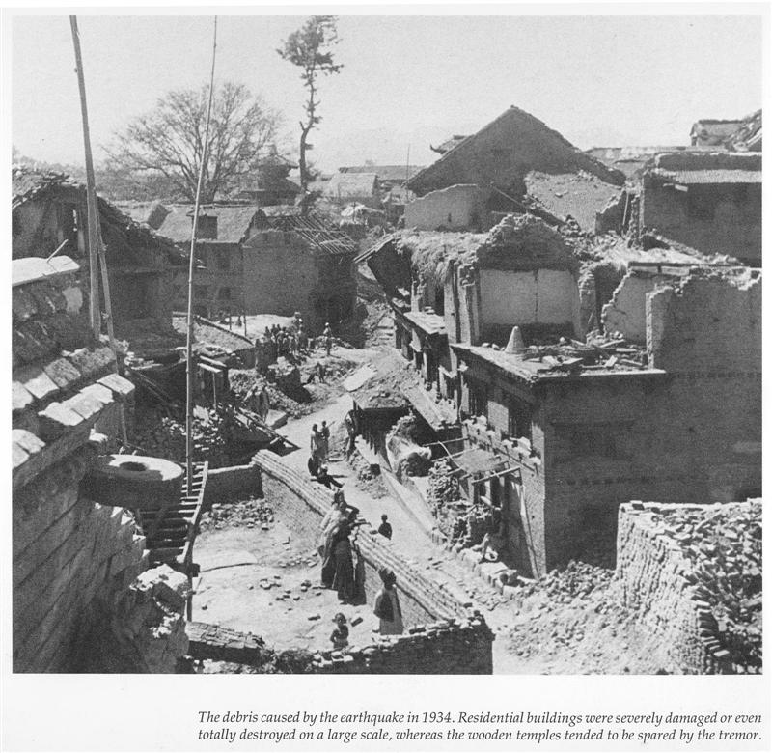
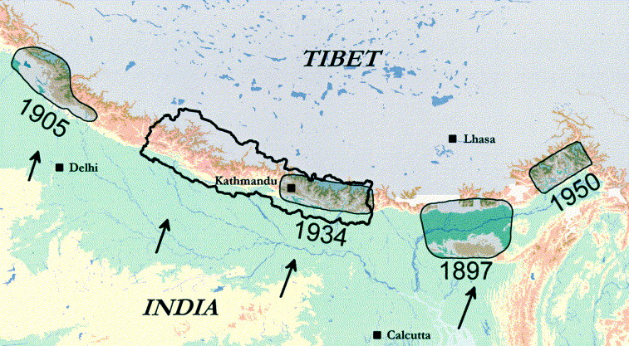
Enquiry starter:

Slide 2
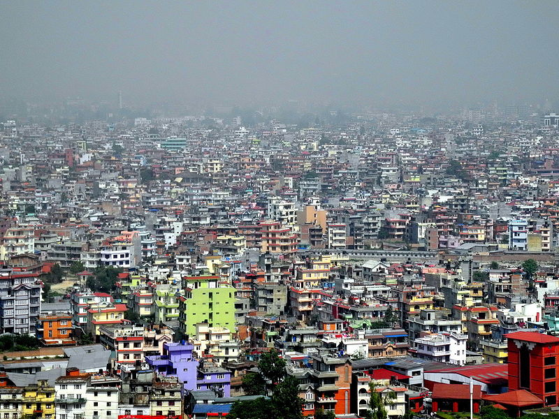
Future earthquake hazard – a case study from Nepal
Starter:

Slide 3
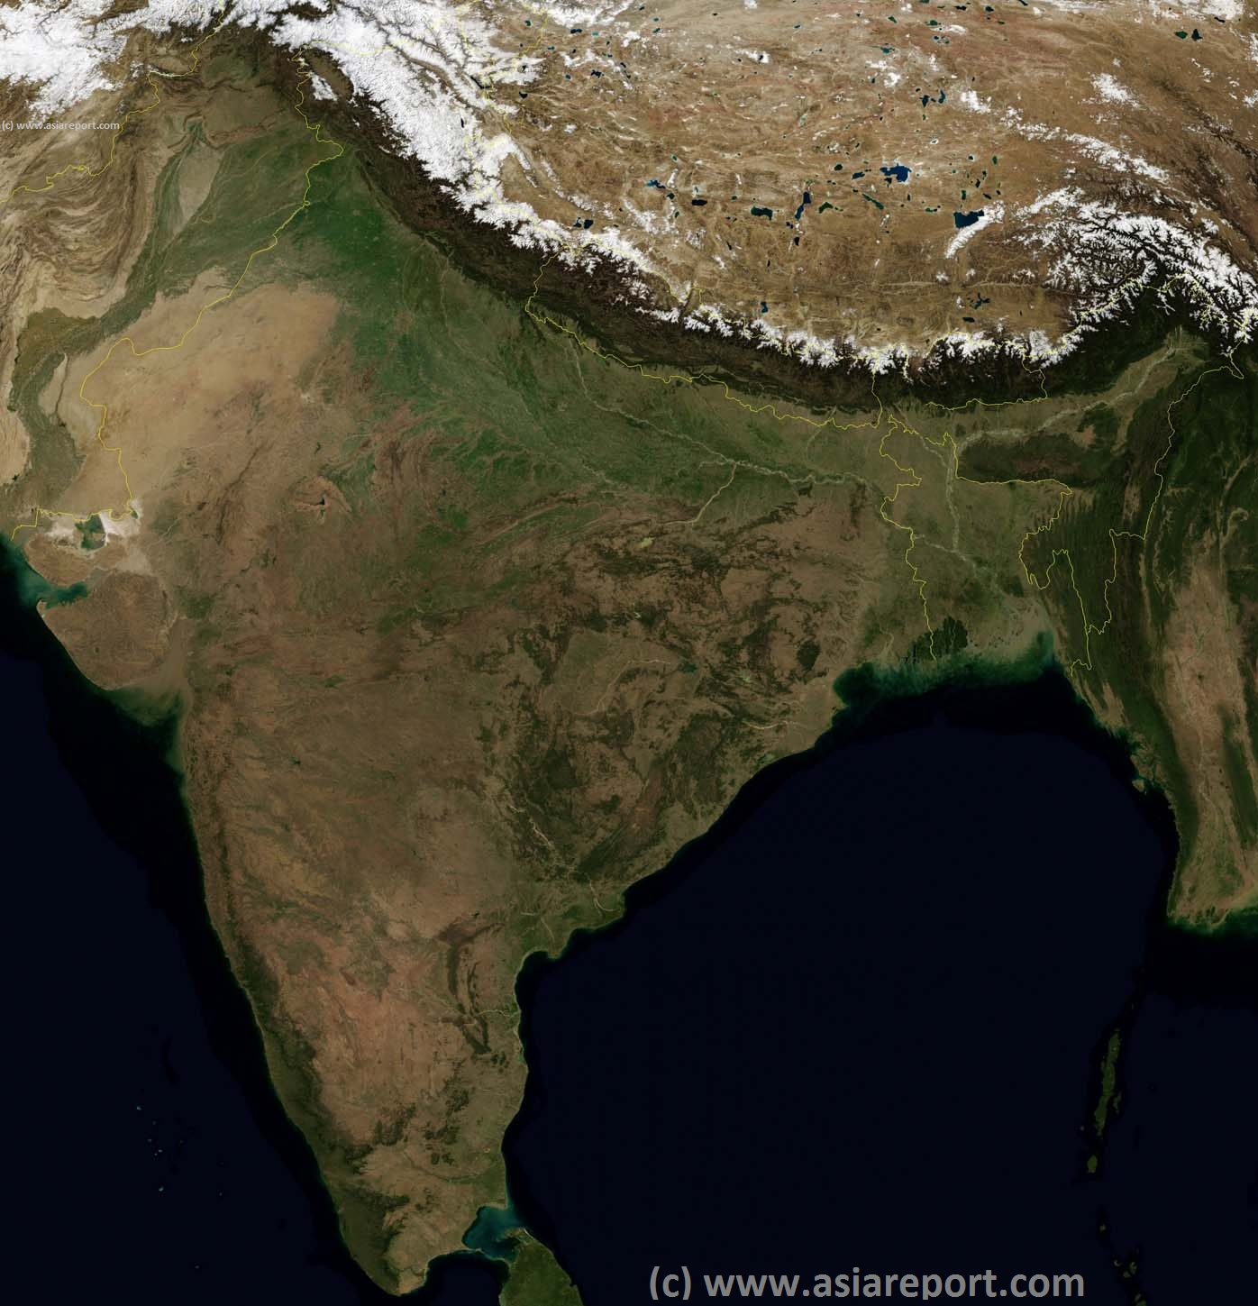
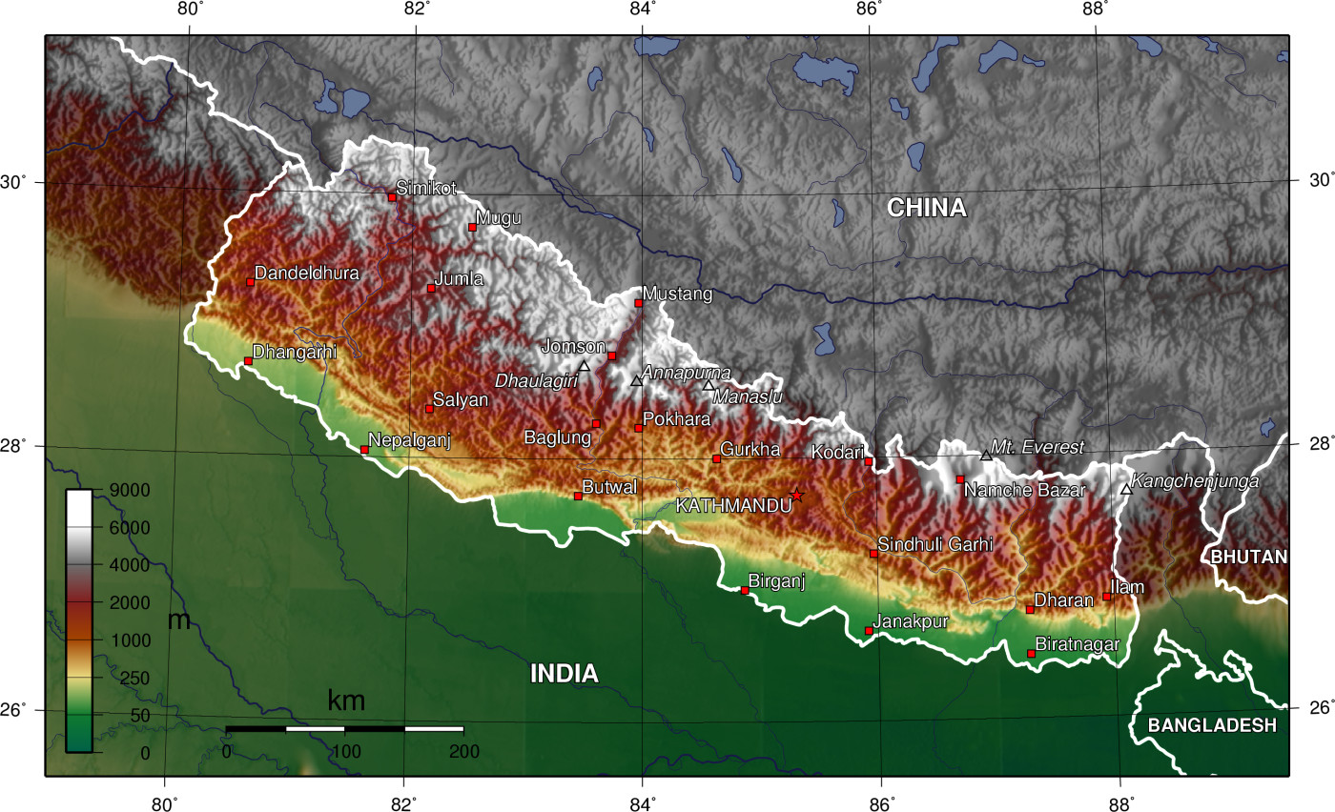
Future earthquake hazard – a case study from Nepal

Slide 4
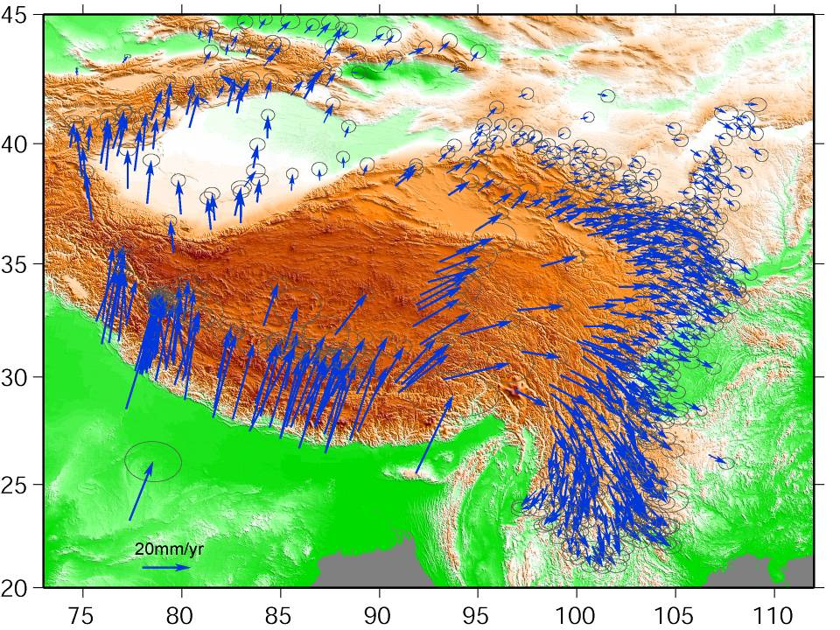
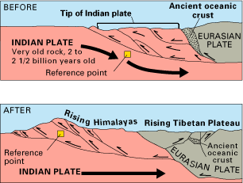

Slide 5
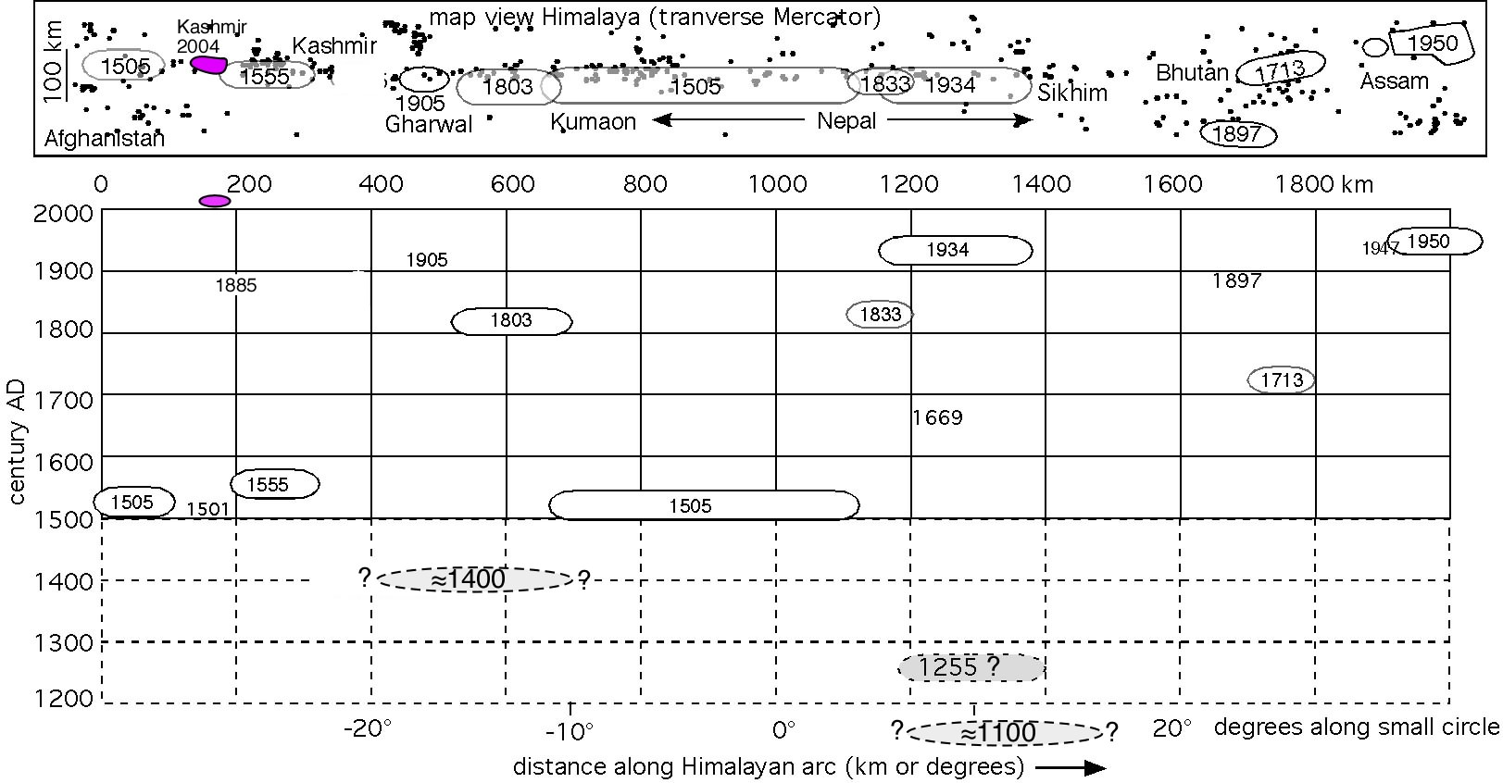
Himalayan Seismic gaps (Roger Bilham)

Slide 6
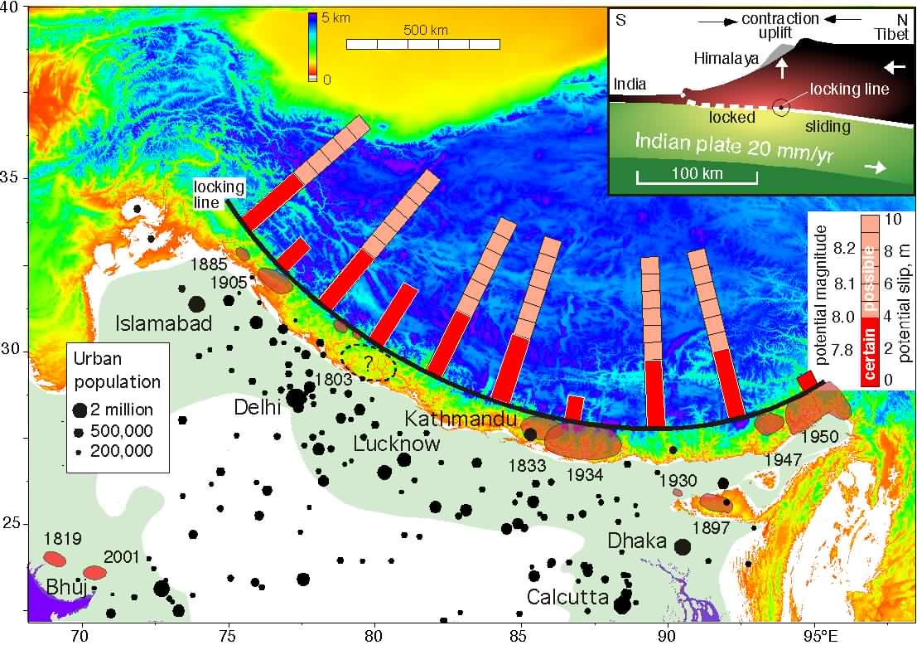
Himalayan earthquake potential (Roger Bilham)

Slide 7
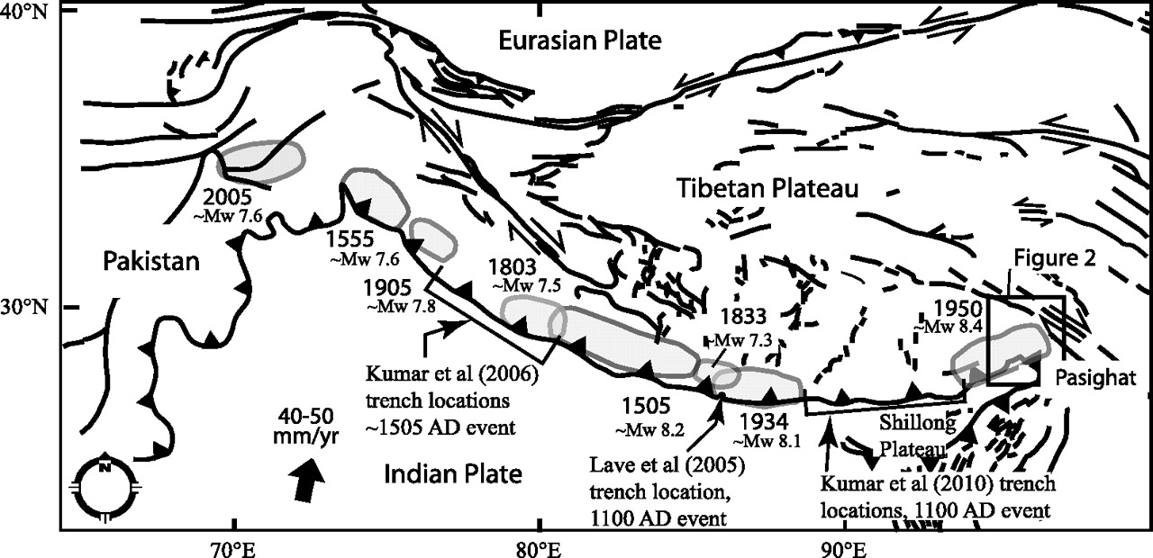
Scenario – rupture of 1505 fault section

Slide 8
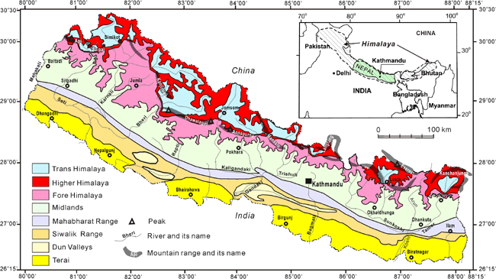
Geology map of Nepal
Dahal 2013

Slide 9
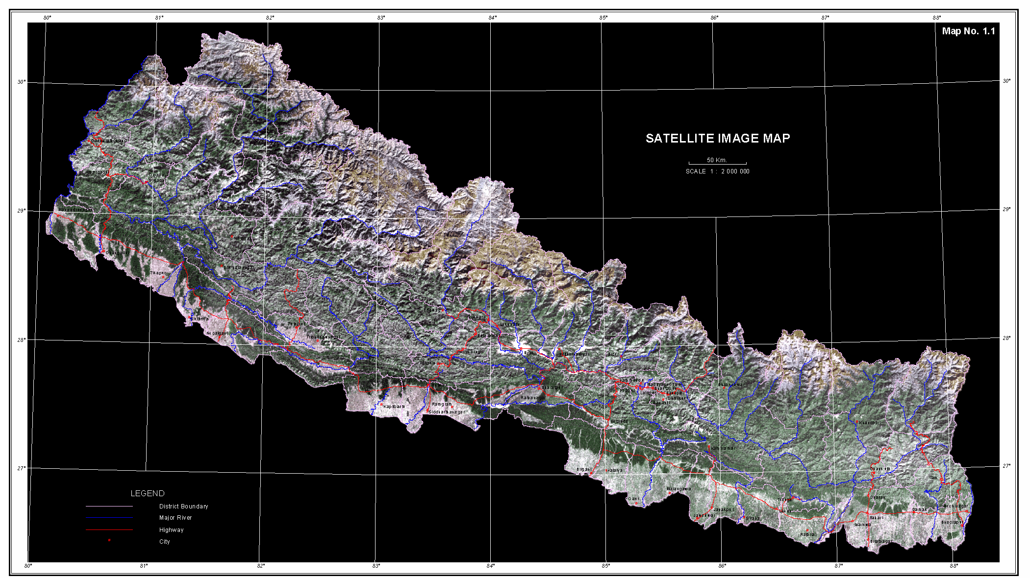
Topographic map of Nepal
NPCS 2013

Slide 10
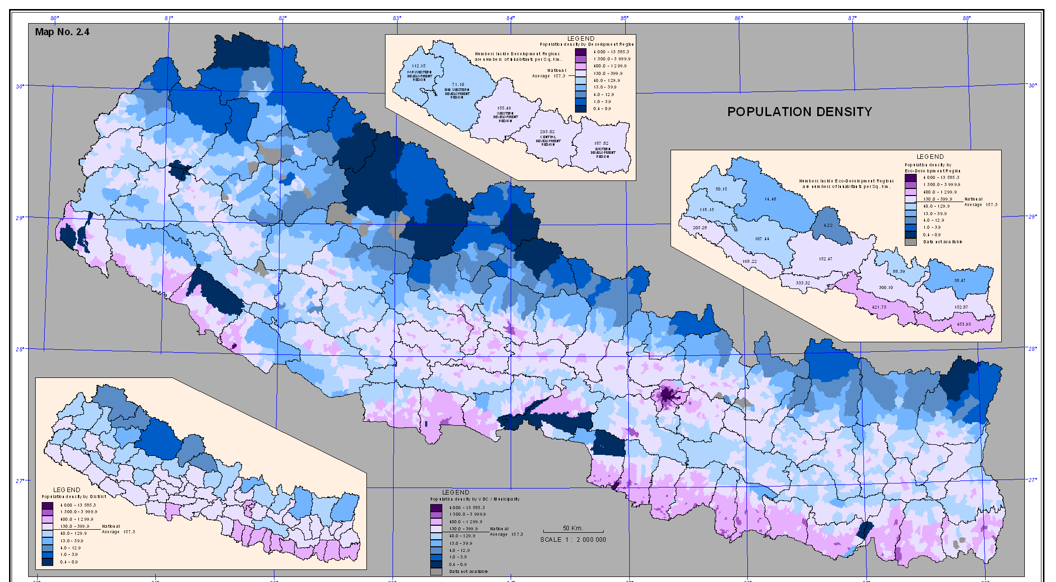
Population density map of Nepal
NPCS 2013

Slide 11
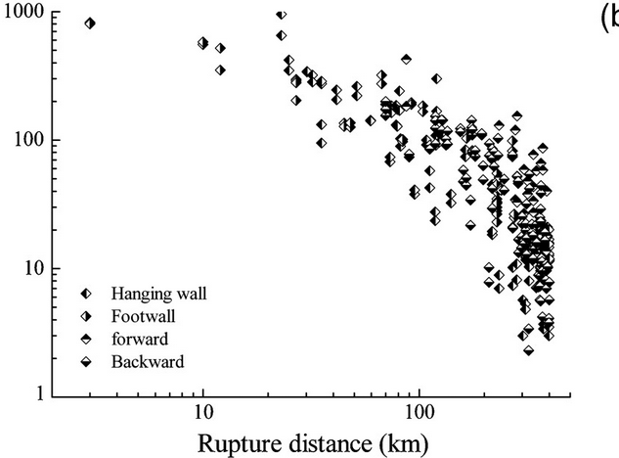
Likely pattern of shaking – Wenchuan data
Xiao Yun Li
Peak ground acceleration (gals)

Slide 12
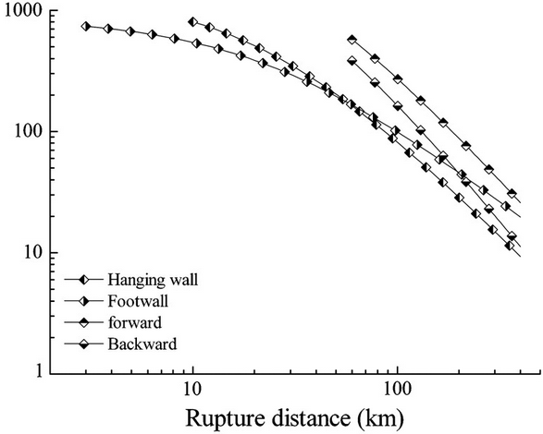
Xiao Yun Li
Likely pattern of shaking – Wenchuan data
Peak ground acceleration (gals)

Slide 13
Xiao Yun Li
Likely pattern of shaking – Wenchuan data
10 km = 550 gal
50 km = 200 gal
100 km = 100 gal
Peak ground acceleration (gals)

Slide 14
Population density map of Nepal
NPCS 2013
Zone of >0.2 g shaking

Slide 15
Population density map of Nepal
NPCS 2013
Zone of >0.2 g shaking

Slide 16
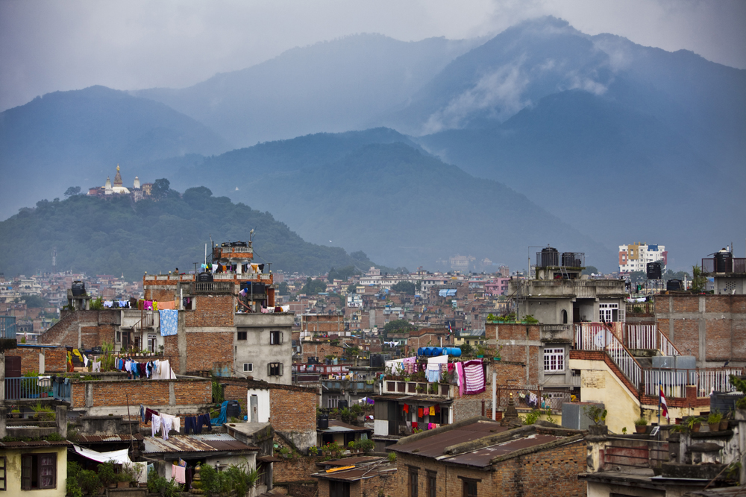
Impacts
Kathmandu – even a M=7.0 event is expected to kill 100,000 people in the city

Slide 17
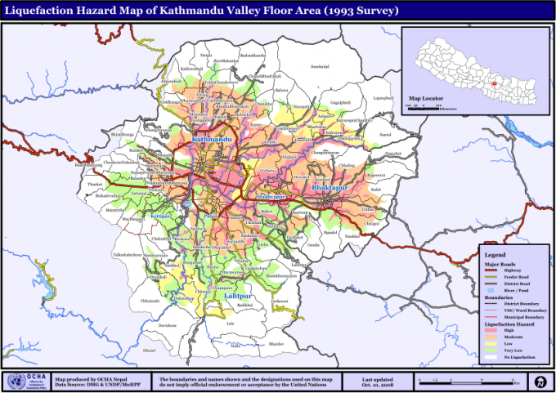

Slide 18
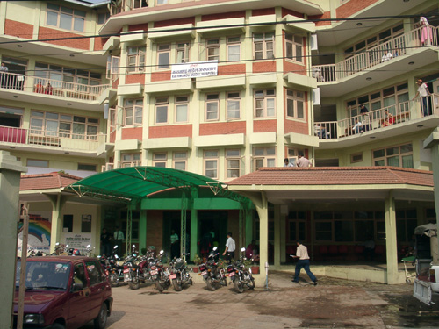
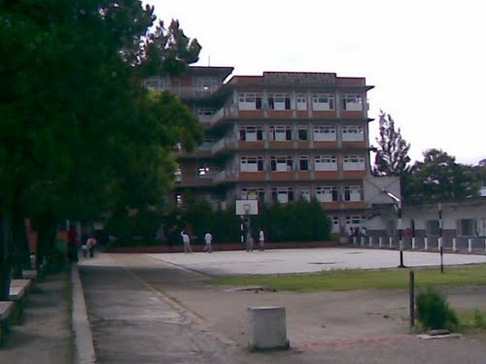
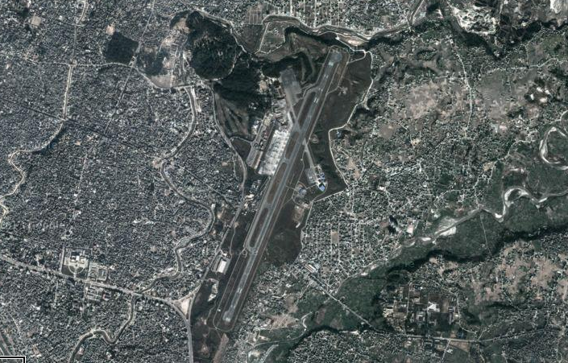
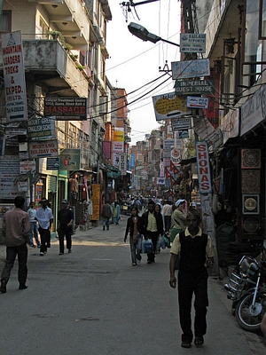
Hospitals, schools and the airport

Slide 19
Road network

Slide 20
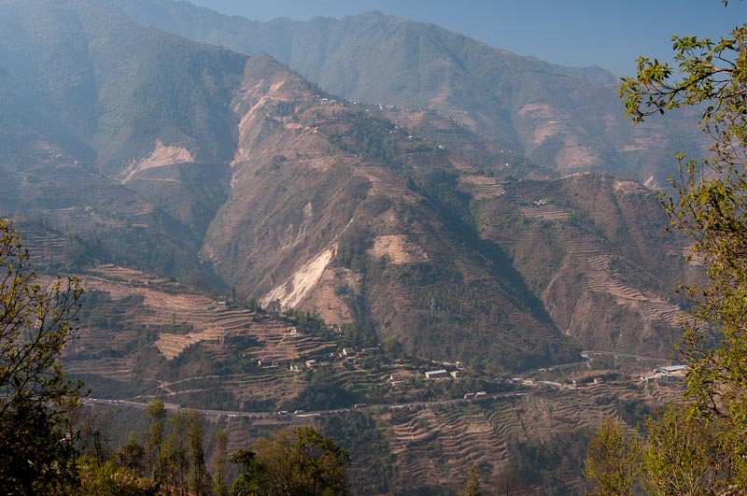
Kathmandu access roads are very landslide prone

Slide 21
Nepal earthquake scenario
M=8 earthquake affects Western Nepal
>100,000 people killed in Kathmandu Valley (probably much higher)
Most of 2.5 million people rendered homeless
All utilities (water, power, communications) lost
Kathmandu airport runway inoperable
Kathmandu valley access roads completely blocked by landslides
Current thinking is that it will be three weeks before communication lines are reopened
All access via north India, which will also have been profoundly affected
Very high levels of loss in rural areas
Communications lines exceptionally difficult in those regions
i.e. Haiti, but much worse

Slide 22
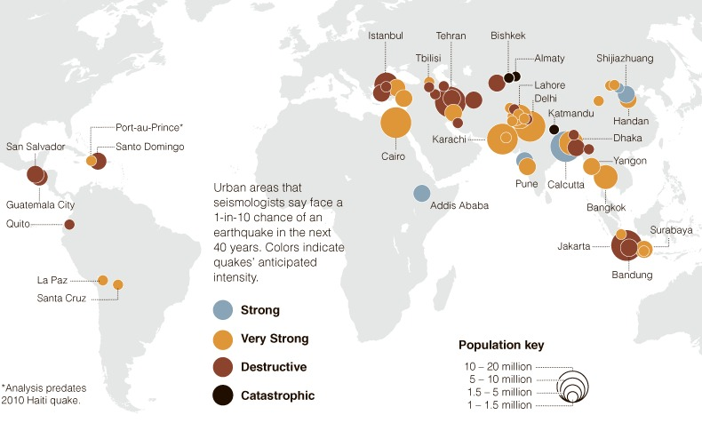
The future: threatened cities from earthquakes
Map: University of Colorado and NYT

Slide 23
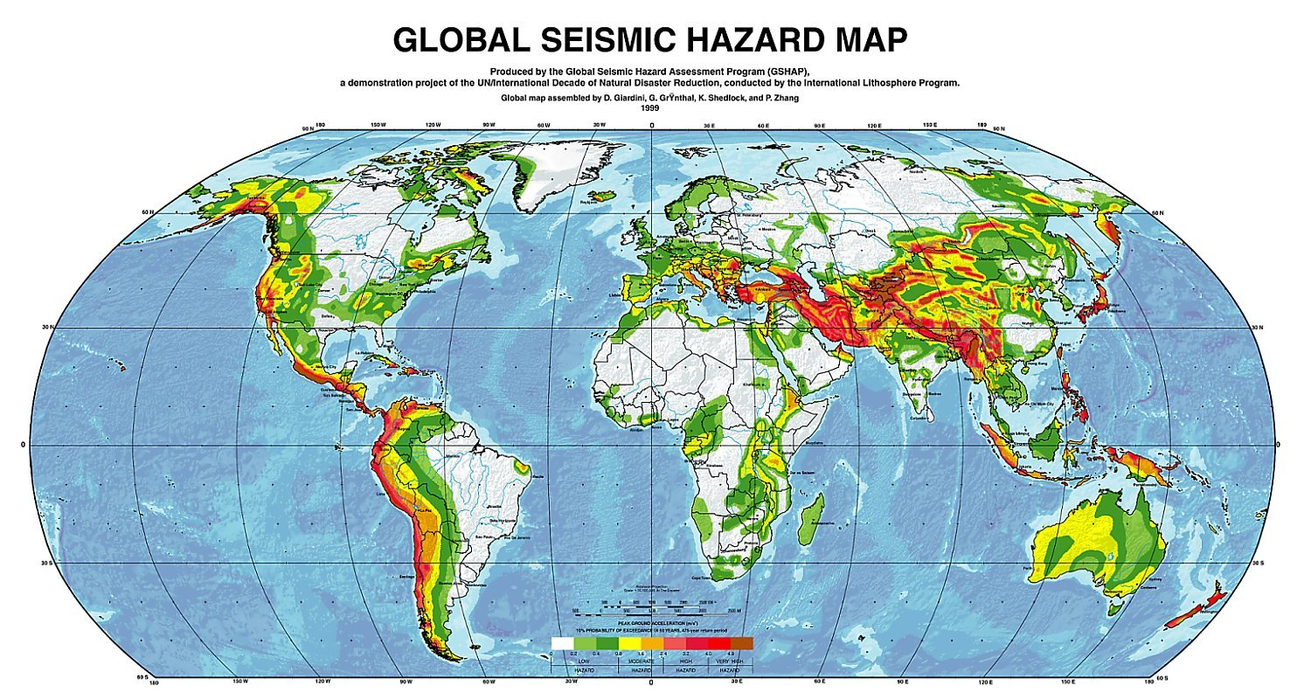

Slide 24
Arctic sea ice death spiral: https://sites.google.com/site/pettitclimategraphs/pettit-climate-graphs

Slide 25
Future patterns of loss
Greater economic costs are inevitable – more assets to destroy
Hazardous events:
Hydrometeorological disasters will probably increase as extremes become more common
But some may decrease in some areas (e.g. tropical cyclones?)
No effective change in rate of tectonic hazards
Patterns of vulnerability will change
Greater economic assets provide resilience
But a larger urban population changes patterns of risk
Increased pressures from climate change?
We should anticipate the million fatality or trillion dollar loss event

