Slide 1
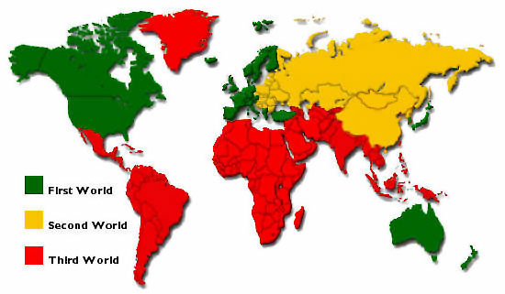
The term first world refers to western developed countries.
Second world refers to the former communist states.
Third world refers to the less developed world.
Mark scheme:
Copy the above definitions if yours is different.
Give 3 examples of countries in each category.
I believe this is an accurate/un-accurate representation of the world because….

Slide 2
Starter: What information can you gain from this map?
What do you think 1st world, 2nd world, 3rd world mean?

Slide 3
Key Questions
How can the level of economic development of a country be measured?
What are the reasons for inequalities between and within countries?
How can economic production be classified into different sectors?
How do the proportions employed in each sector of an economy vary according to the level of development?
What is globalisation?
How important are technology, transnational corporations and other economic factors in the process of globalisation?
What are the impacts of globalisation at local, national and global scale?

Slide 4
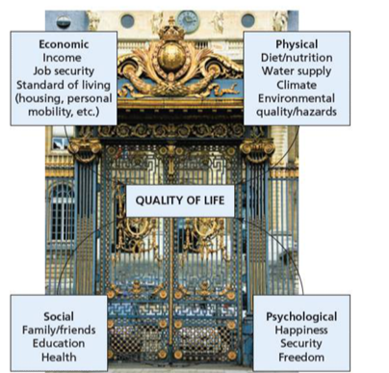
Indicators of Development
Learning objective: To identify how has development been described and mapped in the past. To evaluate how valid these descriptions are.
Demo: Please write down the definition of development.
Language for learning:
Development: the use of resources to improve the quality of life within a country.
Development Gap: The differences in wealth, and other indictors, between the world’s richest and poorest countries.
GNP: The total value of goods and services produced by a country in a year, plus income earned by the country residents from foreign investments and minus income earned within the domestic economy by overseas residents.

Slide 5
Measures of Development
Demo: What other measures of development do you know? Turn to pages 162-164 and makes notes on 4 key measures of development.
Challenge:
Measures of Development
GNP
Literacy Rates
Infant Mortality
Life Expectancy

Slide 6
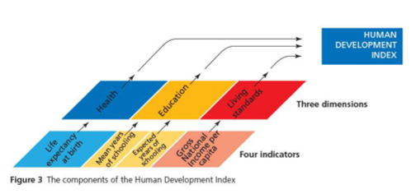
Measures of Development
The HDI (Human development Index) was created in the 1990s by the United Nations as a measure of the disparities in the world.
Challenge (Higher level thinking task):

Slide 7
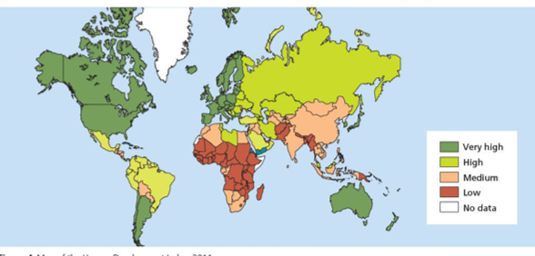
Composite measure of Development

Slide 8
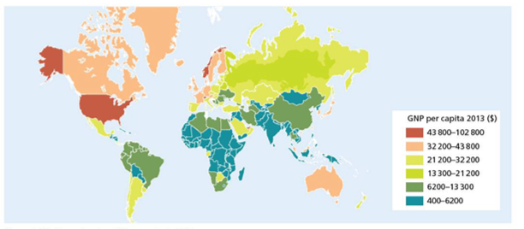
Exam Practice
Demo: What is the distribution of Rich and poor nations?
Source 1

Slide 9
(a) Study Fig. 11 in the Resource Booklet. It shows the average income (G.D.P.) of countries.
(i) Describe the distribution of middle-income countries. Refer to the Brandt line in your answer.
.............................................................................................................................................
........................................................................................................................................ [2]

Slide 10
Measures of Development
Demo: What other measures of development do you know?
Measures of Development

Slide 11
Assessment for learning – interim progress check
Learning objectives:
To identify how has development been described and mapped in the past. To evaluate how valid these descriptions are.
Please complete the activity below reflecting on your learning so in today’s lesson:
So far in this lesson, I have learnt:

