Slide 1
Exam practice: Causes of Landslides
Demo: Complete the possible causes of Landslides.

Slide 2
Exam practice: Causes of Landslides
Demo: Complete the possible causes of Landslides.

Slide 3
Mass Movements
Demo: Using evidence from the photograph explain the possible causes of the landslide (2+2+2 marks).
Factors to Look for:
Slope Angle
Gradient
Wet vs Dry
Undercutting
Lateral Pressure
Loading Pressure
Weathering (Solution of Minerals)
Pores (Saturation
Change in Structure
Organic Effects (Decay/Burrowing Animals)

Slide 4
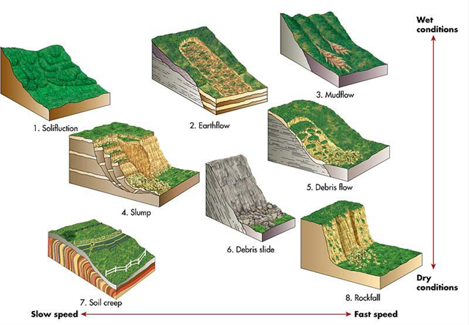
Exam practice: Causes of Landslides
Demo: Using the diagram and the chart identify the characteristic of the landslide.

Slide 5
Slope Stability
Slope stability is defined by its safety factor, which relates to the relative resistance of the slope compared with the force trying to move it.
AO1
Demo: What physical Factors influencing slope stability?
Shear Strength
Pore pressure
Gravity
Diagram
Diagram
Diagram
Short Explanation
Short Explanation
Short Explanation

Slide 6
Shear Strength
Factors that bind slopes and hold slope stability are referred to as shear strength. Factors that weaken stability and force movement are called shear stress.

Slide 7
Pore pressure
Water acts as a lubricant causing greater instability. In some cases, water enters the pores between particles, forcing them apart and reducing its ability to bind. Water can also increase pore pressure further encouraging movement. This is particularly present on wet low-angle slopes.

Slide 8
Gravity
Gravity impacts slope stability in two main ways. Firstly, it acts to move material downslope (slide component) and secondly, it acts to stick the material to the slope (stick component).

Slide 9
Rotational slumps
Demo: How are rotational slumps created?
Rotational slumps occur when a slump block, composed generally of unconsolidated sediments, slides along folds called sheaf folds. Slumps have several characteristic features. The cut which forms as a concave-upward slip surface with rotation about an axis parallel to the slope. Rotational movement causes the original surface of the block to become less steep, and the top of the slump is rotated backward. This results in internal deformation of the moving mass consisting chiefly of overturned the landmass breaks away from the slope is called the scarp and is often cliff-like and concave. The main slump block often breaks into a series of secondary slumps and associated scarp. Rotational slumps vary from translational slumps through the axis of their slip plain. Translational slumps follow a more linear axis

Slide 10
Rotational slumps
Demo: Identify the difference between Translational Slide and Rotational Slide. Label your Worksheet.

Slide 11
Debris flows
Debris flows are geological phenomena in which water-laden masses of soil and fragmented rock rush down mountainsides, funnel into stream channels, entrain objects in their paths, and form thick, muddy deposits on valley floors. They generally have bulk densities comparable to those of rock avalanches and other types of landslides (roughly 2000 kilograms per cubic meter), but owing to widespread sediment liquefaction caused by high pore-fluid pressures, they can flow almost as fluidly as water. Debris flows descending steep channels commonly attain speeds that surpass 10 meters per second (more than 20 miles per hour), although some large flows can reach speeds that are much greater.

Slide 13
Learning Check
Demo: From what we have learnt how does this link with classification of mass movements by speed

