Slide 1
Hazards and disasters - risk assessment and response
1. Characteristics of hazards
Characteristics | Explain the characteristics and spatial distribution of the following hazards. earthquakes Distinguish between the chosen hazards in terms of their spatial extent, predictability, frequency, magnitude, duration, speed of onset and effects. | 7 hours
Demo: Draw a diagram of the Earth Labelling all the parts.
Demo: As we found with volcanoes, earthquakes occur along plate lines which cover the earth. Your task is to put them together to find out where they happen.
Labels: Crust/Mantle/Outer Core/ Inner Core/Asthenosphere/Lithosphere

Slide 2
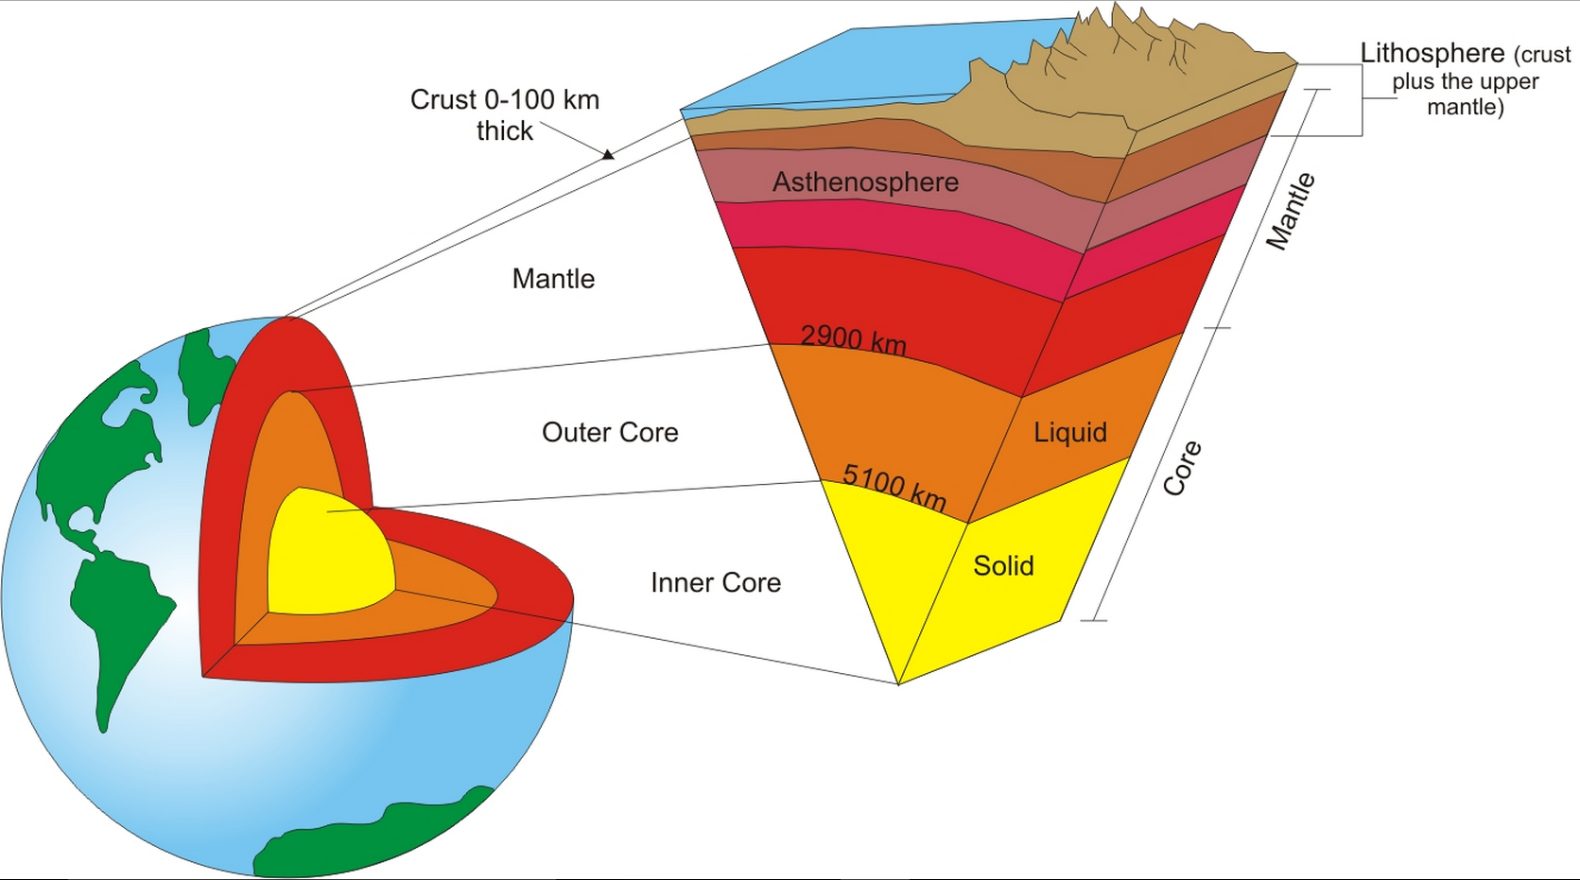
Earth Structure (Check your Answer)

Slide 3
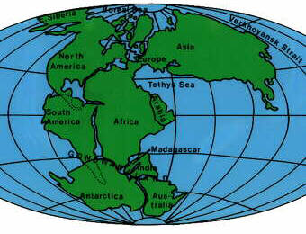
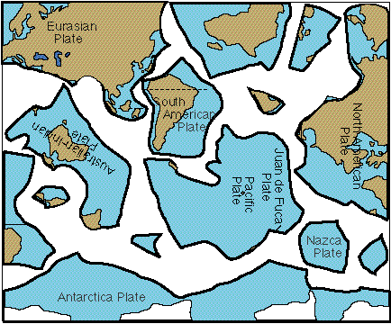
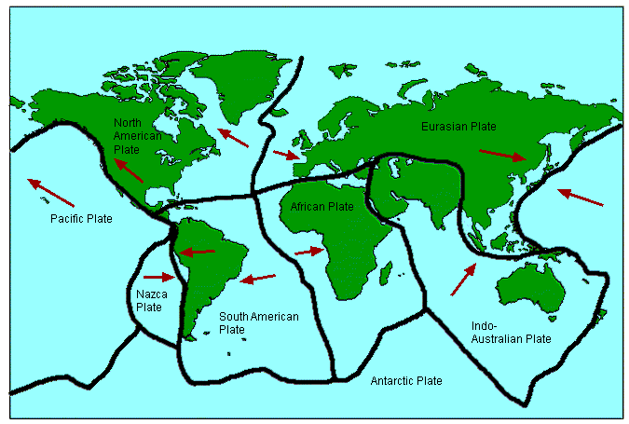
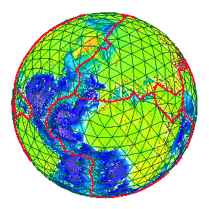
Demo: As we found with volcanoes, earthquakes occur along plate lines which cover the
earth. Your task is to put them together to find out where they happen.
10mins
Notes:
Give students plates sheet. They cut them out and stick correctly in their books.

Slide 4
Tectonic Plates (Check your Answers)

Slide 5
Tectonic Plate Movement
Constructive
Convergent
10mins
Conservative

Slide 6
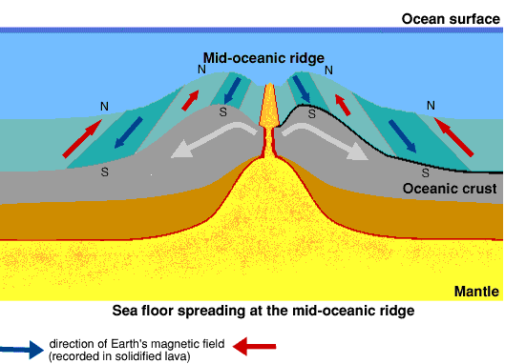
Demo: Using the your drawings and the diagram below, explain how an earthquake can happen. (5 marks)
5mins

Slide 7
LOCATING & MEASURING QUAKES
Learning Objective: To understand the spatial extent and locations of earthquake activity on earth.
Demo: Watch the Video and outline what the Richter Scale is. Make sure you explain what a single number increase means.
Using the video on YouTube, outline what the Richter Scale is. Make sure you explain what a single number increase means.
Complete this table using the YouTube video
Magnitude | Brief Description | Average Number of events per year (click here for link)
Less than 2.0
2.0 – 6.0
6.0 – 8.9
1960 Valdivia earthquake takes the cake at 9.5 (China)

Slide 8
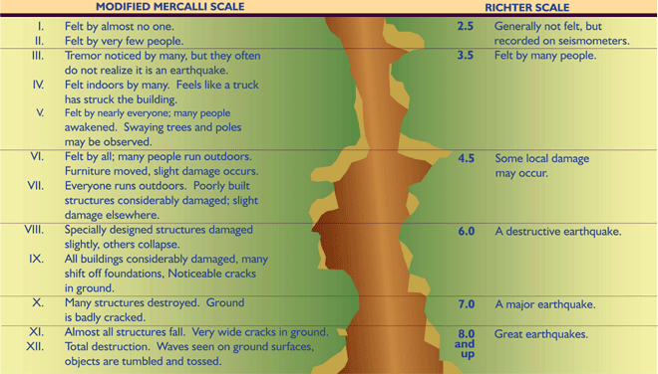
Earthquakes – magnitude (Mercalli Scale vs Richter Scale)

Slide 9
Earthquakes – magnitude vs deaths
Year | Place | Deaths | Richter Scale
1906 | San Francisco | 450 | 8.2
1923 | Tokyo | 156,000 | 7.9
1964 | Alaska | 131 | 8.3
1970 | Peru | 66,000 | 7.8
1971 | San Fernando | 65 | 6.5
1976 | Tangshan, China | 240,000 | 7.6
1985 | Mexico City | 9,500 | 8.1
1988 | Armenia | 25,000 | 6.9
1989 | San Francisco | 67 | 7.1
1990 | Iran | 50,000 | 7.3
1993 | Latur, India | 10,000 | 6.5
1994 | LA | 57 | 6.6
1995 | Kobe, Japan | 5,477 | 7.2
1998 | Afghanistan | 4,000 | 6.1
1999 | Turkey | 3,000 | 7.4

Slide 10
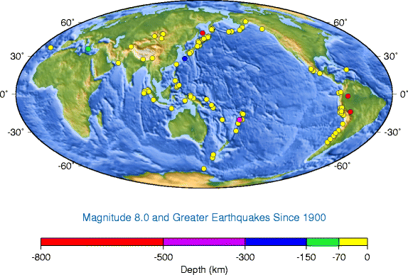
Demo: Describe the distribution of earthquakes of more than 8.0 since 1900.
Demo: Using this link, describe the distribution of magnitude 2+ that have occurred globally in the last 30 days.

Slide 11
Earthquakes – spatial distribution
http://www.google.com/imgres?um=1&hl=en&biw=1145&bih=570&tbm=isch&tbnid=g02BDEaNccI0DM:&imgrefurl=http://geomaps.wr.usgs.gov/sfgeo/quaternary/stories/why_break.html&docid=eptaKoT2QoPnxM&imgurl=http://geomaps.wr.usgs.gov/sfgeo/quaternary/images/worldseis.jpg&w=500&h=300&ei=mGPoT4bnIOOe2wXUp-naCQ&zoom=1&iact=hc&vpx=737&vpy=281&dur=3096&hovh=174&hovw=290&tx=155&ty=120&sig=116452723810063738260&page=3&tbnh=96&tbnw=160&start=46&ndsp=27&ved=1t:429,r:25,s:46,i:299

Slide 12
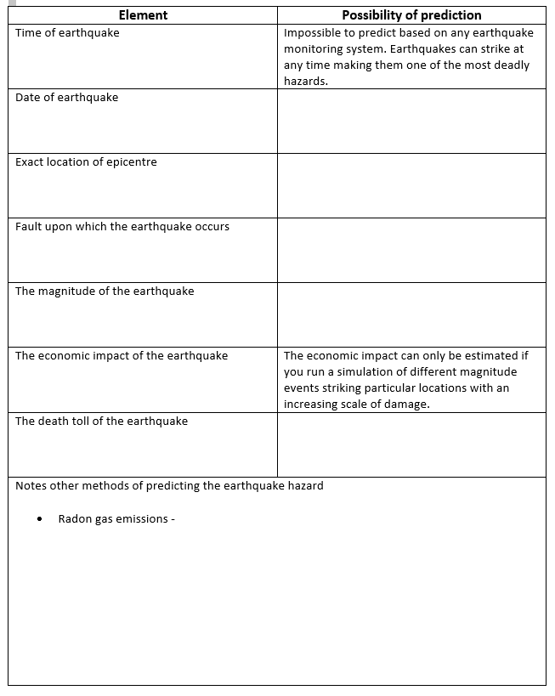
PREDICTING EARTHQUAKE ACTIVITY
Learning Objective: To complete a study on the likely success of earthquake prediction and where this has been implemented.
The following are elements of an earthquake hazard:
Time of earthquake
Date of earthquake
Exact location of epicentre
Fault upon which the quake occurs
The magnitude of the earthquake
The economic impact of the earthquake
The death toll of the earthquake
Demo: Comment on the predictability of the following features of the earthquake hazard below by watching both YouTube videos.

Slide 13
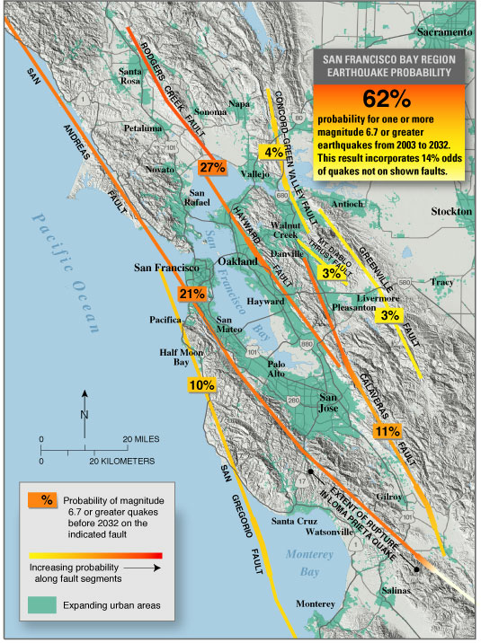
Predictability
http://en.wikipedia.org/wiki/Earthquake_prediction

Slide 14
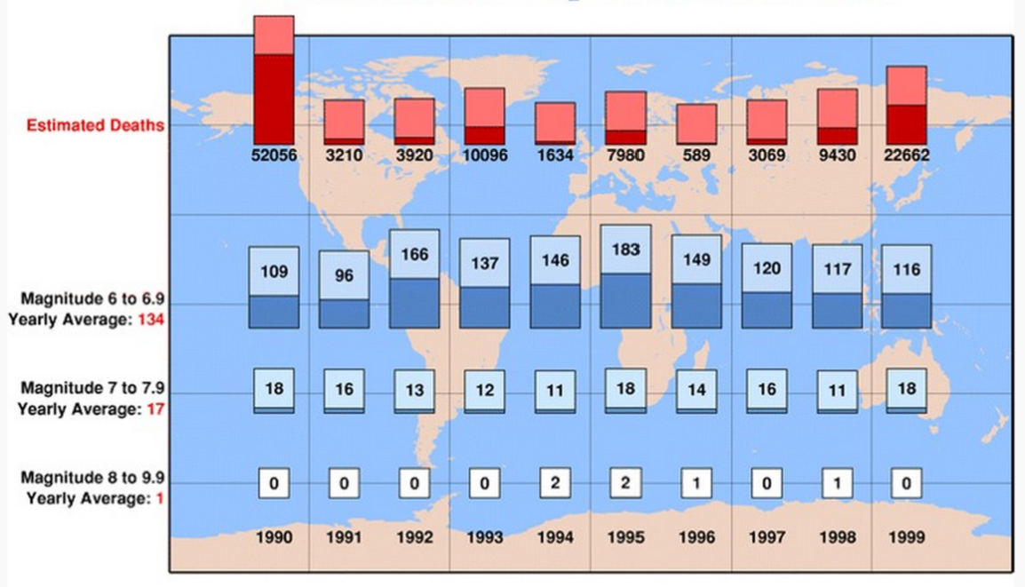
EARTHQUAKE FREQUENCY (WorldWide earthquakes 1990-1999

Slide 15
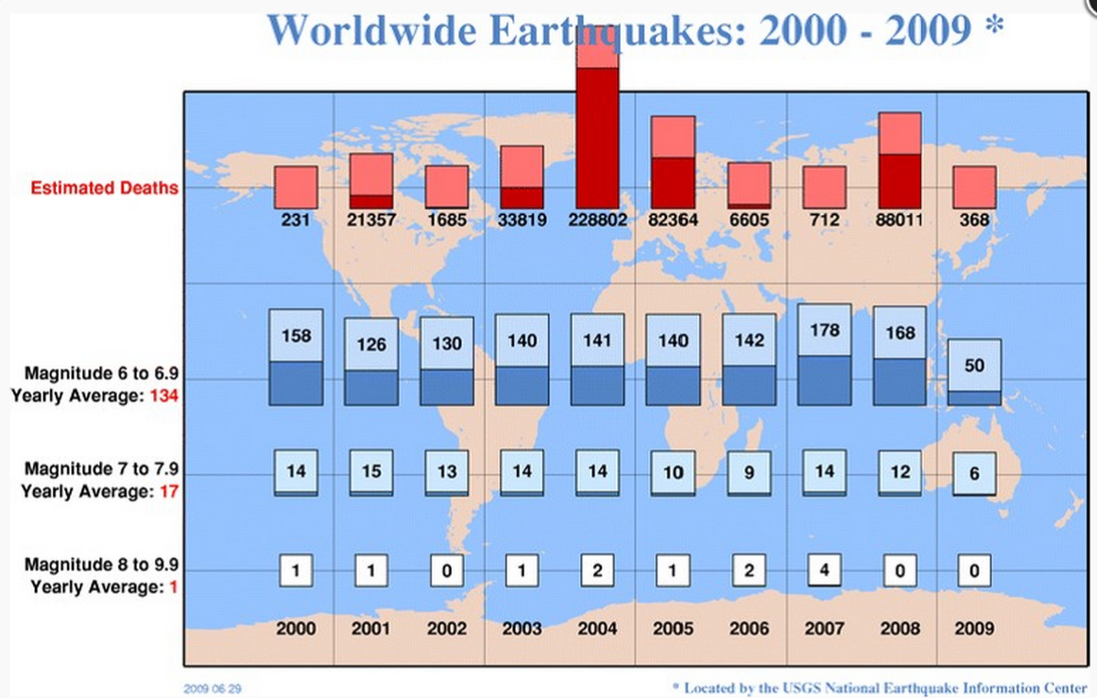
EARTHQUAKE FREQUENCY (WorldWide earthquakes 2000-2009

Slide 16
http://www.google.com/imgres?um=1&hl=en&biw=1145&bih=570&tbm=isch&tbnid=OtSMeFt3c6qfcM:&imgrefurl=http://wowow.ws/os01/ueo/earthquakes_04.html&docid=9iS4fGPg20v38M&imgurl=http://wowow.ws/os01/ueo/media/platetectonics_map.gif&w=791&h=540&ei=mGPoT4bnIOOe2wXUp-naCQ&zoom=1&iact=hc&vpx=374&vpy=143&dur=7030&hovh=185&hovw=272&tx=171&ty=115&sig=116452723810063738260&page=1&tbnh=102&tbnw=149&start=0&ndsp=20&ved=1t:429,r:2,s:0,i:79

