Slide 1
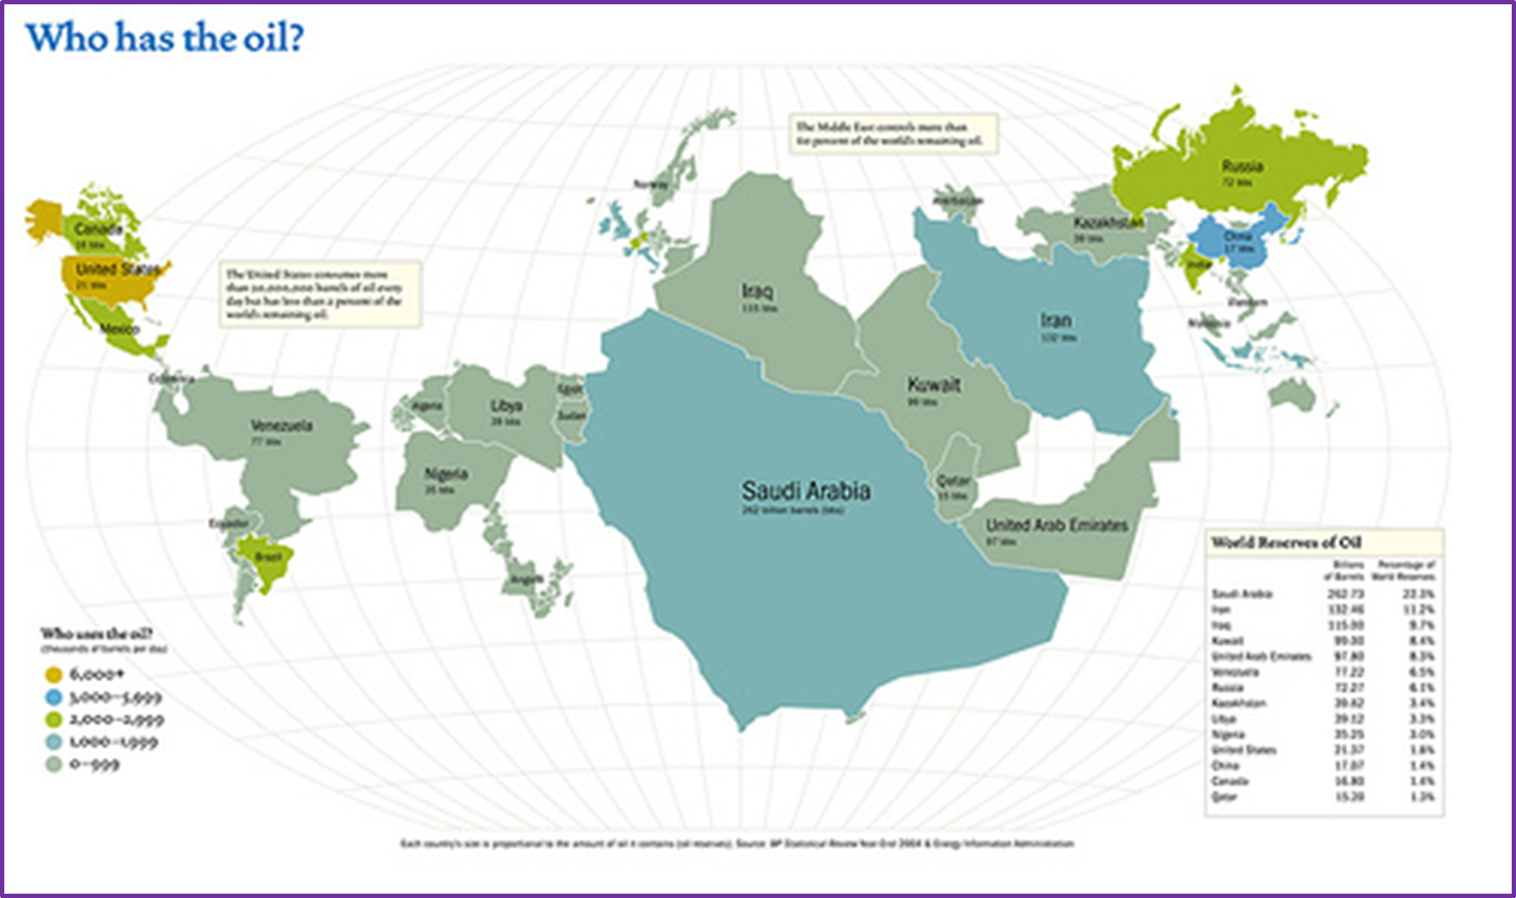
Oil
Learning Objective: To analyse the global patterns and trends in the production and consumption of oil.
Starter: Who has oil?

Slide 2
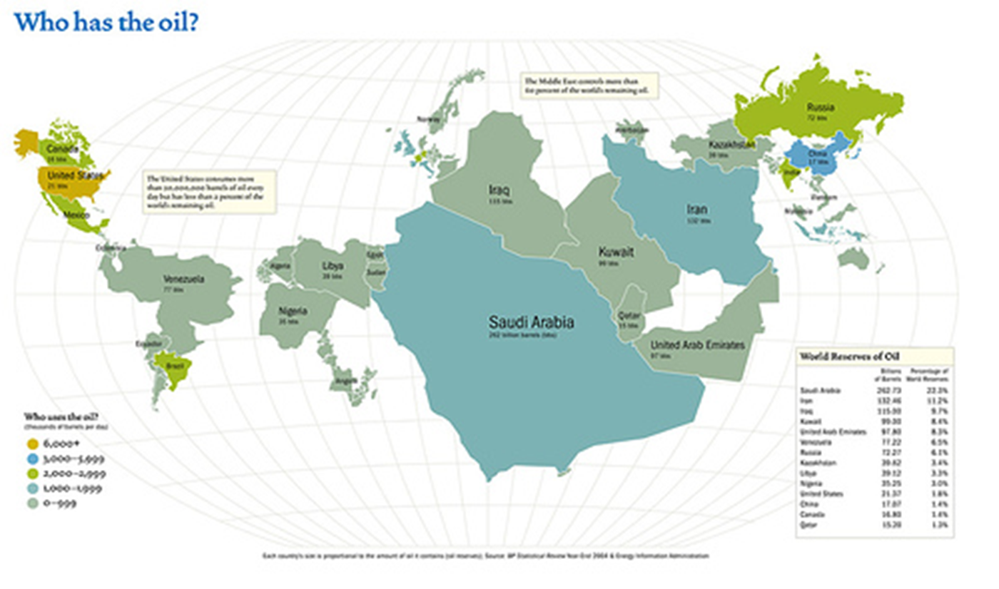

Slide 3
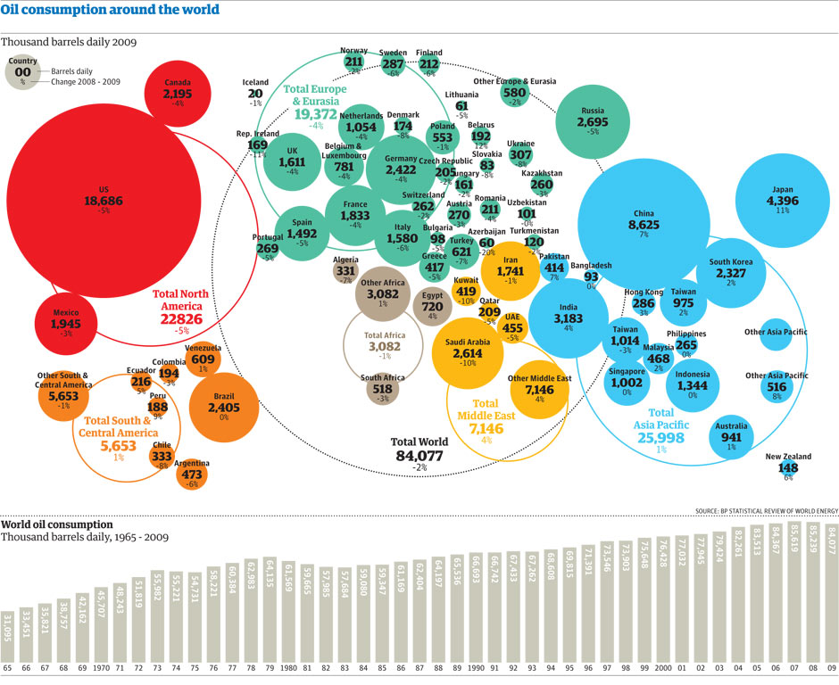

Slide 4
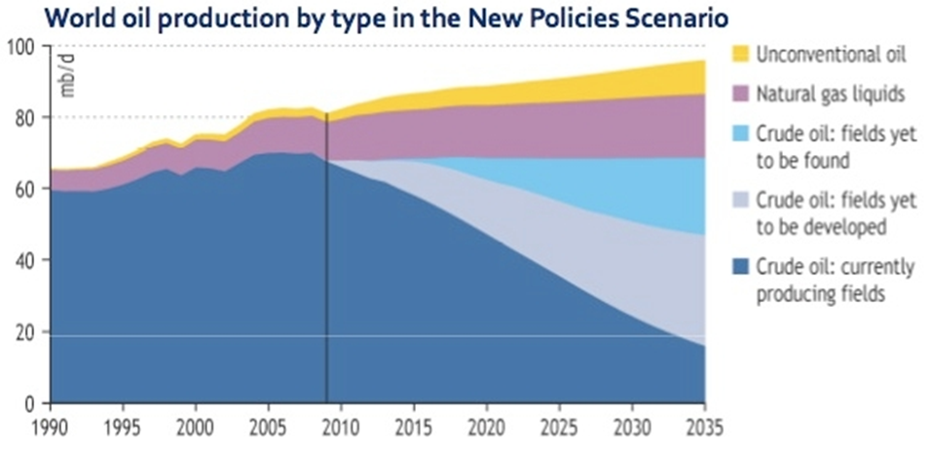
Oil
Practice Questions:
1.According to this graph, what year was peak Crude Oil extraction reached?
2.Describe the best case scenario for the continued use of Crude Oil between now and 2035.

Slide 5
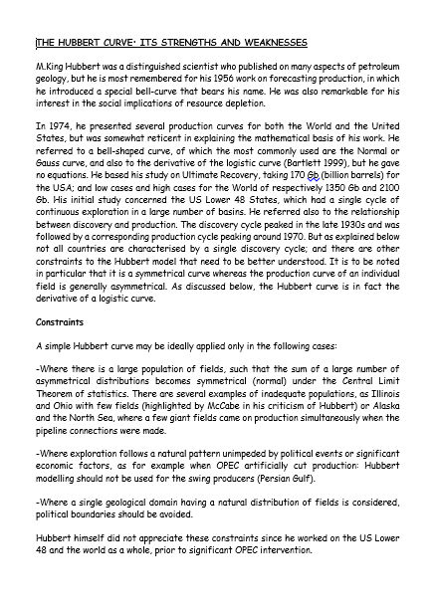
M. King Hubbert's theory
Demo: Copy the Hubbert graph.
Challenge: Ensure to read the text and evaluate the Hubbert curve.

Slide 6
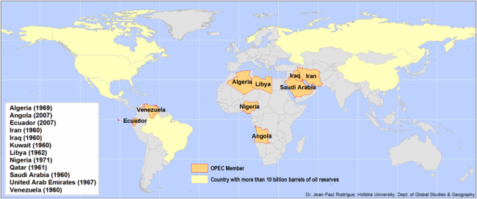
OPEC
The Organization of the Petroleum Exporting Countries (OPEC) is a permanent, intergovernmental Organization, created at the Baghdad Conference on September 10–14, 1960, by Iran, Iraq, Kuwait, Saudi Arabia and Venezuela.
Its aims:
To protect interests of the member nations
Stabilise oil prices
Ensure efficient, economic and regular supply of oil.
Notes:
Has 78% of the world’s oil reserves
Produces around 45% of crude oil and 15% of natural gas
Has the power to significantly affect oil prices by increasing or decreasing production.
OPEC is a cartel, with monopolistic and price controlling power.
Formed in 1960
Can increase production sharply if global economic conditions allow it.

Slide 7
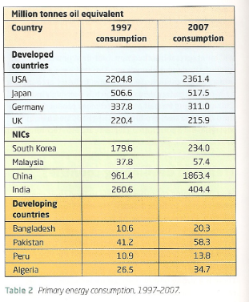
Disparities in wealth and development
USA consumes almost one quarter of global oil output but has 2.5% of its reserves. 20 million barrels a day consumed in the USA, 25% is used for transportation.
NIC’s are increasing their energy demand by the fastest growth. China has accounted for 1/3 of the growth in global oil demand since 2000.China passed Japan as the world’s second largest user of oil in 2004. China will take over from the USA as the world’s largest consumer of oil in 2025.
Two factors that effect rate of economic development and the rate of population growth. There is a strong positive correlation between GNP per capita and energy use. 2 billion people lack access to household electricity. 1% of greenhouse gases will

Slide 8
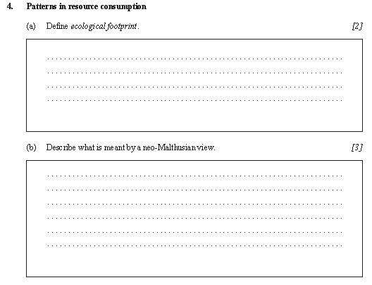
Alternate Starter Task:
Starter: Complete the first two questions (a) and (b).

Slide 9
Case Study
Demo: Read the Case Studies and complete a case study sheet for each of the given case studies.
Case Study
Russia = An energy giant flexes its muscles
The Niger Delta = Oil Pollution
Oil sands in Canada and Venezuela
The Arctic Circle
Challenge: Self-reflection can answer the following questions for all of your case studies?

Slide 10
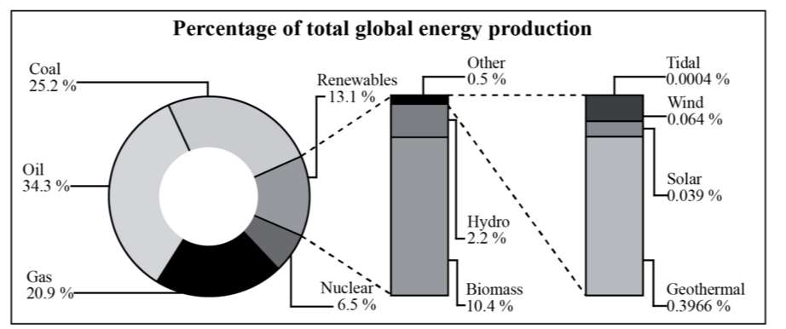
Exam Practice:
1. Identify and rank the top three renewable sources of energy shown on the graph from highest to lowest. [2]
2. Suggest two reasons why some areas of the world are unlikely to depend entirely on renewable energy sources. [2x2]
3. Analyse how the global pattern of oil production has changed in recent decades. [5]

Slide 11
Markscheme
1.
2.
3.

