Slide 2
Patterns in environmental quality and sustainability 2rd part of the Core
Short-wave radiation is the energy from the sun that enters the earth's atmosphere (very short wavelengths), such as ultraviolet and visible light. Generally emitted by hot bodies.
Long-wave Radiation is the energy leaving the earth as infrared radiation at low energy and contains less energy than shortwave radiation. Generally emitted by cold bodies. Convection is the transfer of heat by movement of a gas or liquid.
Conduction is the transfer of heat by contact.
Greenhouse Effect - Process where water vapor, C02, CH4 & CFCs allow SW energy from the sun to pass through the atmosphere and heat up the earth. However some of the resultant LW radiation is trapped leading to a heating of the earth.
Enhanced Greenhouse Effect occurs as a result of increased quantities of greenhouse gasses in the atmosphere owing to human activities and their impact on these fragile atmospheric systems.

Slide 3
Examples of albedos:
Oceans and lakes 0.03-0.10
Sea ice 0.30-0.45
Fresh snow 0.75-0.95
Tundra 0.15-0.20
Conifer forest 0.09-0.15
Broadleaf forest 0.15-0.20
Desert 0.20-0.45
Albedo = the fraction of solar energy (shortwave radiation) reflected from the Earth back into space, (a measure of the reflectivity)

Slide 4
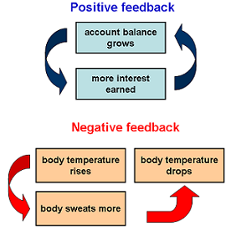
Positive and negative feedback loops
Language for Learning: Positive feedback loops enhance or amplify changes; this tends to move a system away from its equilibrium state and make it more unstable. Negative feedbacks tend to dampen or buffer changes; this tends to hold a system to some equilibrium.

Slide 5
Positive feedback loops
Increases in
temperature
The snow – albedo feedback loop
Decreases in
snow cover
Increase in
heat absorption
Decreases in
albedo

Slide 6
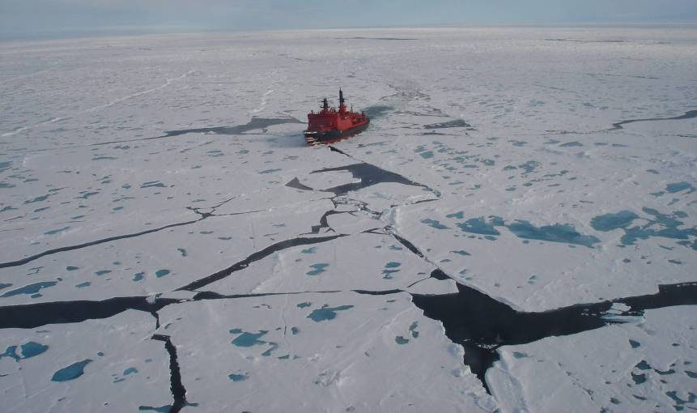
Albedo
New snow
= 0.82 (+/-)
Light melt pond
= 0.40
Arctic Ocean
= 0.08

Slide 7
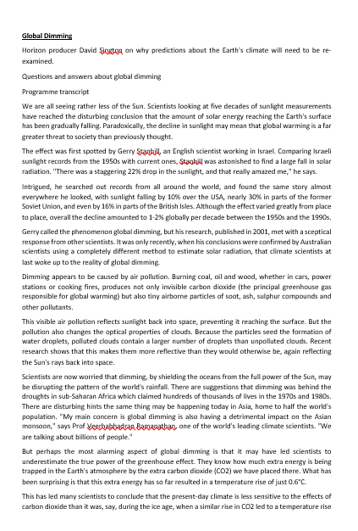
Global Dimming and Global Brightening
Demo: Read the Sheet on global dimming.
Global brightening is caused by changes in cloud cover, reflective aerosols and absorbing aerosols. While changes in cloud cover & aerosols lead to more sunlight hitting the surface, this can be compensated by the cooling effect on the atmosphere due to fewer clouds trapping less warmth and fewer absorbing aerosols absorbing less sunlight.
Global dimming is defined as the decrease in the amounts of solar radiation reaching the surface of the Earth. The by-product of fossil fuels are tiny particles or pollutants which absorb solar energy and reflect back sunlight into the space.
Challenge: What might Volcanic eruption have to do with the process of global dimming?

Slide 8
Feedbak Loop Methane release
Demo:Complete a feedback loop diagram of effects of Methane on climate change.
Quick Read
Methane is particularly problematic as its impact is 34 times greater than CO2 over a 100-year period, according to the latest IPCC Assessment Report. A significant source of human-made methane emissions is fossil fuel production. For example, methane is a key by-product of the rapidly rising global extraction and processing of natural gas. Other top sources of methane come from the digestive process of livestock and from landfills, which emit it as waste decomposes.

Slide 9
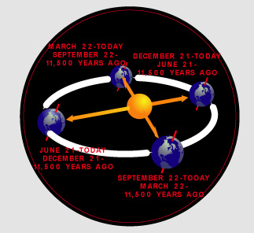
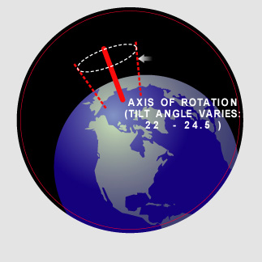
External forcing's
Angle of impact of solar radiation
Solar constant
Distance from the sun
Tilt of the planet
Wobble

Slide 10
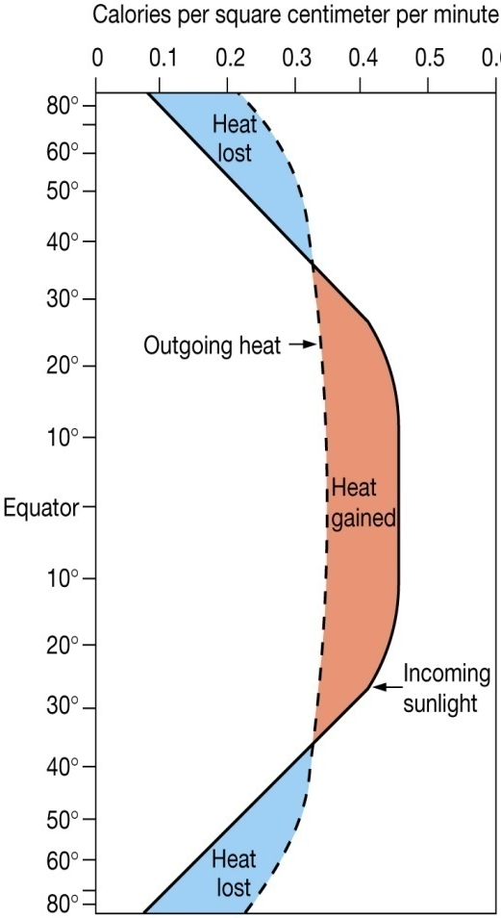
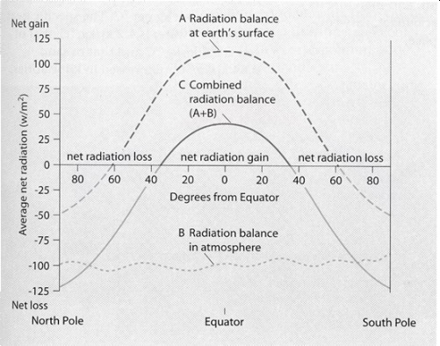
The atmospheric heat budget
Starter: Look at the graph and describe its findings. (3 marks)

Slide 11
The atmospheric heat budget (model answer)
The graph to the left shows the global heat budget. It shows that insolation reaching the Earth's surface is concentrated in the tropics. In the tropical region there is a net heat gain. In contrast, the polar regions are said to have a net heat loss. The reason for this disparity is due to the altitude of the sun and latitude. In the tropics the altitude of the sun is highest and so insolation is more concentrated. In polar regions due to the low angle of the sun, insolation is spread out over a larger area due to a lower angle of incidence. In addition due to this angle incoming electromagnetic radiation has to travel through more atmosphere. As a result, more radiation is absorbed or reflected back into space. The position of the sun, relative to the Earth varies in time. Due, to the Earth's rotation, we experience day and night and due to Earth's elliptical orbit around the sun and axial tilt the sun's relative position to Earth and hence altitude in the sky varies throughout the year. It is this change in altitude that causes the seasonal changes outside the tropics.

Slide 12
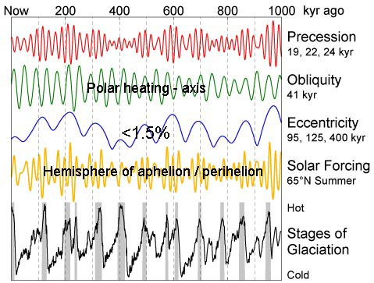
Earth and sun – Milankovich cycles
Demo: Watch the Video on the Milankovich cycles and take notes.
‘Spinning top’
tilt
shape of orbit

Slide 13
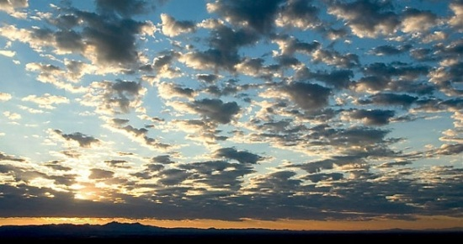
An example of negative feedback

Slide 14
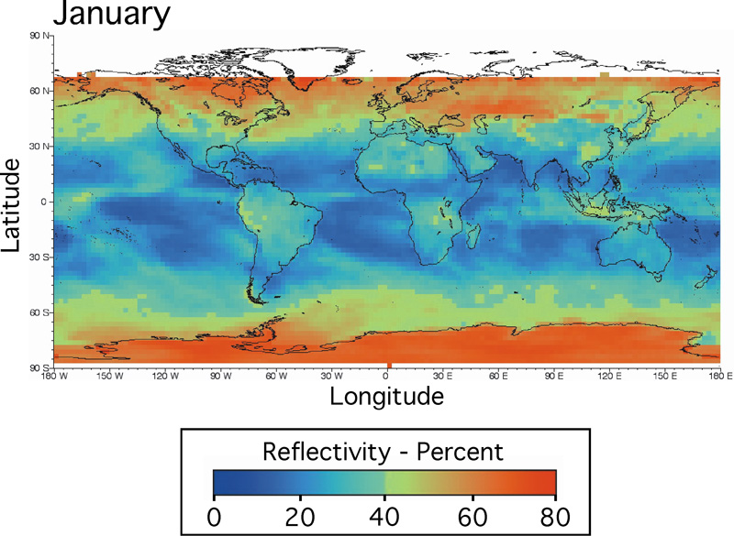
Albedo (Practice Question)
Demo: With reference to the map, describe and explain the global variations in Albedo. (5)

