Slide 1
Lesson 2: Urban Environments
Learning Objective: To explain the variation in global growth rates and patterns and explain the process of centripetal movements(rural-urban, gentrification, re-urbanisation/ urban renewal).
Starter:
Define the term urbanisation. (2 marks)
_________________________________________________________________________________________________________________________________________________________
Markscheme: Urbanisation is the process by which n increasing percentage of a country’s population comes to live in towns and cities. It may involve both rural-urban and natural increase.

Slide 2
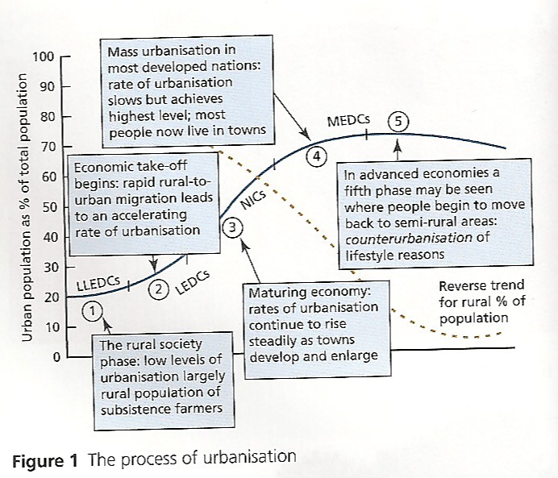
Urbanisation
Demo: Describe the process of urbanisation.
Language for learning: Urbanisation- is an increase in the percentage of a population living in urban areas.
Plenary
Key Learning Questions
What is Urbanisation?
What are the reasons for rapid urban growth?
What are the impacts of urban growth on both urban and rural areas?
What are the strategies to reduce the negative impacts of urban growth?

Slide 3
Megacities
Language for learning: What is a megacity?
A megacity is a city with a population of more than 8 million people
Switzerland and Austria both have populations of around 8 million
In 2010, there were about 25 cities falling into the megacity category
In the late 90s, the 8 million definition became common.
Changing definitions:
In the 80s ‘megacity’ referred to cities of over 5 million people.
Today 10 million is often used.
This change reflects the rapid urbanisation of the planet.
What was ‘big’ in 1980 does not seem very big at all today.
Both 8 and 10 are acceptable definitions in your exams.
Challenge: Turn to page 63 and create a table like below and ensure to add the examples.
1950 | 1975 | 2000 | 2015
1Example | 2 Examples | 3 Examples | 4 Examples

Slide 4
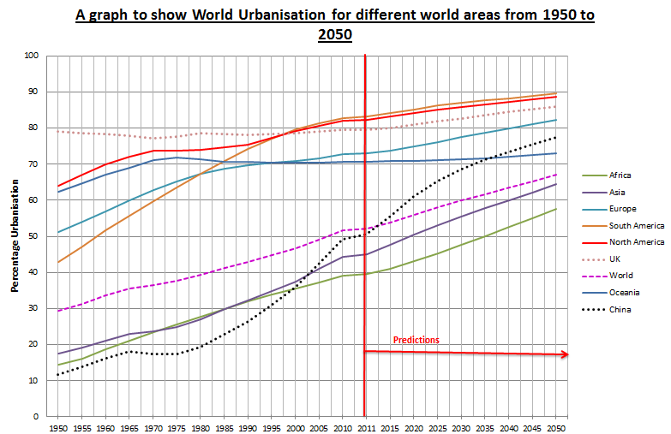
Starter Quiz
Demo: Describe the global urban change from 1950 to 2050. (4)
Markscheme:
Have you highlighted the correlation (1)
Have you used Exemplification. (1)
Have you highlighted the global change (1)
Have used the term exponential growth (1)

Slide 5
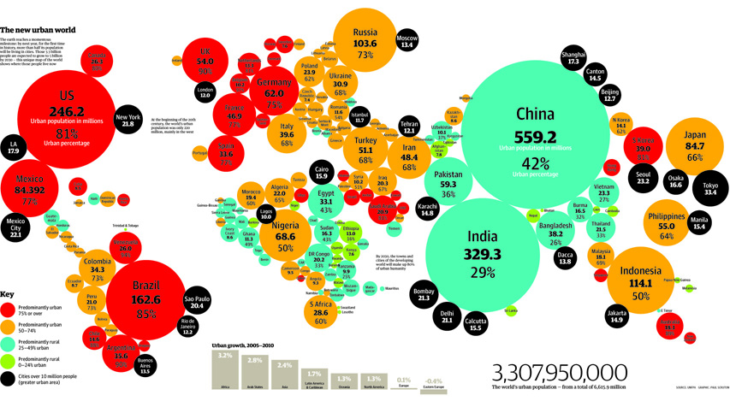
Global growth rates and patterns
Demo: Explain the variation in global growth rates and patterns. (5)
Markscheme:
Have you used Exemplification. Countries/ Continents (1)
Have you highlighted the pattern or trend (1)
Have you highlighted the variation in global growth rates(1)
Have you given two well explained reasons as to why global growth rates differ.(2)

Slide 6
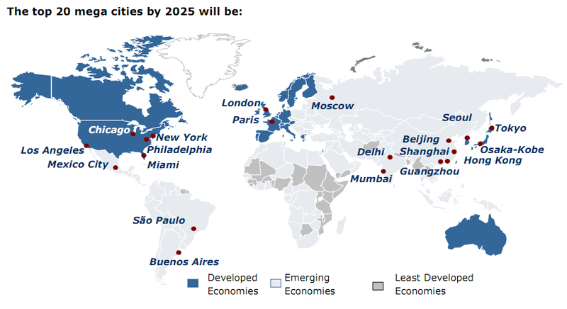
Explaining the variation in global growth
Demo: Describe the global distribution of Megacities by 2025. (4marks)

Slide 7
Consequences of Urbanisation
Demo: Draw the table below and use pages 287 and 288 to fill in the table.
Term | Definition | Explanation | Example
centripetal movements(rural-urban)
gentrification
re-urbanisation
re-urbanisation/urban renewal
People moving in!!!!

Slide 8
Consequences of Urbanisation
Language for learning: Centrifugal Movement or decentralisation, are the outward movements of a population from the centre of a city towards its periphery.
Demo: On the outside of your table add the following terms:
Suburbanisation
Urban Sprawl
Counter-Urbanisation
People moving out!!!

Slide 9
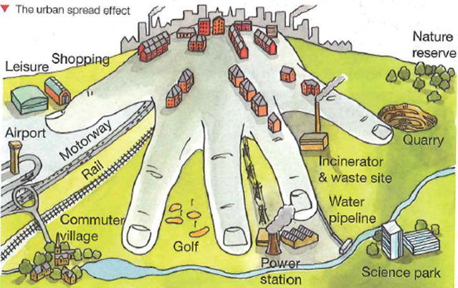
The Urban Fringe
Language for Learning: The rural-urban fringe is the area at the edge of a city where it meets the countryside. There are many pressures on the rural-urban fringe.
The Urban sprawl - is the unplanned and uncontrolled physical expansion of an urban area into the surrounding countryside.
Suburbanisation - the growth of areas on the fringes of cities. It is one of the many causes of the increase in urban sprawl. Many residents of metropolitan regions work within the central urban area, and choose to live in satellite communities called suburbs

