Slide 1
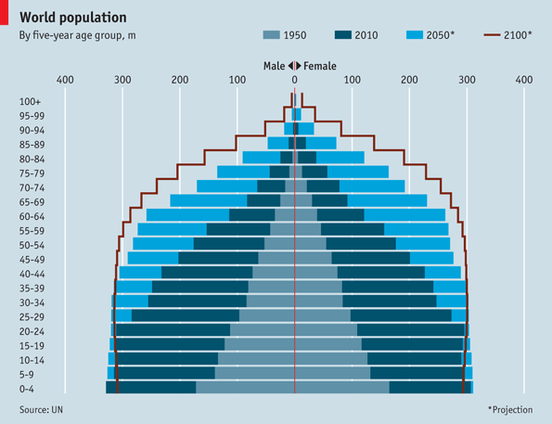
The Future??

Slide 3
An ageing population
Learning Objectives: How can a country’s geography be changed by an increasing percentage of older people in the population?
Starter:
Starter: At what age do you think a person should retire from their work?
Do you think the same age should apply to everyone? Give reasons for your answer.
Challenge: Why is age such an important topic for geographers?

Slide 4
Japan 2016
Demo: What can you infer from the population pyramid?

Slide 5
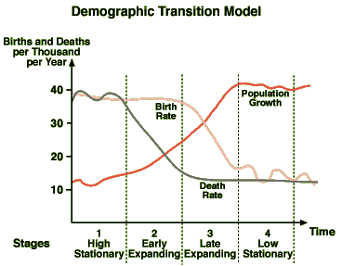
Demographic Transition Model
Demographic – human populations
Transition – Process of Changes
Model – a Perfect example
A model is a representation of some phenomenon of the real world made in order to facilitate an understanding of its workings
Demo:
Write your own definition for what you believe the demographic transition model is (in your own words).

Slide 6
Demographic Transition Model
Stage 3
FALLING Birth rate
LOW Death rates
SLOW population growth
Stage 1
HIGH Birth and Death rates
LOW population
NO population growth
Stage 2
HIGH Birth rate
FALLING Death rates
RAPID population growth
Stage 4
FALLING Birth rate
LOW Death rates
NO population growth

Slide 7
Demographic Transition Model
Positives
Limitations
Gives countries a model to follow to track demographic change
Also can be linked to economic growth and sectors of industry through the Clark fisher model
Based on England and Wales –
Can it be applied to the rest of the world?
Can LEDCs pass through the same stages during a different time period?
Does population have to change first for economic change to occur?
Does it include migration?
Does it into account the effects from other countries? (e.g. War)

