Slide 1
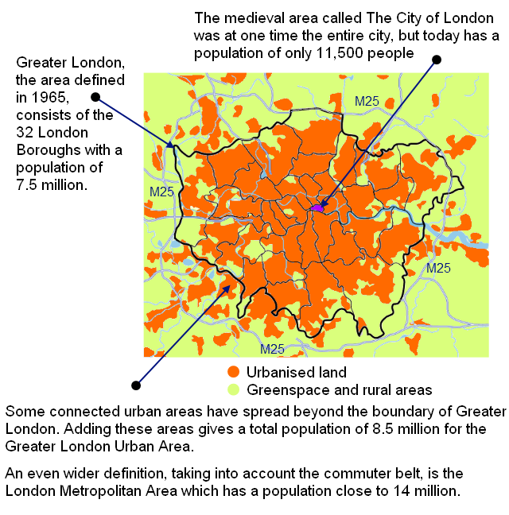
(A01) Defining the ‘city’
Defining a City
Starter: Why might it be difficult to define a city?
Counting residents to work out the size of a city is no simple task
Migrants, homeless people and illegal residents complicate the count
The administrative boundary of a city often does not reflect its resident population as the diagram for London shows
Because of this, it is common to come across very different stated population sizes for the same city

Slide 2
Megacities
Starter: What is a Megacity?
Changing definitions:
In the 80s ‘megacity’ referred to cities of over 5 million people.
In the late 90s, the 8 million definition became common.
Today 10 million is often used.
This change reflects the rapid urbanisation of the planet.
What was ‘big’ in 1980 does not seem very big at all today.
Both 8 and 10 are acceptable definitions in your exams.
Demo: Student should choose a Megacity and Investigate the following:
Location
Demographic
Problems and Solutions
Poverty vs affluence.

Slide 3
The growth of megacities
Demo: How has the pattern of Megacities changed over time? (3marks)
Cities of 8 million+ from 1950 to 2010

Slide 4
Changing patterns
Demo: How has the pattern of Megacities changed over time? (3marks)
In 1950s and 1960s the world’s largest cities were in developed countries
In the 1970s, several Latin American megacities emerged
From 1960 to 1990 a few developed world megacities, such as London, actually saw population decline due to deindustrialisation and counter-urbanisation
Since 1990 megacity growth has been centred on Asia, and especially India and China since the turn of the millennium
Africa has relatively few megacities although many African cities are growing rapidly
It is important to recognise that megacities around the world have very different characteristics

Slide 5
Immature megacities
Developing world
Immature cities are growing rapidly in an uncontrolled way
Many are in Africa
Growth is usually fed by rural–urban migration
Growth is so rapid that housing, transport, education, sewers and water services cannot be built to keep pace with growth
This leads to major health, housing and pollution problems
Lagos, Nigeria
Population in 2010 | 8 million
Annual population growth rate | 4.5%
% of people living in slums | 70%
% of households with piped water supply, 2008 | 6%

Slide 6
Consolidating megacities
Developing world
With slower growth, consolidating megacities can begin to provide basic services
Self-help schemes are important in these cities – improving housing, water and sewage disposal
Many people still work in the informal sector
Mumbai, India
Population in 2010 | 13.8 million
Annual population growth rate | 2.3%
% of people living in slums | 55%
% of households with piped water supply, 2008 | 87%

Slide 7
Maturing megacities
Developing world
Maturing cities have a more developed formal economy, with large service industries
The majority live in legal, well-built homes and work in the formal economy
Advanced transport, education and waste systems are in place
Such cities are managed efficiently
São Paulo, Brazil
Population in 2010 | 20 million
Annual population growth rate | 1.9%
% of people living in slums | 30%
% of households with piped water supply, 2008 | 94%

Slide 8
Established megacities
Developed world
Stable cities have advanced and effective governance
They are often engaged in regeneration and urban sustainability projects
Many people work in high-end, professional service sector jobs
Quality of life is very high for most
London, UK
Population in 2010 | 8.5 million
Annual population growth rate | 1%
% of people living in slums | 0%
% of households with piped water supply, 2008 | 100%

