Slide 1
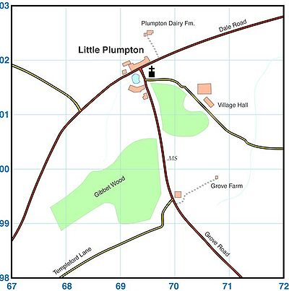
Map Reading Skills
Starter: Give the four figure grid references of letters A, B, C, D then E.
A
C
Give the six figure grid references of the points next to A, B, C, D then E.
D
B
E

Slide 2
Resources
A map must be clear and easy to read. Symbols are used to save space – they may be small drawings, lines or letters.

Slide 3
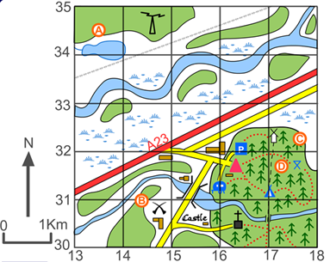
Resources
Demo: Give a six figure grid reference of the following:
(a) Mast
(b) Parking
(c) Church with spire
(d) Picnic Site
(e) Battlefield
Give a four figure grid square of one with:
(f) Marshland
(g) A river
(h) Coniferous woodland
(i) A Castle

