Slide 1
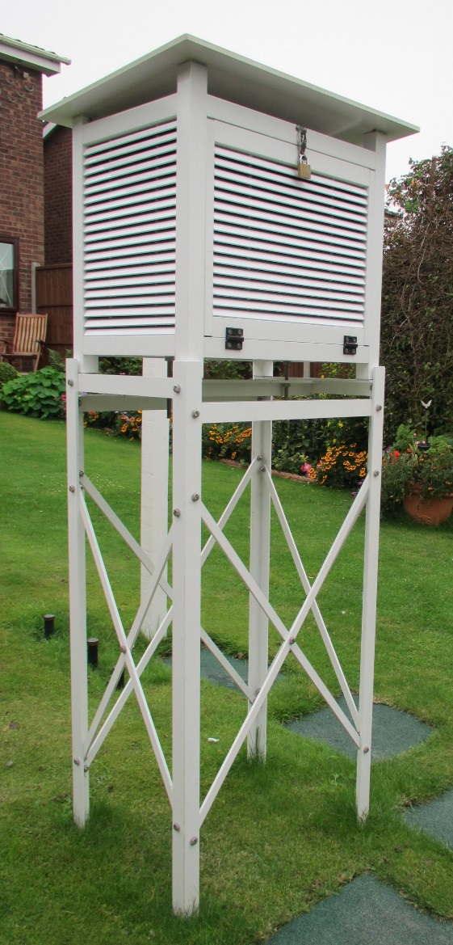
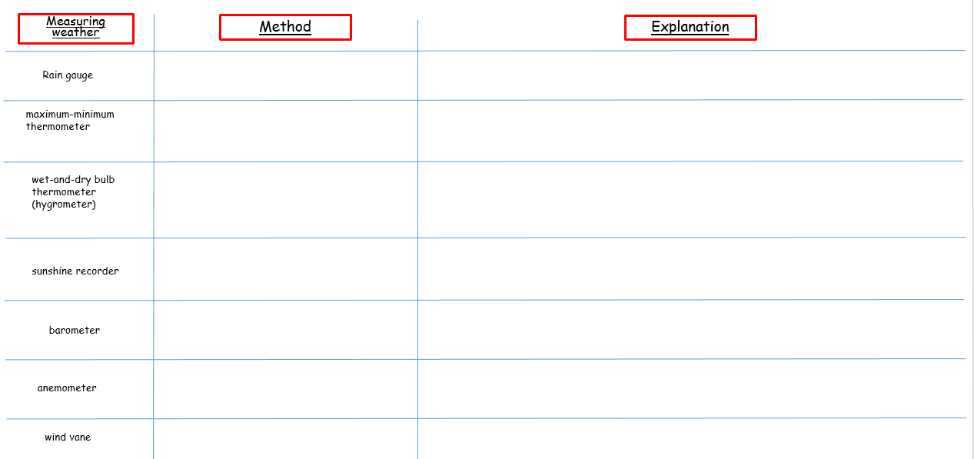
Weather
Learning Objective: To be able to explain how weather data is collected.
Stevenson screen
Starter: Complete your starter sheet. Use pages 140-146 to help you complete the table.
Challenge: Look at your past paper and attempt to answer the questions.

Slide 2
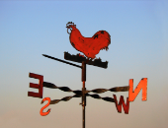
Weather (Recording the weather)
Learning Objective: To be able to explain how weather data is collected.
Stevenson screen
Starter: Complete your starter sheet. Use pages 140-146 to help you complete the table.
Wind vanes are used to check the direction of the wind. Compass points are used to give wind direction. Wind is measured in the direction that the wind is coming from. Wind vanes are often placed on top of buildings so that they are fully exposed to the wind. When using a wind vane you need to use a compass to make sure that it is properly aligned.

Slide 3
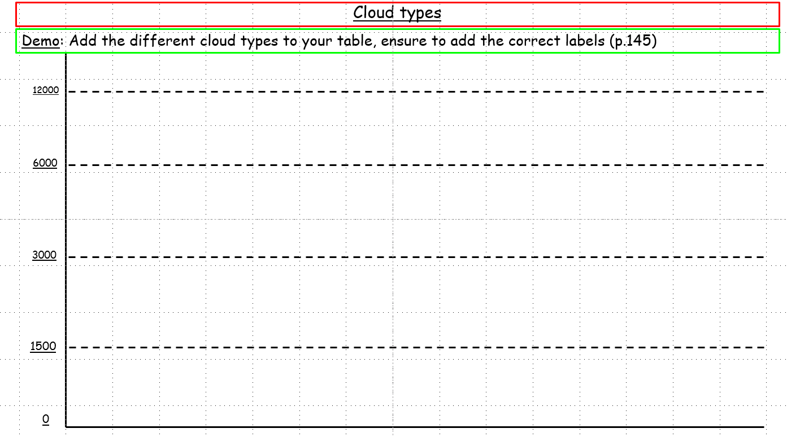
Clouds
It is also possible to count day light hours, sunshine hours or cloud cover. To Calculate day light hours you need to record the time between sun rise and sun set. To Calculate sun shine hours is a lot harder, because you have to time every time the sun comes out (stopwatch). To calculate cloud cover a mirror is often used. You divide the mirror into squares and then place the mirror on the ground. The mirror will reflect the clouds and you can count the number of squares covered or partially covered by cloud. You can do this as a percentage or convert to oktas, which is the normal measurement of cloud cover. You have to take several readings to avoid anomalous results.
Demo: Complete your worksheet on the different cloud types.
Use supporting material found on page. 145
Language for learning:
Clouds are a collection of water droplets or ice crystals. The warmer the air temperature, the more water vapour (gas) that the air can hold. However, when the air starts to cool, water vapour starts to condense as long as it has condensation nuclei to condense around.

Slide 4
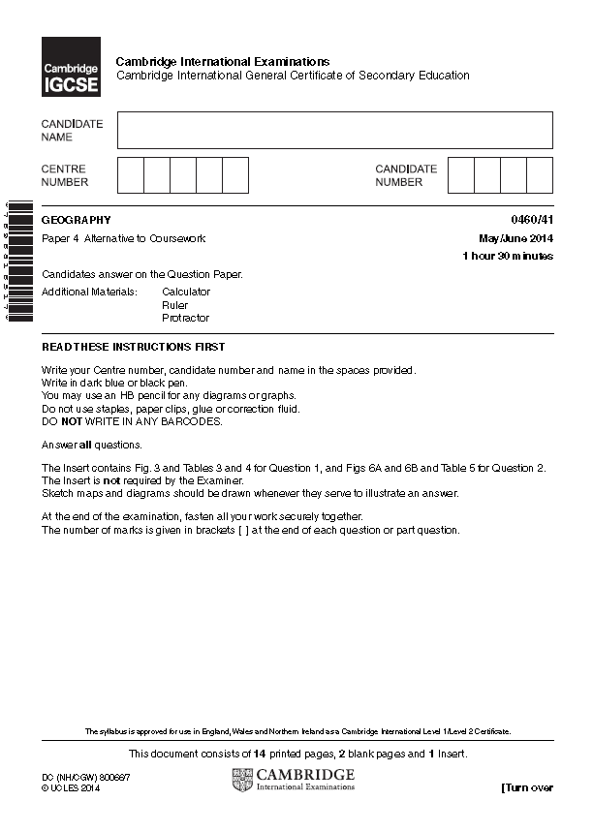
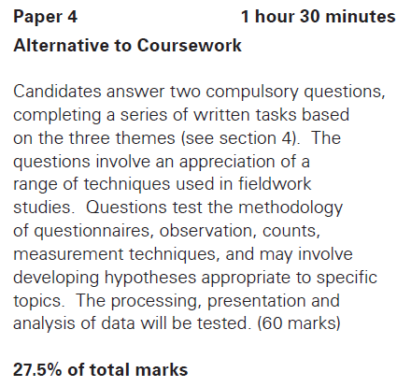
Paper 4
1 ½ Hours 60 marks worth 27.5% of your overall grade
Tip 2
Questions are not always easy to spot
It is often possible to miss questions on this paper. They can ask you to fill in table, complete graphs and many other activities. Do not always look for a questions but instead look for the box that tells you there are marks. It will look like this [2].
When you see marks there is always a question for you to answer.
Tip 1 Yes it really is that easy Do not over-complicate the question. They are asking you for straightforward things so as to assess your common sense.
Tip 3
You need to prove or disprove hypothesis
Any question asking you to look at data and a hypothesis will require you to say if the hypothesis is correct or not. Failure to do so can mean that you lose all the marks for that question. Even if you do not know you stand a 50% of getting it right so do not leave a blank.

Slide 5
Cloud types
Demo: Add the different cloud types to your table, ensure to add the correct labels (p.145)
12000
6000
3000
1500
0

Slide 6
Weather
Learning Objective: To be able to explain how weather data is collected.
Measuring weather
Method
Explanation
Rain gauge
maximum-minimum
thermometer
wet-and-dry bulb
thermometer (hygrometer)
sunshine recorder
barometer
anemometer
wind vane

