Slide 1
Case Study: Nigeria shell company
Learning Objective: To analyse the global patterns and trends in the production and consumption of oil.
Starter: Watch the Video and outline the problems faced by the country, criminal impacts on the company and what Shell is doing to "improve lives" of people in the country.
Challenge: To what extent can Shell be seen as a sustainable (SEEP) company in Nigeria?

Slide 2
Geopolitical Impacts
Learning Objective: To examine the geopolitical impacts of the increased demand for and production of oil.
Energy Security - What is the dilemma that the USA face? What do they feel it is in their national interest to do?
Fuelling Terror – What tensions exist between Saudi Arabia and the USA? Outline the problems. What role do Al-Qaeda play?
Threats to Oil Transport – Do a ‘find’ search on the page for “al-” How many times is Al-Qaeda mentioned? Outline the USA’s issues with transport and Al-Qaeda. What are the main threats and where?
The Geopolitics of Oil – Read and summarize. What are the issues relating to this article?
*Can it be trusted as completely accurate?
Homework: Watch the second half of the Videos (follow the link).
Homework: Also complete the reading provided.

Slide 3
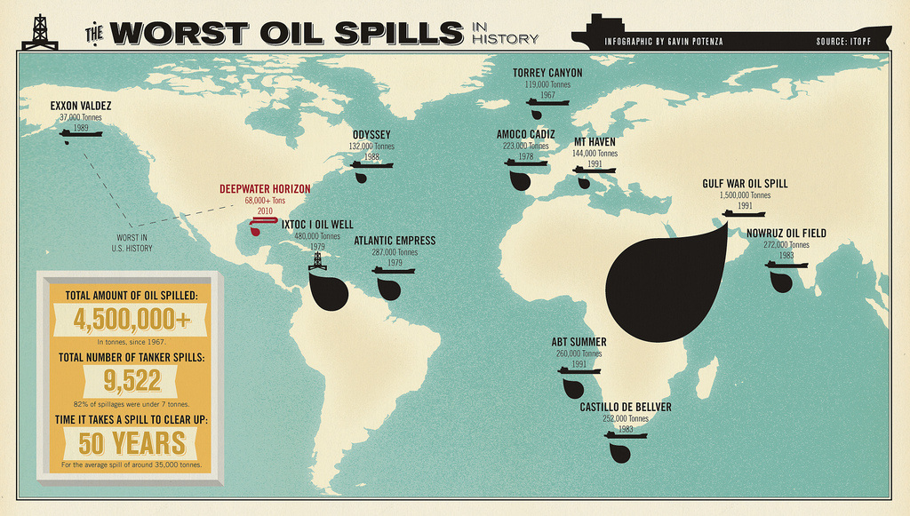
ENVIRONMENTAL IMPACT OF INCREASED OIL DEMAND
Learning objective: To examine the environmental impacts of the increased demand for and production of oil.
Case Studies: BP Oil Spill
Demo: Complete a case study sheet on the given case study.

Slide 4
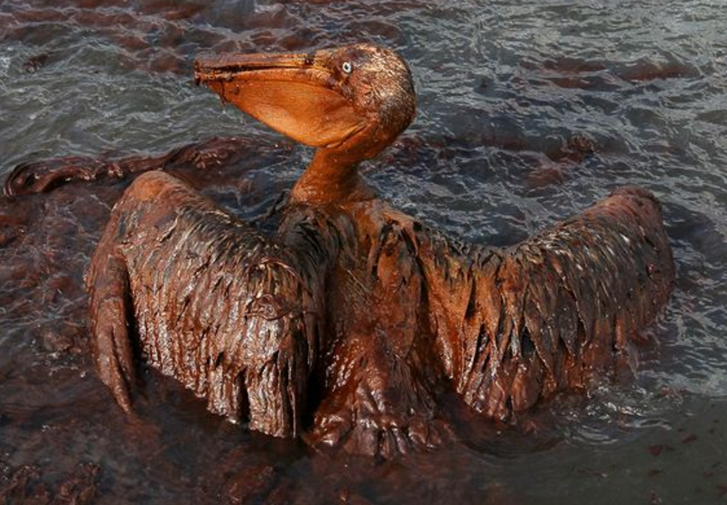
Case Studies: BP Oil Spill
Demo: Complete a case study sheet on the given case study.

Slide 5
Case Studies: Approaching your Case Study
Tip: Ensure to focus on these areas when covering any case study.
A01 Knowledge
Where?
A02 Analysis
When?
How?
A03 Evaluation
What has changed over time?
Geographical
language
Case Study
Can it be managed?
Facts & Figures
Why?
What?

Slide 6
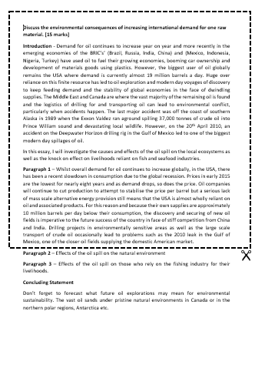
Homework
Exam Question: Discuss the environmental consequences of increasing international demand for one raw material. [15 marks]
Due by Friday the 11th March2016

Slide 7
Alternative Sources of Energy
Learning Objective: To examine the changing importance of other energy sources.
Demo: Read the chapter and summarise, definitions, data, exemplification and information on your worksheet.
Traditional Sources
Coal
Natural Gas
Oil
Nuclear
Renewable Sources
Hydro Electric power
Wind power
Biofuels
Solar
Geothermal Electricity
Tidal Power
Possible Exam Question: Examine the changing importance of three energy alternatives to oil [15 Marks].

Slide 8
Traditional Sources of Energy
Traditional Sources
Coal
Natural Gas
Oil
Nuclear

Slide 9
Alternative Sources of Energy
Renewable Sources
Hydro Electric power
Wind power
Biofuels
Solar
Geothermal Electricity
Tidal Power

