Slide 1
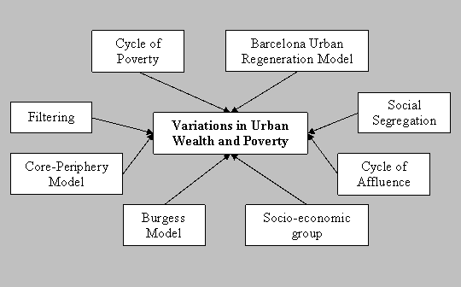
Urban Deprivation
Learning Objective: For students to be able to measure and explain urban deprivation through the use of a case study.
Language for Learning:
Urban decline is the deterioration of the inner city often caused by lack of investment and maintenance. It is often but not exclusively accompanied by a decline in population numbers, decreasing economic performance and unemployment.
Urban deprivation is a standard of leaving below that of the majority in a particular society that involves hardships and lack of access to resources. Places suffering from urban deprivation have visible differences in housing and economic opportunities been the rich living alongside poor people.
Starter: Define the term Urban decline and urban deprivation.

Slide 2
Urban Deprivation (LEDC VS medc)
Location
Processes of Urbanisation
Population and change
Urbanisation
Impact of these processes.
Slums and Urban deprivation

Slide 3
Urban Deprivation
Demo: What inner city problems arise due to urban deprivation?
Environmental Problems
Economic problems
Social Problems
Decay & deprivation of factories – seedbeds for crime e.g. drugs.
Lack of open space
Dereliction and poor state of repair causes depressing environment.
Air pollution
Local watercourses often badly polluted by factories.
Loss of business & industry – massive unemployment (51% above national average.
Few people can afford to own their own houses or invest any money.
Local authorities have little taxes so lack of investment in the local area.
Environmental decay – spiral of decline.
Businesses put off by high land prices, lack of space, high crime & traffic congestion.
Properties have deteriorated
High percentage of overcrowded households
Higher death & infant mortality rates
Lower life expectancy
Social segregation – Racial discrimination e.g. Brixton. People are socially excluded.
Persistent unemployment – culture of poverty
High levels of stress due to poverty – family breakdowns.

Slide 5
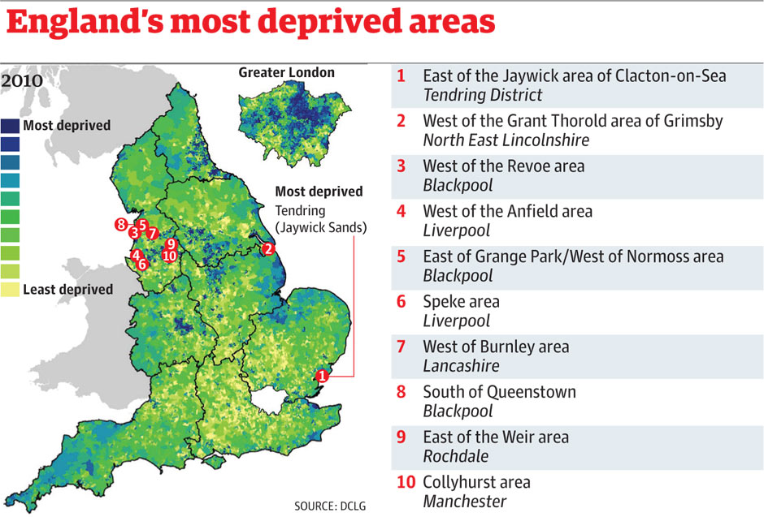
Urban Deprivation

Slide 6
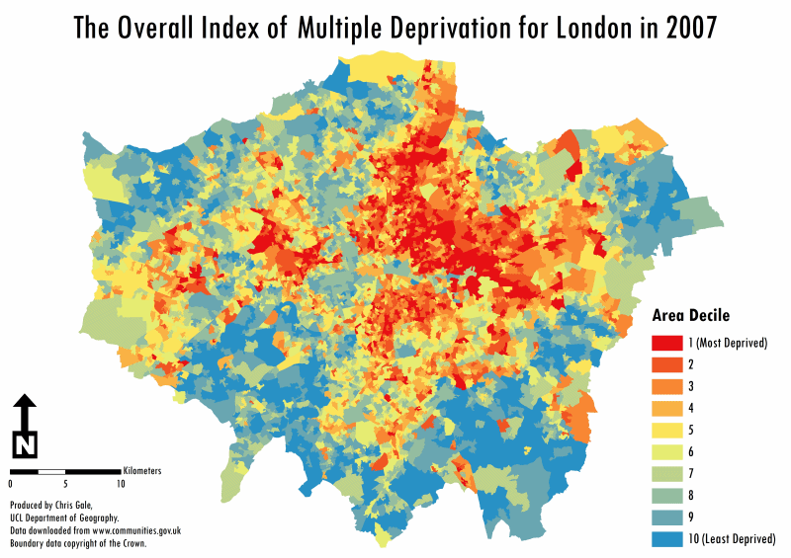
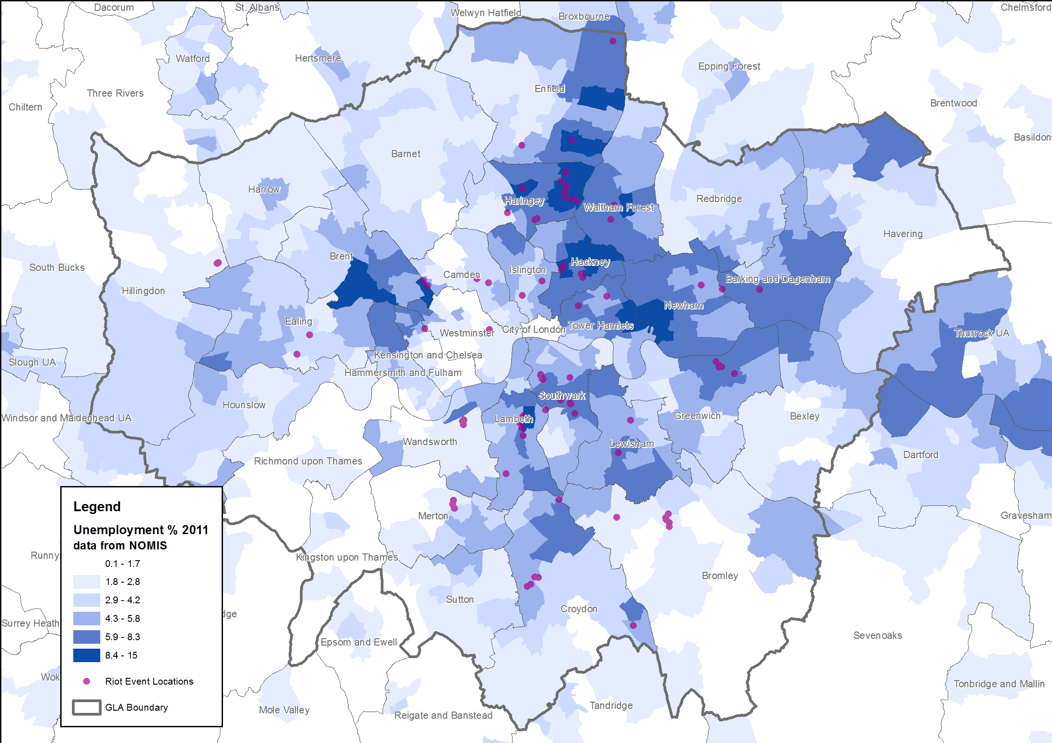
Urban Deprivation
Demo: How does Deprivation/Unemploymen/ ethnicity link together.
Linking your learning

Slide 7
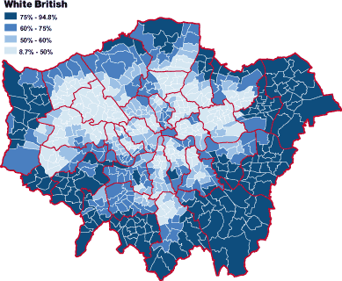
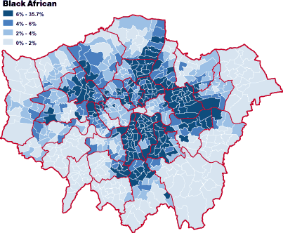
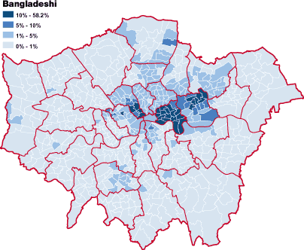
Mapping ethnicity in London
Darker areas are higher percentage

Slide 9
Urban Deprivation (London)
Employment
Education
Barking and Dagenham lowest:
Ethnic Minorities tend to be disadvantaged
2000/2011
Barking and Dagenham lowest:
Ethnic Minorities tend to be disadvantaged
2000/2011
Housing
Health
Barking and Dagenham lowest:
Ethnic Minorities tend to be disadvantaged
2000/2011
Barking and Dagenham lowest:
Ethnic Minorities tend to be disadvantaged
2000/2011

Slide 10
Urban Regernation
Demo: Read the Case Study Summery and highlight the solutions.
Reading
Manchester

