Slide 1
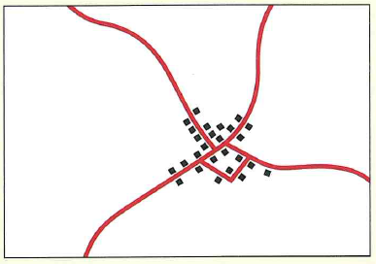
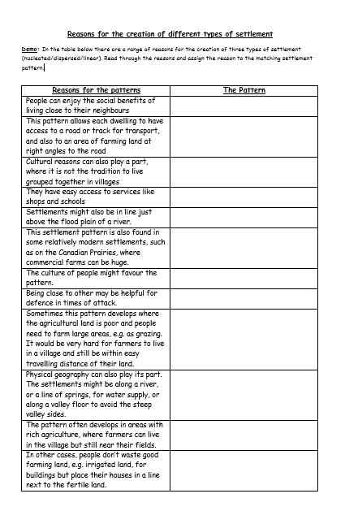
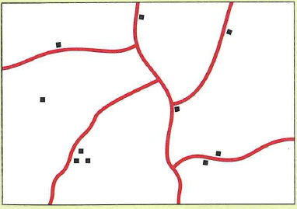
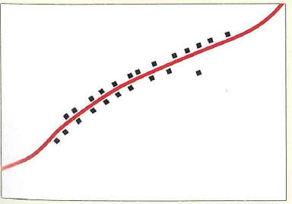
How to construct a settlement?
Settlement Pattern
Description
Reasons for this pattern
Dwellings are clustered together as villages, with fewer isolated dwellings. The shape of the villages is compact and more square or circular
Demo: Complete the provided worksheet.
Nucleated Settlement
Dispersed Settlement
There are scattered isolated dwellings and small hamlets with few villages
Settlements are in long thin rows, often along roads or tracks.
Linear Settlement

Slide 2
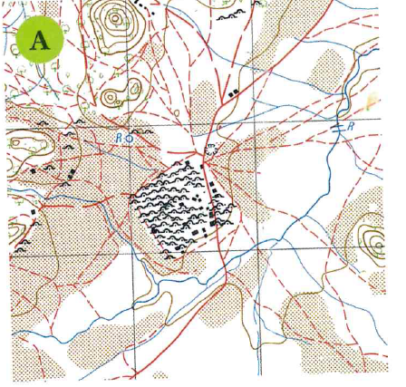
Question 1: What type of settlement is being shown?

Slide 3
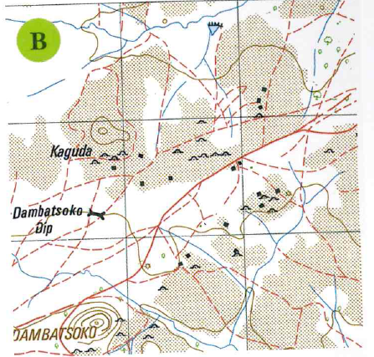
Question 2: What type of settlement is being shown?

Slide 4
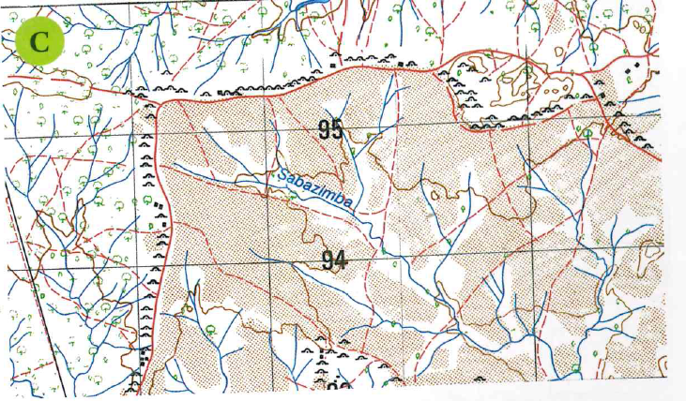
Question 3: What type of settlement is being shown?
Question 4 Suggest reasons as to why this settlement has formed this way.

Slide 5
Learning Check
Plenary: Stick the above note into your book and fill in the missing words from the choice below:
transport links/water/ more important/self sufficient/ change/amenities/heavy/bulky/defence
Location/factors
Best site for a settlement summary
1. ______________ ___________ are important when deciding where to build a settlement.
2. Location Factors can be weighted, that is some factors are ______ ________________ than others. _______ will be given a high weighting because it is needed every day, and it is ________ and _______ to carry far.
3. Location Factors will _________over time, for example in the Stone Age villagers had to be _____ ___________ and so factors regarding farming, building materials as well as __________ were very important.
4. Today villagers do not have to be self sufficient nor is defence an important factor, instead good ____________ ________ and a pleasant environment are important together with having a _______________ such as good shopping, hospitals and schools nearby.

Slide 6
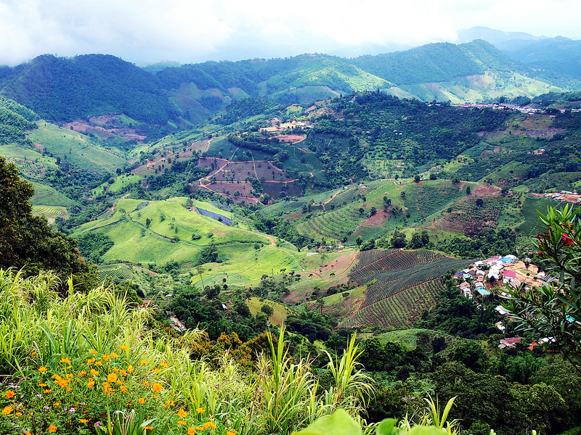
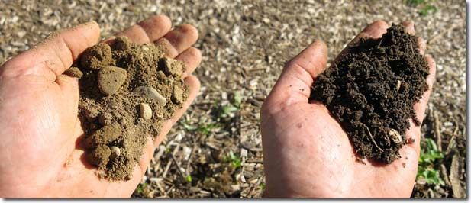
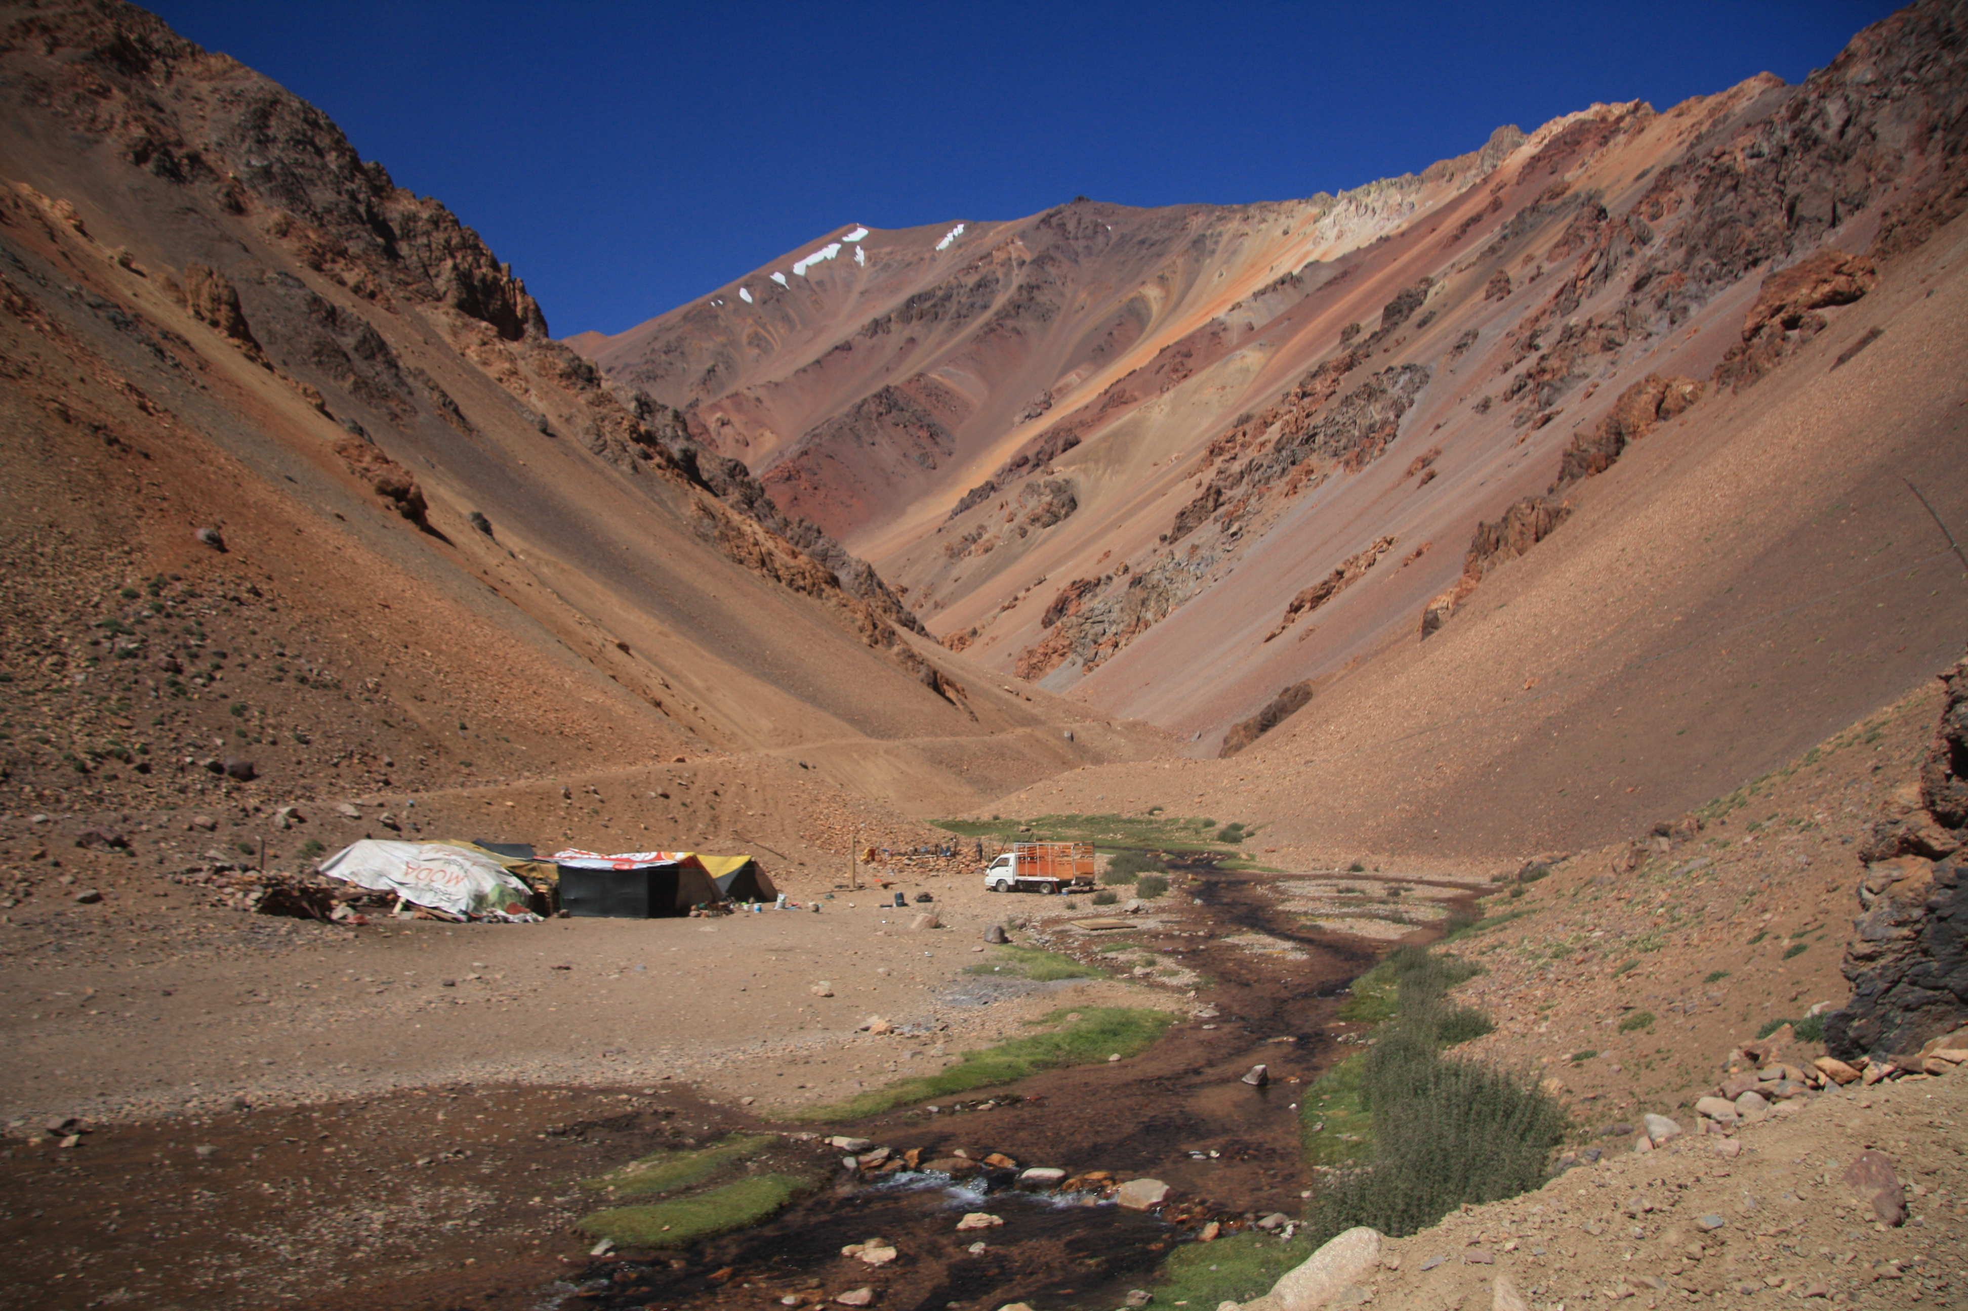
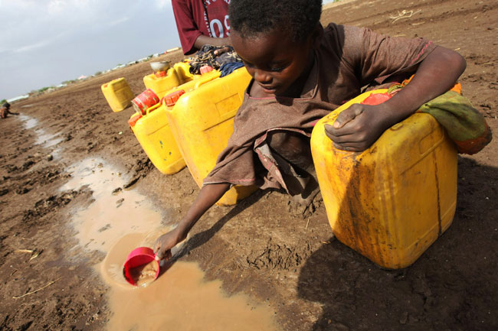
Factors influencing the sites and development
Learning Objectives: To be able to explain how physical factors (relief, soil, water supply, accessibility, resources) influence the sites and development of settlements.
Demo: Add your thoughts and ideas to the post it notes on your sheet. Focus question how do these 5 factors influence the sites and development of settlements.
Relief
Soil
Water Supply
Accessibility
Resources

Slide 7
Factors influencing the sites and development
Stage 1
Learning Objectives: To be able to explain how physical factors (relief, soil, water supply, accessibility, resources) influence the sites and development of settlements.
Demo: Add your thoughts and ideas to the post it notes on your sheet. Focus question how do these 5 factors influence the sites and development of settlements.
Relief:
……………………………………………………………………………………………………………………………………………………………………………………………………………………………………………………
Soil:
…………………………………………………………………………………………………………………………………………………………………………………………………………………………………………………………………………………………………………………………………………………………………………………………………………………………………………....
Resources:
…………………………………………………………………………………………………………………………………………………………………………………………………………………………………………………………………………………………………………………………………………………………………………………………………………………………………………....
Relief
Soil
Water Supply
Accessibility
Resources
Accessibility:
……………………………………………………………………………………………………………………………………………………………………………………………………………………………………………………………………………………………………………………………………………………………………………………………………………………………………………
Water Supply:
…………………………………………………………………………………………………………………………………………………………………………………………………………………………………………………………………………………………………………………………………………………………………………………………………………………………………………....

Slide 8
Factors influencing the sites and development
Stage 2
Learning Objectives: To be able to explain how physical factors (relief, soil, water supply, accessibility, resources) influence the sites and development of settlements.
Demo: Add your thoughts and ideas to the post it notes on your sheet. Focus question how do these 5 factors influence the sites and development of settlements.
Relief:
……………………………………………………………………………………………………………………………………………………………………………………………………………………………………………………
Soil:
…………………………………………………………………………………………………………………………………………………………………………………………………………………………………………………………………………………………………………………………………………………………………………………………………………………………………………....
Resources:
…………………………………………………………………………………………………………………………………………………………………………………………………………………………………………………………………………………………………………………………………………………………………………………………………………………………………………....
Relief
Soil
Water Supply
Accessibility
Resources
Accessibility:
……………………………………………………………………………………………………………………………………………………………………………………………………………………………………………………………………………………………………………………………………………………………………………………………………………………………………………
Water Supply:
…………………………………………………………………………………………………………………………………………………………………………………………………………………………………………………………………………………………………………………………………………………………………………………………………………………………………………....

Slide 9
Factors influencing the sites and development
Stage 3
Relief: This includes Altitude, gradient and aspect.
Altitude: alone is a rarely a factor influencing the site of settlements. Mountainous regions might be to cold to grow crops. They could also be covered in snow for much of the year. The lowest areas are sometimes sparsely populated because of poor drainage, disease and dense vegetation.
Gradient: Gentle slopes have the advantages of being well drained, easy to cultivate and easier to build on. Settlements are often located along valley floors
Aspect: is the direction the slope faces. East to west. The sun always rises in the east and sets in the west.
Soils: Areas with fertile soils are often more densely settled, because the greater productivity of the land can support a larger population. E.g. Alluvial soils (are soils deposited by running water and are often located in existing floodplains.) found in river valleys and the soils that develop on certain volcanic rocks, such as basalt.
Relief
Soil
Water Supply
Accessibility
Resources
Water Supply: Many settlements were first established next to rivers, springs and wells. Sites in otherwise dry areas, with reliable water supplies from rivers, springs and wells are called wet point sites.
In areas with large populations and a shortage of land (Bangladesh), flood plains are sometimes densely settled. Areas slightly higher than flood plains, with gentle well drained slopes, are good for farming and provide good sites for rural settlements. Higher points in otherwise poorly drained areas are known as dry point sites.
Resources(A resource is any physical material constituting part of Earth that people need and value. Natural materials become resources when humans value them. The uses and values of resources change from culture to culture and from time to time.)
Resources will determine whether a settlement can flourish or not.
Accessibility: The remotest settlements benefit from contact with other settlements to sell, buy and trade good and services. This falls in line with Linear settlements.

Slide 10
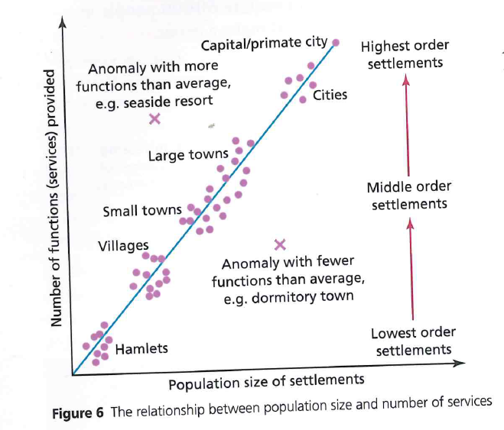
Settlements and Services
Demo: Look at Figure 6 and describe the relationship between population size and the number of services.
Services (sometimes called functions) are anything that is provided in a settlement for the population. These include retail-services (hairdressers), as well as public services like schools, hospitals, government, police, water and electricity.
Sphere of influence is the area served by a settlement.
Threshold population-This is the number of people needed to provide a large enough demand for a service.
Low order settlements-local shops/primary stores
High order settlements-Low order settlements

Slide 11
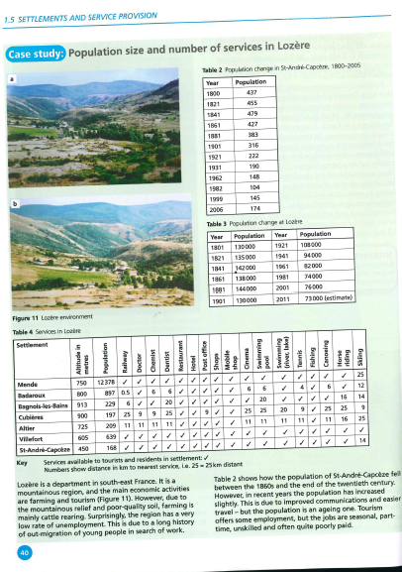
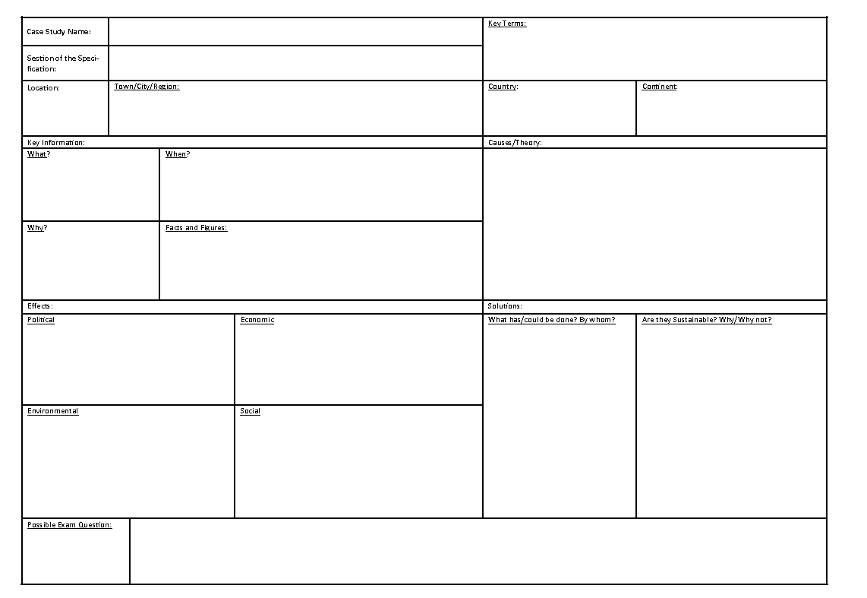
Case Study: Settlements and Services
Demo: Turn to page 40/41 and read through the case study. Complete the case study analysis .
Learning Objectives: To be able to explain how population size and number of services in Lozere and to be able to develop geographical skills.
Geographical skills:
Map Reading up to 6 Figure References
Able to read map symbols
Interpretation of graphs
Interpreting data
Description of relationships
Interpretation of settlement patterns
Use Map Evidence
Yes
No
Challenge: Complete a Case Study Card on Lozere.

Slide 12
Settlements and Services
1.
11A.
Key Terms: mountainous/Valley/Temperate Forest
11B
Economic opportunities>Agriculture/Tourism

Slide 13
Case Study: Settlements and Services
Describe the changes in population in the graph.
Between 1800 and 1841 there was an increase in population in Lozere. Since 1921 there has been a steady decrease in global population.
Suggest reasons for the change in population between.
Reasons
Decrease Increase
Migration
Ageing population
famine/Conflict/war
Peace
Migration
Family planning

Slide 14
Case Study: Settlements and Services
Demo: Compare the population changes in the Lozere department with those in St-Andre-Capceze.
Lozere department
St-Andre-Capceze

Slide 15
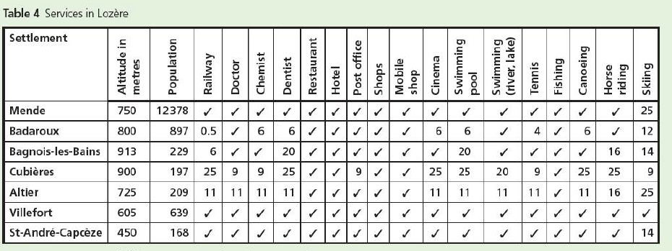
Case Study: Settlements and Services
Demo:

Slide 16
Settlement Hierarchy
Mega-cities (population over 10 million) are placed at the top of the pyramid because they have the highest population, a huge range and number of services and will be a long way from any other mega-cities.
Hamlets are placed at the bottom of the pyramid because they have very few people, possibly no services and they will be close to other hamlets.

Slide 17
Describe the changes in population in Lozere between 1801 and 2011 using the vocabulary below:
increased slight decrease fallen rose dropping
The population of Lozere ---- steadily between 1801 and 1841 from 130,000 to 142,000. In 1861 there was a ------ dip with the population -------- by 4,000 to 138,000. This number --------- again slightly to 144,000 in 1881. However, there was a dramatic -------- in population from 144,000 in 1881 to 74,000 in 1981. This number increased by 2,000 between 1981 and 2001, but had ------ again to 73,000 by 2011.

Slide 18
How to construct a settlement?
Settlement Pattern
Description
Reasons for this pattern
Revision Task

Slide 19
Settlement Hierarchy
Mega-cities (population over 10 million) are placed at the top of the pyramid because they have the highest population, a huge range and number of services and will be a long way from any other mega-cities.
Hamlets are placed at the bottom of the pyramid because they have very few people, possibly no services and they will be close to other hamlets.

