Slide 1
Freshwater
Learning Objective: Discuss the changing balance between water stored in oceans and ice.
1. The water system
Sub-topic | Development | Teaching hours | Reflection/Notes
The hydrological cycle | Examine the inputs, outputs, stores and transfers of the hydrological cycle. Discuss the causes and consequences of the changing balance between water stored in oceans and ice. | 3 hours
The water balance | Explain the concept of maximum sustainable yield of freshwater in terms of a balance between inputs and outputs.

Slide 2
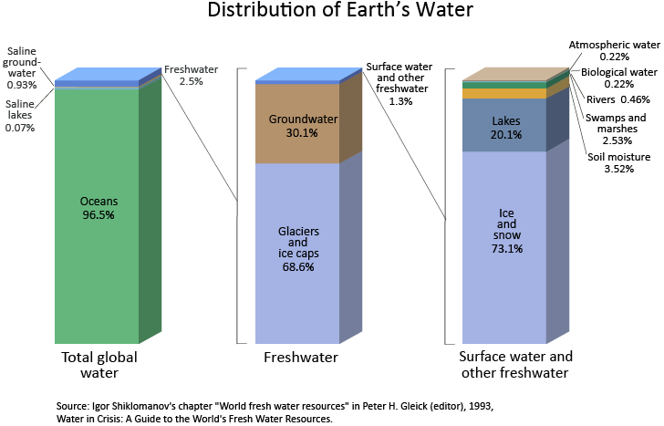
Water stored in ice and oceans

Slide 3
Water stored in ice and oceans
Permafrost: Ground that is permanently frozen. For permafrost to exits the ground temperature must be below freezing for the whole year, Permafrost contains large amounts of methane which is released when it melts.
Glacier: A slow moving river of ice ages. many of the world's glaciers are melting. The melting of glaciers at their snouts is known as ablation.
Ice sheet: Also known as a continental glacier, ice sheets are areas of ice over 50,000 square kilometres found on land. The world's only ice sheets are found on Antarctica and Greenland.
Iceberg: A large piece of ice that has broken off a glacier or ice shelf. 90% of icebergs are submerged underwater
Ice shelf: Thick floating platforms of ice. Ice shelves are between 100, and 1,000m thick
Sea ice: Frozen sea water. Seas like the Baltic Sea freeze during winter

Slide 4
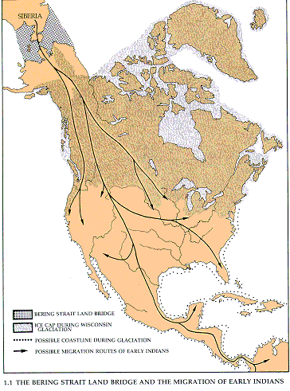
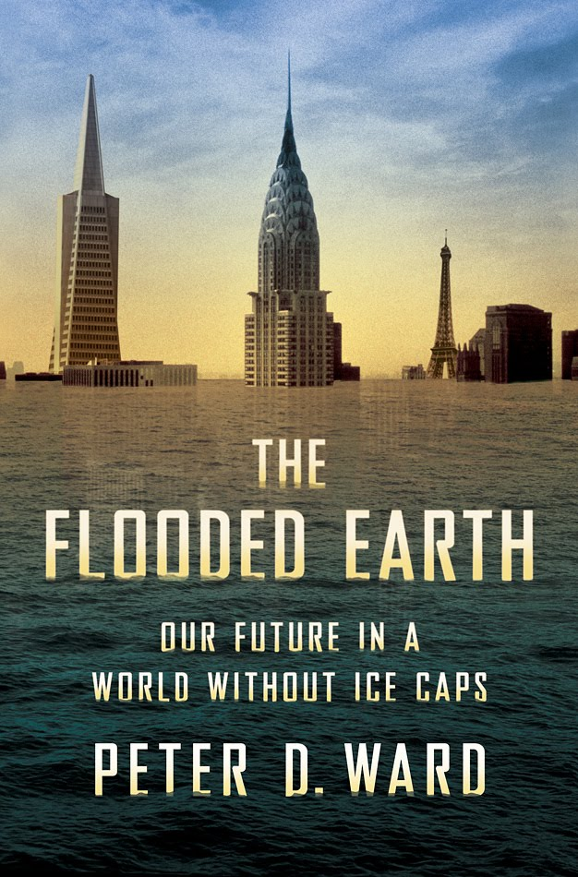
Water stored in ice and oceans
Land bridge between Siberia and North America

Slide 5
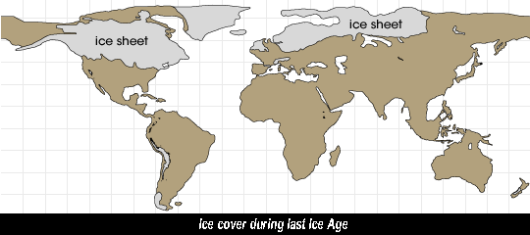
Water stored in ice and oceans

Slide 6
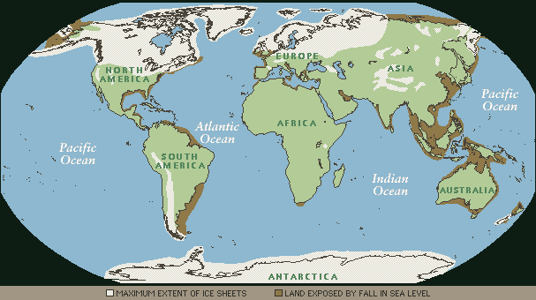
Water stored in ice and oceans

Slide 7
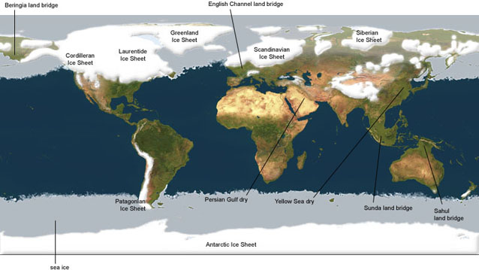
Water stored in ice and oceans

Slide 8
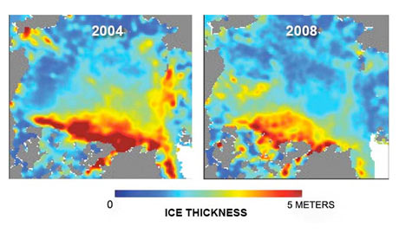
Water stored in ice and oceans

Slide 9
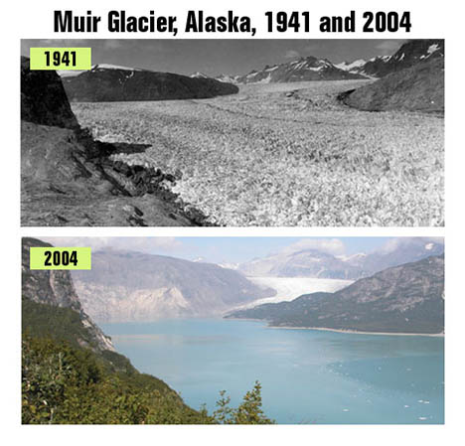

Slide 10
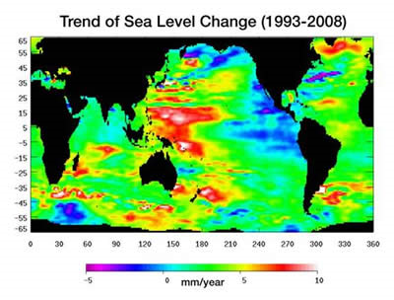
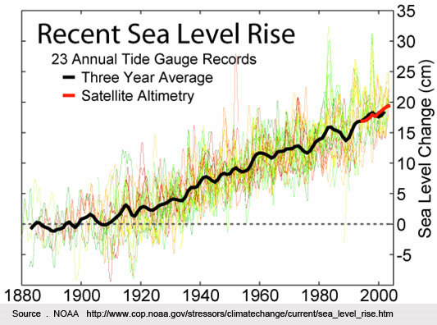
Water stored in ice and oceans

Slide 11
Changes to sea level

Slide 12
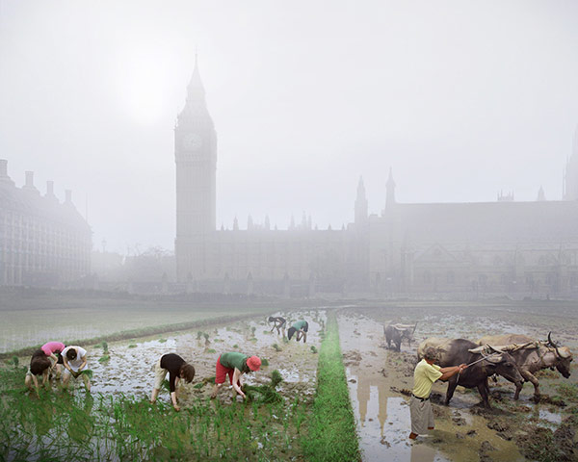

Slide 13
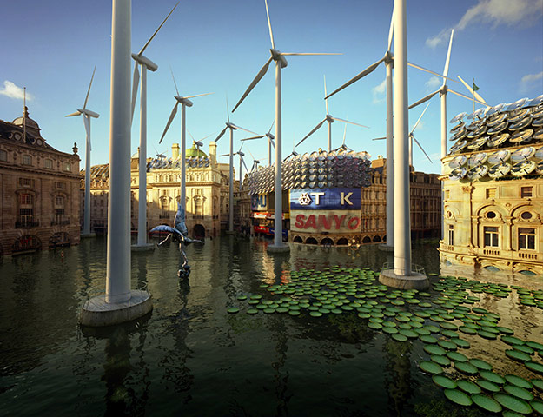

Slide 14
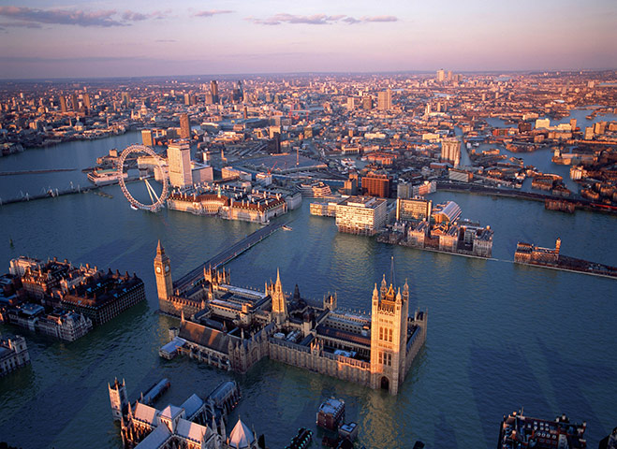

Slide 15
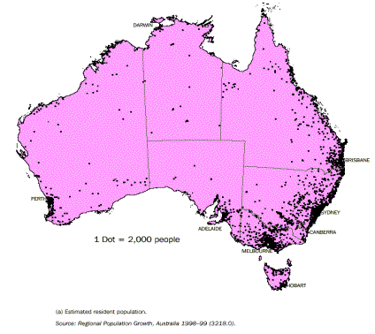
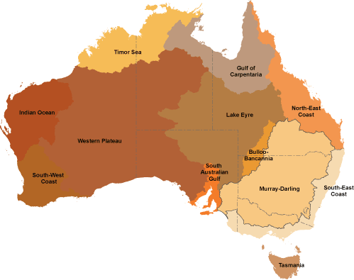
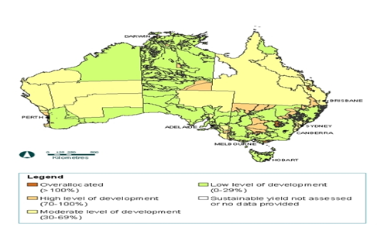
Maximum sustainable yield

