Slide 1
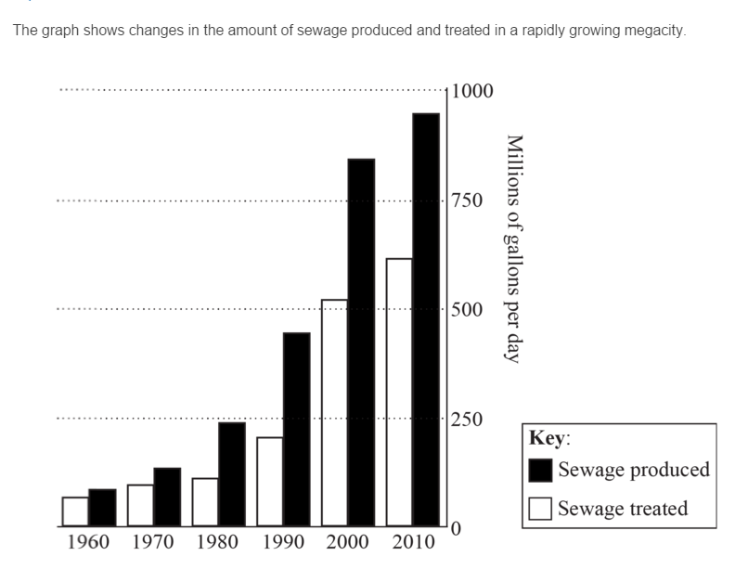
Urban Stress
Describe the trends shown in the graph. [4]
Explain three symptoms of urban stress. [3x2]
“Urban poverty and deprivation are widespread in all cities.” Discuss this statement. [10]
The amount of sewage produced and treated both increase
Sewage produced has increased at a faster rate than sewage treated
Rate of growth has slowed since 2000
Biggest increase between 1990 and 2000 in sewage produced and sewage treated
Provides quantification.

Slide 2
Explain three symptoms of urban stress. [3x2]
Urban stress is considered to be the inability of the urban system to cope with the demands of its population (either because of its size or its consumption). A01 Defined
Possible symptoms of urban stress could be: A02 Explain
pollution (air or water) beyond acceptable levels, for example, photochemical smog
widespread poverty, beyond ability of city authorities to provide social care
lack of adequate housing evidenced by high levels of homelessness or informal housing
inability of health services to cope with demands
possible outbreaks of epidemic disease
high levels of civil unrest or crime levels
widespread traffic congestion or poor transport infrastructure.
Answers referring to physiological stress symptoms should not be credited.
1 mark should be awarded for each valid symptom of actual stress with 1 mark for a more developed explanation or elaboration. Maximum 2 marks for a simple list of problems (for example, unemployment, pollution, etc.).
Surprisingly poorly done – many were able to list appropriate symptoms but explanations tended to be lacking or generalized. At standard level a number of responses incorrectly referred to the causes of urban growth or urban sprawl.

Slide 3
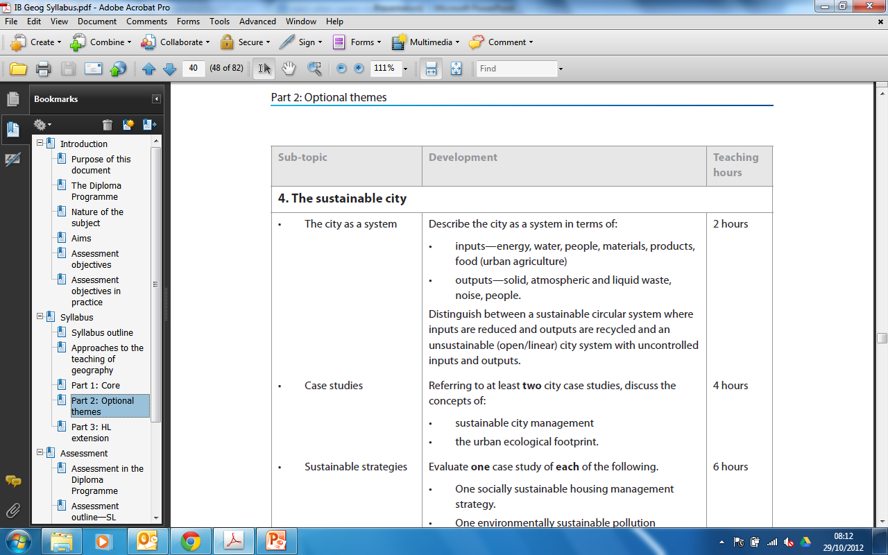
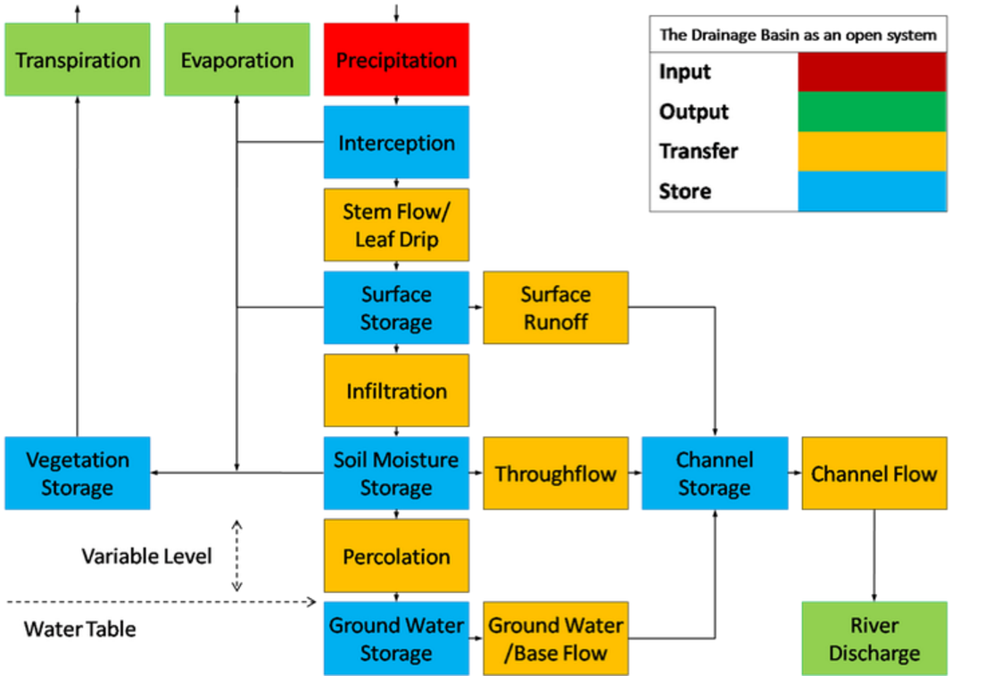
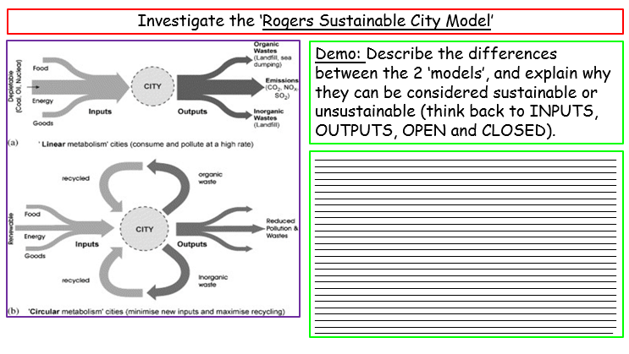
Sustainable Cities
Learning Objective: To be able to describe the city as a system, most importantly to distinguish between circular and open/linear systems.
Starter: Define and explain the terms OUTPUT and INPUT.
Linking your Learning
Challenge: Complete your worksheet that has been provided for you.

Slide 4

Millennium Development Goals
Environmental sustainability is actually Millennium Development Goal number seven. The goal has four targets The targets are:
Target 7a: Integrate the principles of sustainable development into country policies and programmes; reverse loss of environmental resources
Target 7b: Reduce biodiversity loss, achieving, by 2010, a significant reduction in the rate of loss
Target 7c: Reduce by half the proportion of people without sustainable access to safe drinking water and basic sanitation
Target 7d: Achieve significant improvement in lives of at least 100 million slum dwellers, by 2020

Slide 5
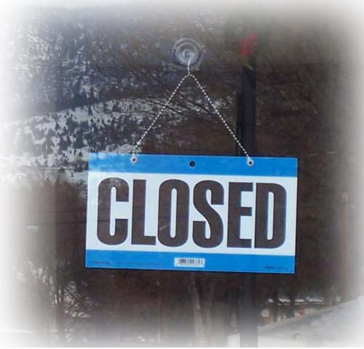

City systems can be either ‘closed’ or ‘open’.
Demo: What do you think these terms open and closed system mean?

Slide 6
Are Larger Cities the answer?
Large cities are often considered to be unsustainable systems because they consume large amounts of resources and produce vast amounts of waste.
Compact cities minimize the amount of distance travelled, use less space, require less infrastructure (pipes cables roads…), are easier to provide a public transport network for, and reduce urban sprawl.
BUT, if the compact city covers too large an area, it becomes CONGESTED, OVERCROWDED, OVERPRICED and POLLUTED. It then becomes unsustainable.
Demo: What needs to be done to make achieve sustainability? List your answers.
Improve economic security
Meet social, cultural and health needs
Minimize the use of non-renewable energy
Use finite renewable resources sustainability
Preserve Green Space

Slide 7
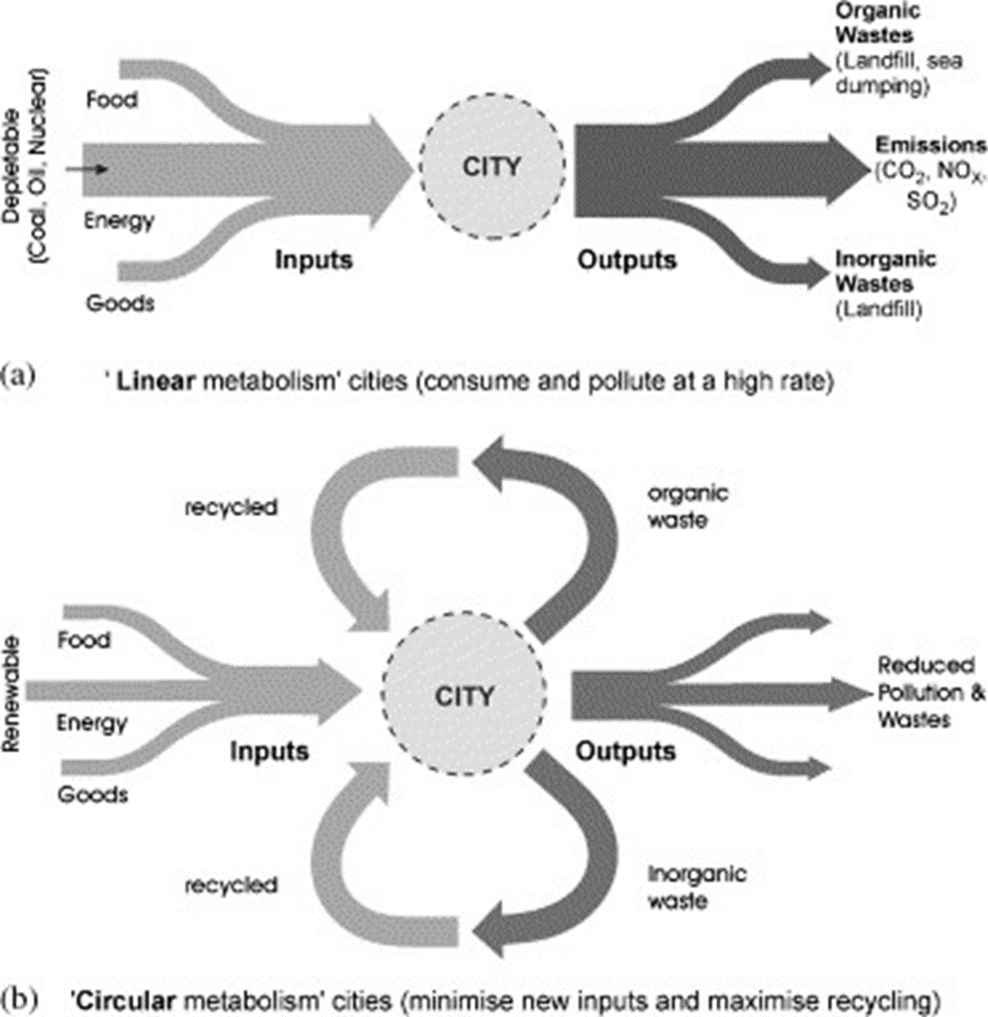
Investigate the ‘Rogers Sustainable City Model’
Demo: Describe the differences between the 2 ‘models’, and explain why they can be considered sustainable or unsustainable (think back to INPUTS, OUTPUTS, OPEN and CLOSED).
_______________________________________________________________________________________________________________________________________________________________________________________________________________________________________________________________________________________________________________________________________________________________________________________________________________________________________________________________________________________________________________________________________________________________________________________________________________________________________________________________________________________________________________________________________________________________________________________________________________________________________________________________________________________________________________________________________________________________________________________________________________________________________________________________________________________________________________________________________________________________________________________________________________________________________________________________________________________________________________________________________________________________________________________________________________________________________________________________________________________________________________________________________________________________________________________________________________________________________________________________________________________________________________________________________________________________________________________________________________________________________________________________________________________________________________________________________________________________________________________________________________________________________________________________________________________________________________________________________________________________________________________________________________________________________________________________________________________________________________________________________________________________________________________________________________________________________________________________________________________________________________________________________________________________________________________________________________________

Slide 8
What is SUSTAINABILITY?
Demo: Which system (linear or cyclical) is most likely to be more sustainable? Why? Evidence?
Writing Frame:
Markscheme:
Have you defined the two systems?
Have you stated which one is more likely to be sustainable?
Have you provided Evidence as to why that system maybe more sustainable?
Can you link this to a real life example?
An ecocity is… • An ecologically healthy human settlement modelled on the self-sustaining resilient structure and function of natural ecosystems and living organisms. • An entity that includes its inhabitants and their ecological impacts.
Challenge: Is a sustainable city the same as an eco-city?

Slide 9

Urban Ecological Footprint
The ecological footprint is a measure of human demand on the Earth's ecosystems, the amount of natural capital used each year. The footprint of a region can be contrasted with the natural resources it generates.
Demo: Ensure to make notes on the Ecological Handprints.
Problems
Solutions

Slide 10
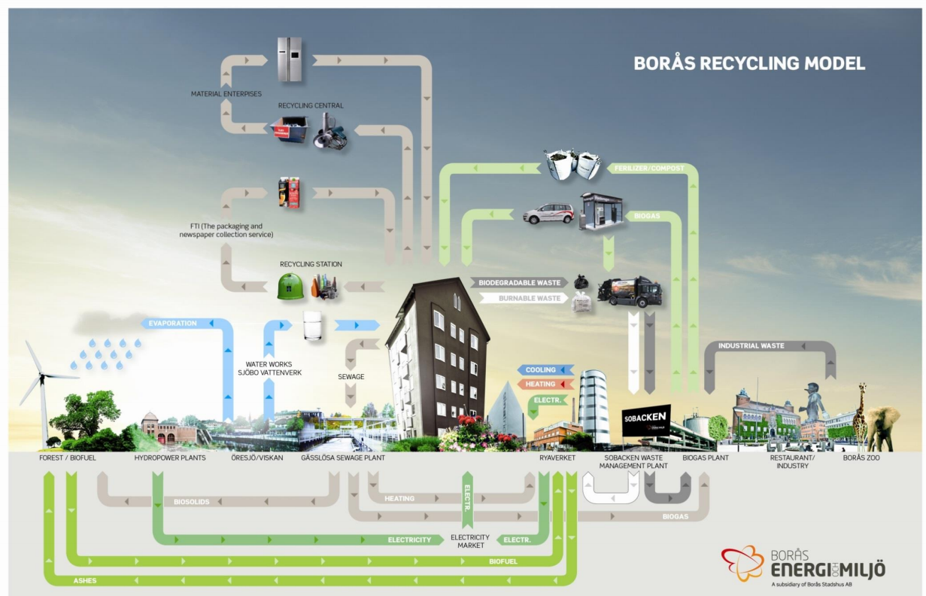

Slide 11
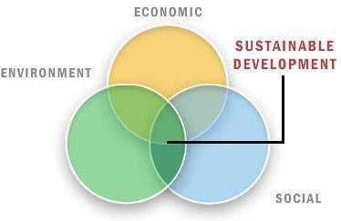
Sustainable Cities
Sustainable Development: Meeting the needs of today's population without compromising the needs of future generations. Today sustainable development is usually considered to include environmental, social and economic sustainability (see definitions below). If development includes social, economic and environmental aspects then it is considered to be sustainable development.
Stewardship: The act of overseeing the protection of something e.g. rainforests.
Conservation: The act of preserving and protecting something.
Environment: The things that surround you. In Geography when we talk about the environment we normally mean the natural things that surround you e.g. trees, rivers, mountains and lakes.
Demo:
Make sure to get the key language (definitions) down in your notes.
What does this mean and how might this be achieved?

Slide 12
Sustainable Cities
Environmental Sustainability | Economic Sustainability | Social Sustainability
Definition: Improvements in the standard of living that do not cause long-term damage to the environment that impact future generations. | Definition: Development that includes everyone, where everyone has the right of economic improvement. The development should be long-term and devoid of corruption and burdening debt. | Definition: Development that is inclusive and ensures an improvement in the standard of living for all. It should incorporate everyone and ensure equal access to healthcare, education, resources, etc. while respecting individual cultures.
What does it include: Protecting biodiversity Stopping human caused climate change Elimination of acid rain Elimination of damage to ozone layer Reduction of pollution (air, water, noise, etc.) Management of resources e.g. fish, water | What does it include: Access to finance No corruption (kleptocratic governments) No absolute poverty No extortion No nepotism Debt removal? | ,What does it include: Freedom of speech Health and safety at work Access to clean water and sanitation Access to needs i.e. water, food, shelter, clothing Access to education Access to health care Equality between sexes, religions, etc. Right to vote Access to justice Safety - no threat from crime Respect of cultures

Slide 13
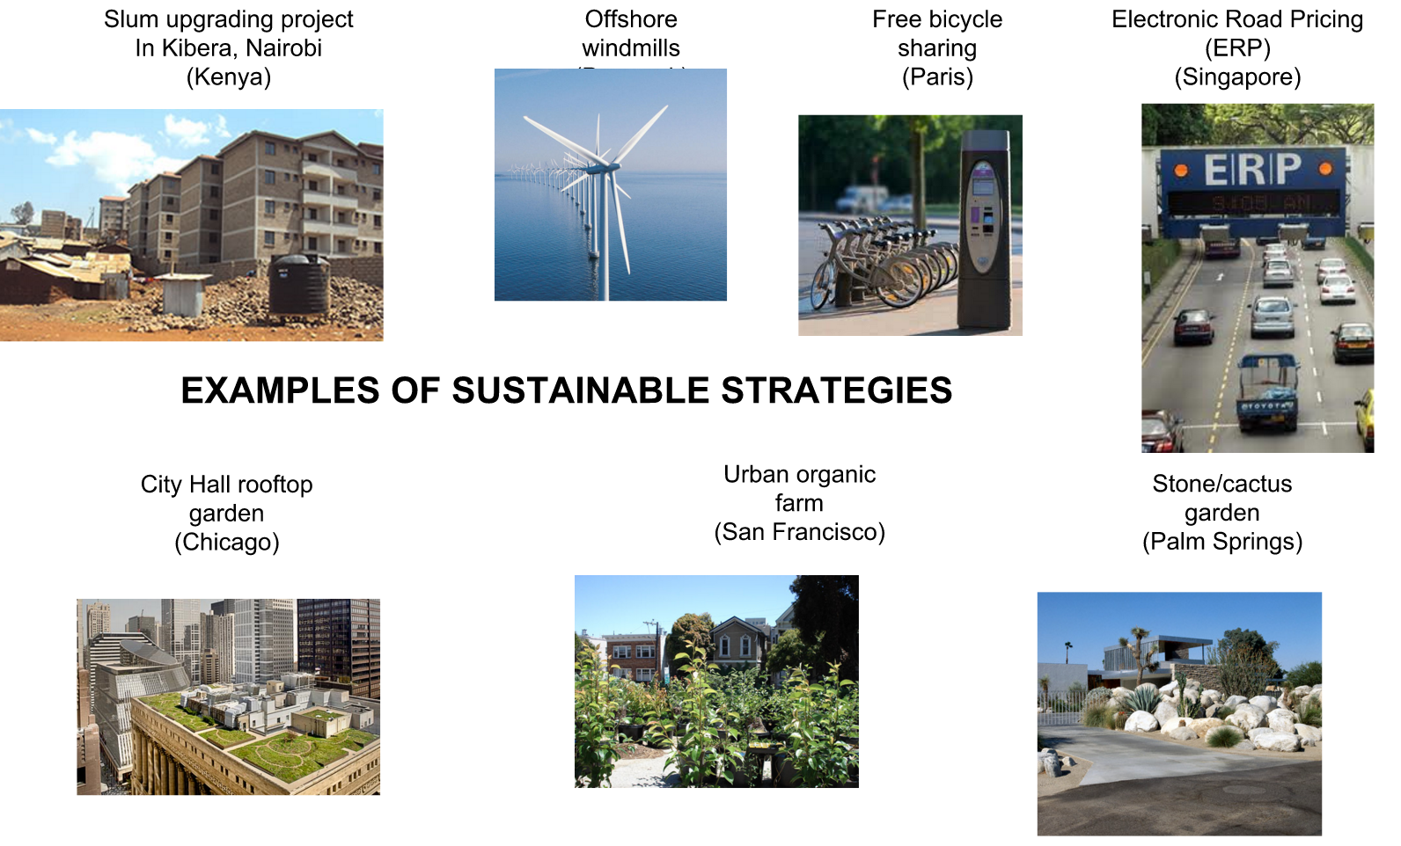

Slide 14
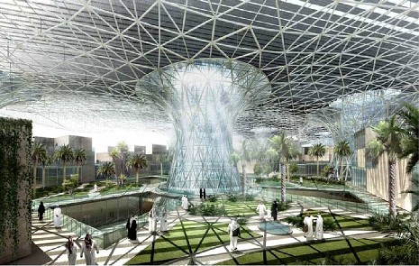
Masdar United Arab Emirates (UAE)
Demo: Watch the Video and make notes on how Masdar is creating a sustainable city.

Slide 15
Exam Question
Evaluate one or more sustainable strategies designed to improve life in urban areas. [10]
The sustainable strategy chosen is likely to be one that addresses either a social issue (housing quality), environmental issue (air, water, land resources) or overall city growth (and in-migration) – in ways that seek to maintain and improve the quality of life for current and future urban dwellers.
Responses should go beyond mere description of a management strategy. Answers should provide effective evaluation, addressing both positive and negative aspects of the strategy, the problems encountered and some conclusion on the success of the scheme. Answers that do all of this will access bands E/F.
Answers that evaluate an urban management strategy that is not explicitly sustainable (does not mention future generations or ecological footprints etc.) should be limited to band D.
Marks should be allocated according to the mark bands.
Most answers simply explained the existence of squatter settlements without referring to areas of high and low deprivation and their relative locations in a city in a low-income country. There were some good answers, though at both levels, many were overly descriptive and had only very limited evaluation. Frequently, relevant strategies were detailed without saying how they related to sustainability.

Slide 16


Plenary
Learning Objective: To be able to describe the city as a system, most importantly to distinguish between circular and open/linear systems.
Plenary: Reflect on whether you have enough information to for fill the below learning Outcome.
Learning Outcome
Application to Exam
Homework
Students should be able to:
AO1 Define key language and concepts
A02 Analyse and apply key concepts
A03 Evaluate how and why it might the two case studies be overpopulated and underpopulated.
A04 Be able to read and interpret population density graphs and maps.
"Gender inequality exists to some extent, in most areas of society, in all countries of the world." Geographically examine this statement. 15 Marks
Listen to the Podcast below and make notes on the issues discussed.

Slide 17
Sustainable vs Unsustainable
Demo: Describe the differences between a sustainable city and an unsustainable city. Use Model A within your answer.
Class Answer:
Model A

