Slide 1
Crime and Inequality
“For many people, especially those who belong to the middle class and elite and to government circles, it is the urban poor who are responsible for violence and crime in the cities.”

Slide 2
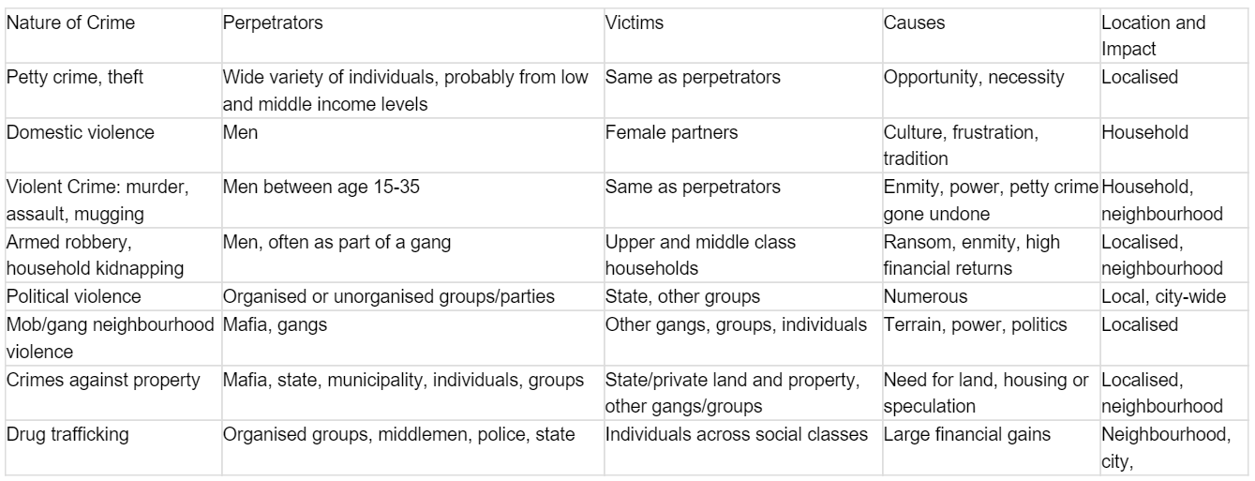
The distribution of crime in the city

Slide 3
Case Study
Symptoms of Urban Stress
Case Study
Background/Causes-Effects
Facts and Figures
congestion
overcrowding and noise
depletion of green space
waste overburden
poor quality housing
social deprivation
crime and inequality

Slide 4
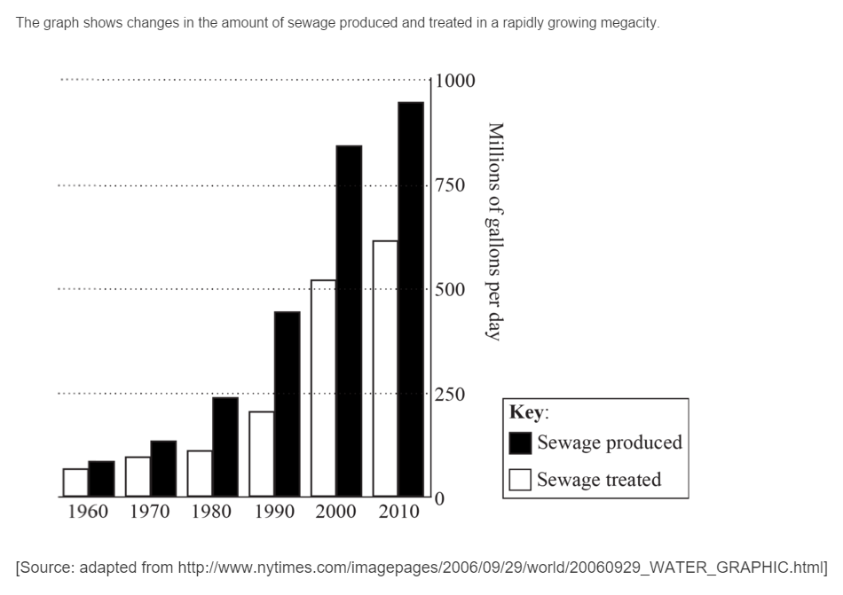
Exam Questions:
A. Describe the trends shown in the graph.[4]
B. Explain three symptoms of urban stress. [3x2]
C. “Urban poverty and deprivation are widespread in all cities.” Discuss this statement.[10]

Slide 5
Markscheme
A. The amount of sewage produced and treated both increase
Sewage produced has increased at a faster rate than sewage treated
Rate of growth has slowed since 2000
Biggest increase between 1990 and 2000 in sewage produced and sewage treated
Provides quantification.
Award 1 mark for each valid point. Quantification is needed for the award of the full 4 marks.
A04
Urban stress is considered to be the inability of the urban system to cope with the demands of its population (either because of its size or its consumption).
Possible symptoms of urban stress could be:
pollution (air or water) beyond acceptable levels, for example, photochemical smog
widespread poverty, beyond ability of city authorities to provide social care
lack of adequate housing evidenced by high levels of homelessness or informal housing
inability of health services to cope with demands
possible outbreaks of epidemic disease
high levels of civil unrest or crime levels
widespread traffic congestion or poor transport infrastructure.
Answers referring to physiological stress symptoms should not be credited.
1 mark should be awarded for each valid symptom of actual stress with 1 mark for a more developed explanation or elaboration. Maximum 2 marks for a simple list of problems (for example, unemployment, pollution, etc.).
A01
A02

Slide 6
Markscheme
C. Answers could approach the question in several valid ways.
A starting approach is to examine differences in poverty and deprivation within one urban area. This approach could argue that it is widespread in the chosen example and agree with the statement – this is sufficient for band D if well exemplified. An answer that shows that it is not widespread in a single city, and therefore disagrees with the statement could reach bands E/F.
Another approach is to look at contrasting urban areas and examine differences in poverty and deprivation between cities. This approach would most likely show that poverty and deprivation are more widespread in some cities than others. Such responses are also likely to reach bands E/F if they are detailed.
Marks should be allocated according to the mark bands.

