Slide 1
Essay Feedback
Starter: Look at the answer given to you and highlight the things that this candidate has done well.
List Three things this Candidate has done well.

Slide 2
Examiner Feedback
There were some inappropriate examples seen – the most common being California rather than USA or a continent given rather than a country i.e. Europe or Africa. Ideas were often not well developed as candidates listed push and pull factors rather than explaining them. There were many references to the impact of migration in the host or losing country which were irrelevant to the question being asked. Place specific information was rarely seen. The majority of candidates gained simple Level 1 marks with some gaining Level 2 but very few gaining Level 3. Many candidates also listed opposites which do not get double credit e.g. ‘a push factor is low pay and a pull factor is higher pay’ this would only gain 1 mark. Candidates need to be aware of a variety of push and pull factors and be able to develop them fully.
Rules:
Don’t List ideas, develop ideas.
Place specific information is required.
A variety of push and pull factors

Slide 3
Learning Check
Exam Question: The population of a country can change as a result of migration.
Choose an example of an international migration which you have studied and name the countries between which people moved. By reference to both pull and push factors, explain why many people made the decision to migrate.
Example of international migration From .............................. to .......................... (7)
level 1 [1–3 marks)] | Level 2 [4–6 marks] | Level 3 [7 marks]
Statements including limited detail which suggest reasons for international migration. | Uses named example. More developed statements which explain reasons for international migration. NB MAX 5 with no named example. | Uses named example (e.g. Turkey to Germany). Comprehensive and accurate statements referring to both pulls and pushes , including some place specific reference. [7] Candidates may refer to ideas such as: Employment opportunities Salary Services Food supply War Drought Natural disaster

Slide 4
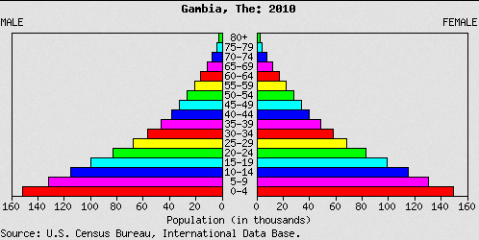
Starter sheet: Gambia
Learning Objective: To explain and evaluate the problems a country may face that has a high dependent population.
Starter : On your sheet mark the dependents on the population pyramid and anything else that you may be able to identify.

Slide 5
Dependents
Dependency ratio is the relationship between the working or economically active population and the non-working population.
Find the formula below
% population aged 0-14 +
% population aged 65 and over
%population aged 15-64
× 100
A dependency ratio of 60 means that for every 100 people in the economically active population there are 60 people dependent on them.
Demo: What limitations might this theory have?

Slide 6
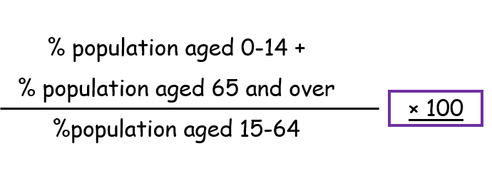
Own calculations
Reminder of the equation
Demo: Using the equation above, calculate the dependency ratio for:
% population aged 0-14 + | % population aged 65 and over | %population aged 15-64
41.47% | 2.55% | 55.98%
Challenge: What does the result mean and for what country might it be? Justify your answer.

Slide 7
Dependency rates
Homework
Homework
Country | % population aged 0-14 + | % population aged 65 and over | %population aged 15-64 | Dependency ratio
Germany
Japan
Gambia
Bangladesh
Australia

Slide 8
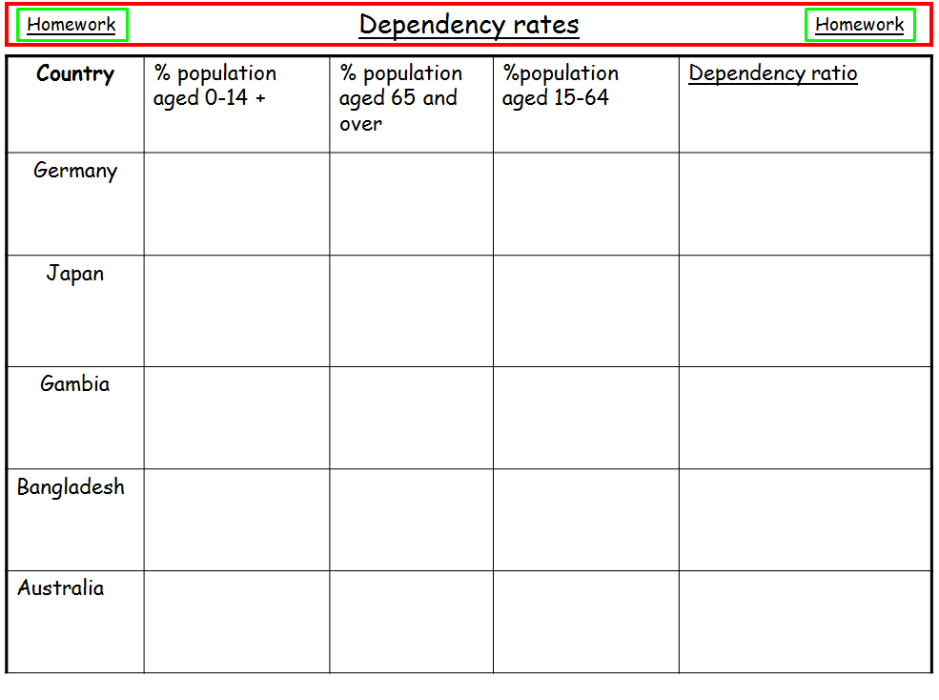
Own Calculation
Homework: Please complete the homework sheet and calculate the dependency ration for each of the nations. Please ensure to show your working out on a separate sheet.
Homework: Please also write down the source of your information. To help you out I have provided some guidance. Please see below.
Sources:
www.quandl.com
www.gapminder.org
www.data.worldbank.org
www.cia.gov

Slide 9
Assessment for learning – interim progress check
Learning Objective: To explain and evaluate the problems a country may face that has a high dependent population.
Please complete the activity below reflecting on your learning so far in today’s lesson:
So far in this lesson, I have learnt:

Slide 10
Gambia
Learning Objective: To explain and evaluate the impacts (positive and negative) of a country with a high dependent population
Demo: Turn to page 30 in your book and answer the three questions.
Describe the location of Gambia.
Learning Tip: Ensure to use Name-Number-North
2. What is the dependency ratio in Gambia and why is it so high?
Learning Tip: Ensure to use data in your answer and provide a detailed explanation.
3. What are the problems of such a high rate of dependency in the Gambia?
Learning Tip: Ensure to think about all aspects (Social-Economic-Environmental-Political)

Slide 11
Plenary: Gambia
Learning Objective: To explain and evaluate the impacts (positive and negative) of a country with a high dependent population.
Please pack everything away
1. Teams are made up of max 3 individuals.
2. Choose a Team name.
3. Get ready to answer the quiz questions.

