Slide 1
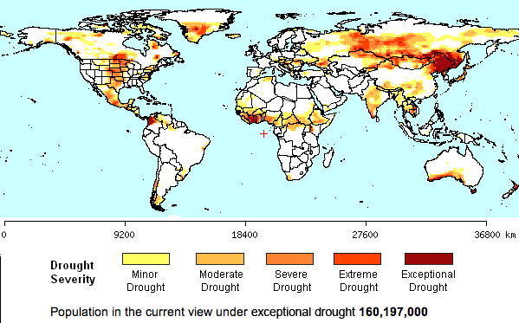
What is drought?
Learning Objective: Explain the causes of drought, explain its distribution and
Starter: Comment on the global distribution of extreme and exceptional drought events.

Slide 2
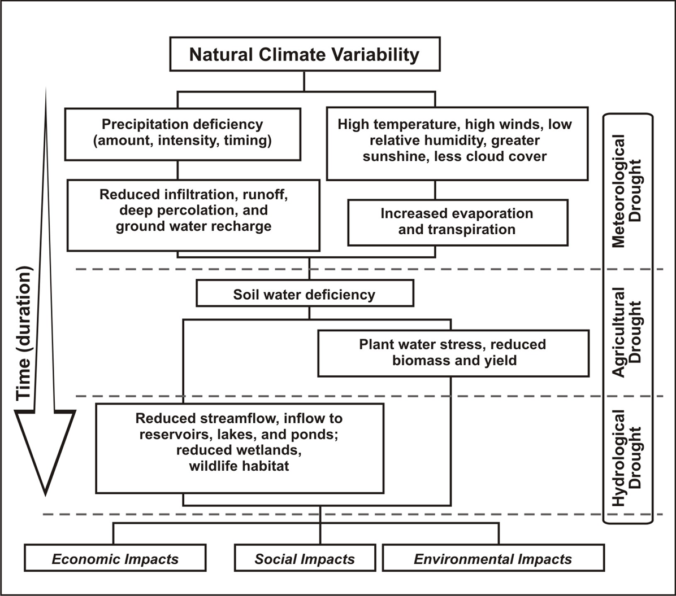
Defining Drought
Language for Learning:
Drought- A prolonged period of months and years where supply of water falls below demand.
Demo: Make notes on the different types of hydrological droughts.
Meteorological Drought
Agricultural Drought
Hydrological Drought

Slide 3
Why do droughts occur?
Demo: List reasons as to why droughts occur.
Reasons as to why droughts occur

Slide 4
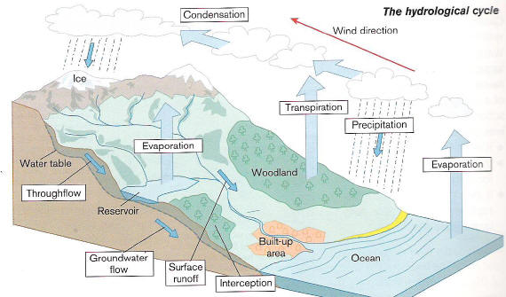
Explain the Hydrological Cycle
Demo: Now you need to draw the Hydrological Cycle for yourself.
Challenge: Explain what happens when part of the hydrological cycle does not occur, explain some of the problems that a community might have.
Notes:
Use jelly babies and the information cards to play

Slide 5
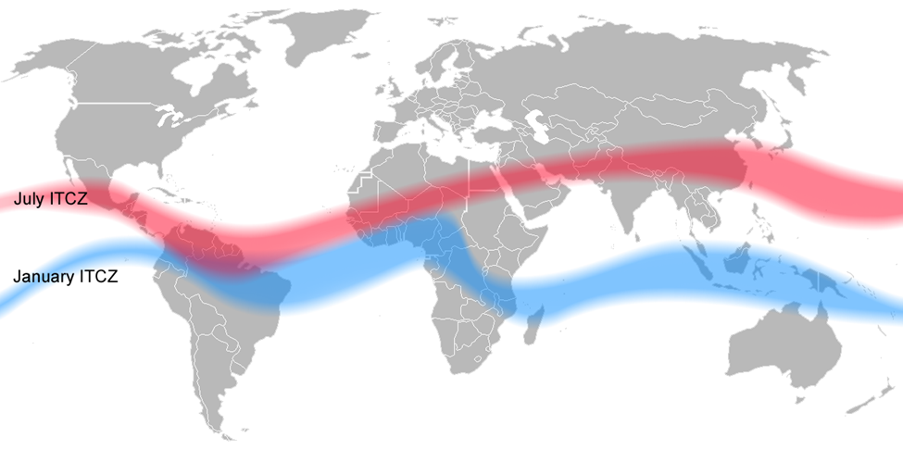
Why do droughts occur? 1. Shifting ITCZ
The ITCZ can shift in position (see map below) depending on the movement of the overhead sun thus, locations that lie within this fluctuating zone will experience wet and dry seasons with rainfall lasting for 5 to 6 months a year on average. The dry seasons will tend to occur with the period where the sub-tropical high-pressure belts lies across a particular area (20-30° North and South) due to the shifting of the ITCZ. This area will experience high pressure which prevents the formation of rain clouds thus, leading to the formation of deserts. The size of these areas will also vary from year to year and in years where the areas are larger, droughts along the desert edges will occur.

Slide 6
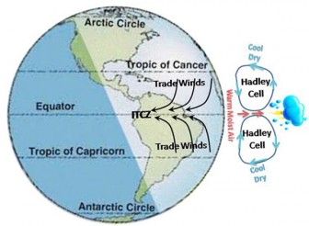
Why do droughts occur? 1. Shifting ITCZ
The Hadley cell, named after George Hadley, is a tropical atmospheric circulation which features rising motion near the equator, poleward flow 10–15 kilometers above the surface, descending motion in the subtropics, and equatorward flow near the surface.

Slide 7
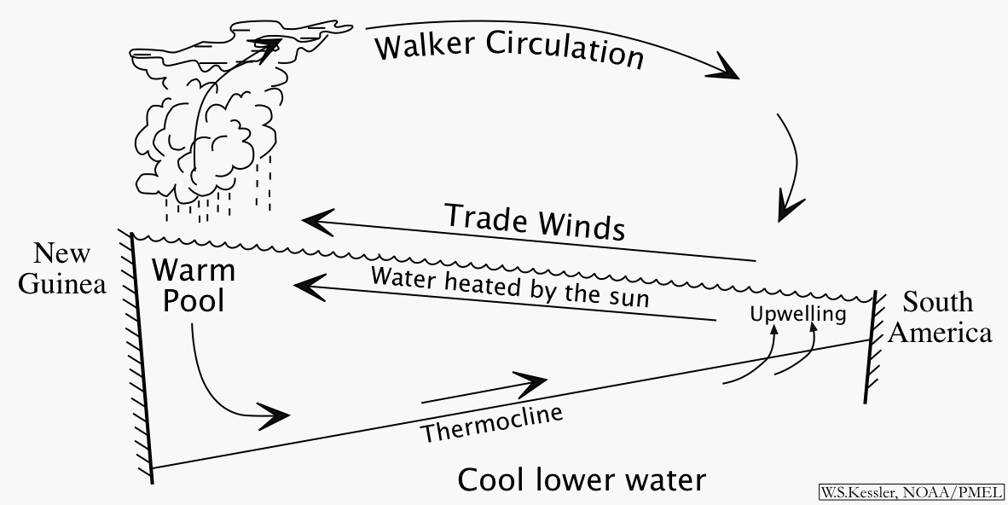
Why do droughts occur? 2. El Nino
El Nino is the term used to describe an extensive warming of the upper ocean in the tropical eastern Pacific lasting up to a year or even more. They are normally linked with a change in atmospheric pressure known as the Southern Oscillation (SO).Under normal atmospheric conditions, pressure rises over the eastern Pacific Ocean and falls over the western Pacific Ocean. This creates a circulation system where the upper air moves from west to east and the surface air from east to west as the trade winds. During El Nino, there is a reversal in these conditions and this allows the ITCZ to migrate southwards and causes the trade winds to weaken in strength or even to be reversed in direction. The air will now descend over South East Asia instead of the eastern pacific, giving us much drier conditions and even droughts at times.

Slide 8
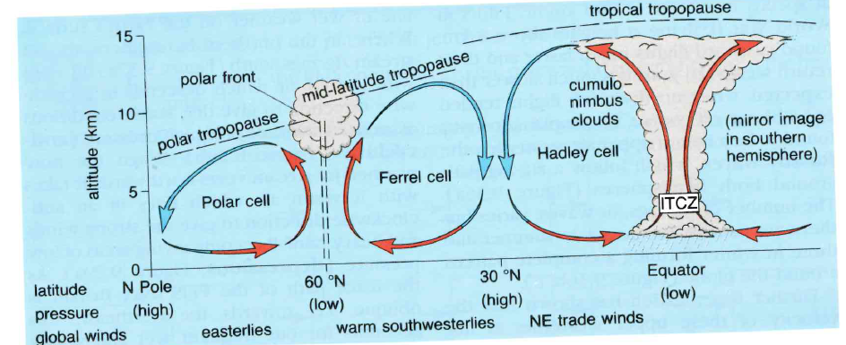
Freshwater– Drought & Relationship to Deserts
Tricellular model – The relationship between atmospheric circulation and drought conditions.

Slide 9
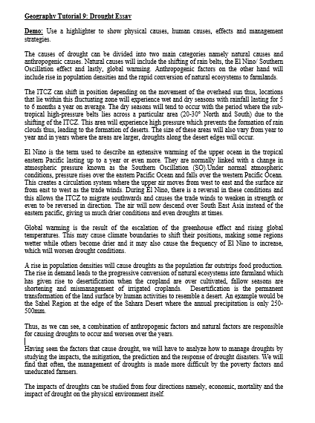
IB Hazards – Drought & Relationship to Deserts
Demo: Use a highlighter to show physical causes, human causes, effects(Impacts) and management strategies.
physical causes
human causes
effects
management strategies.

