Slide 1
Unit 3: Global resource consumption and security

Slide 2
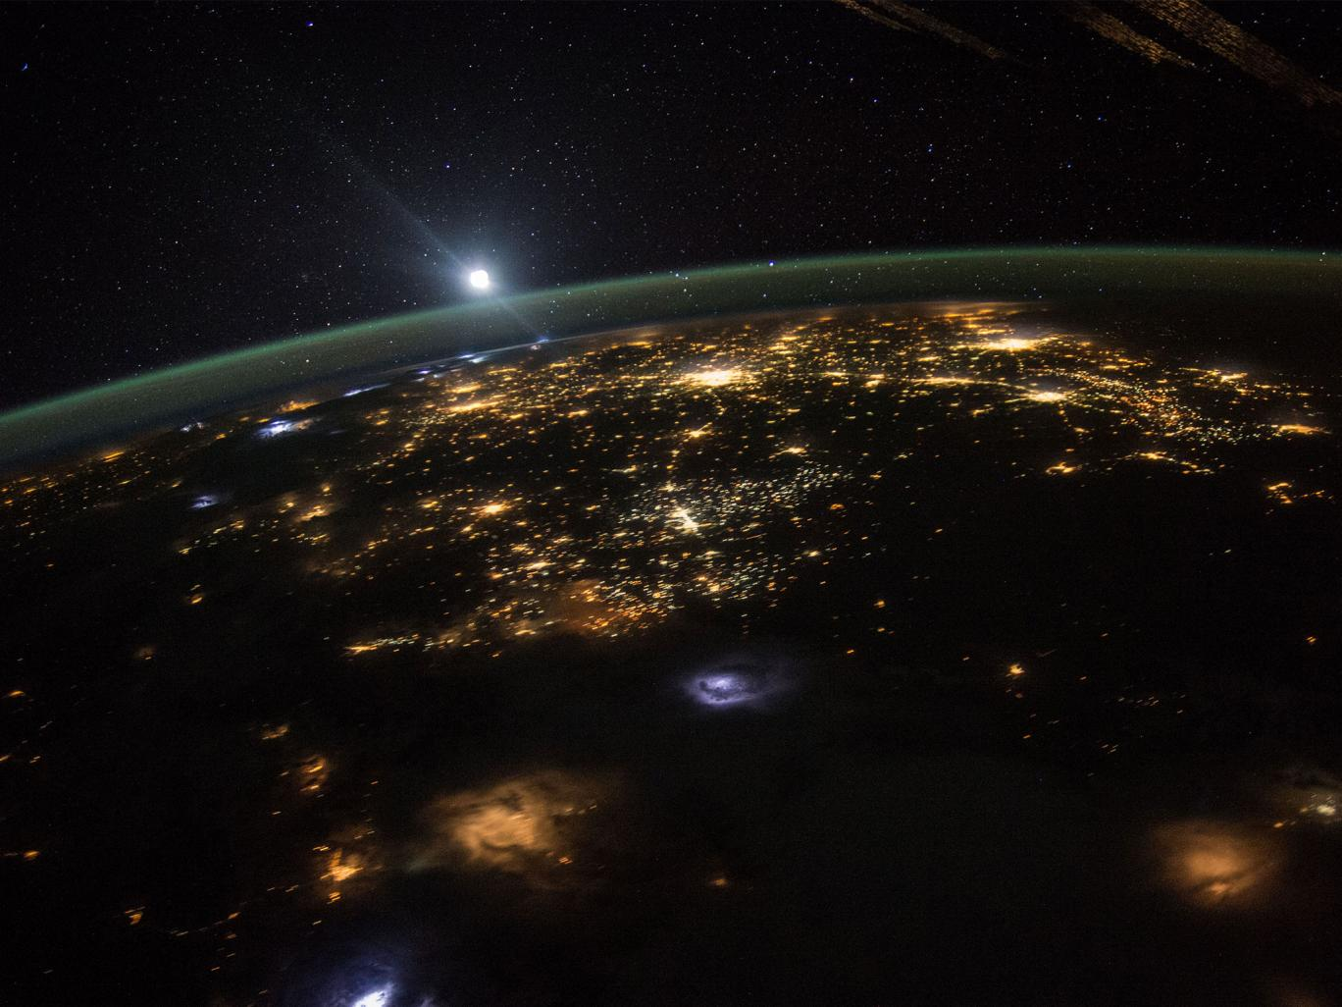
Patterns in Resource Consumption
Learning Objective: Evaluate the ecological footprint as a measure of the relationship between population size and resource consumption. Identify international variations in its size.
The world’s richest 20% accounted for 76.6% of the worlds private consumption in 2005, while the world’s poorest 20% were responsible for only 1.5% of global consumption.
Starter: What do we know about patterns in resource consumption?

Slide 3
Patterns in Resource Consumption
An economic indicator intended to replace GDP. Rather than simply adding together all expenditure like GDP does, consumer expenditure is balanced by such factors as income distribution and cost associated with pollution and other unsustainable costs.
Index of sustainable Economic Welfare
Genuine Progress Indicator
Happy Planet Index
Living Planet Index
Ecological Footprint
A measure of human demand on the earth’s Ecosystem.
An attempt to measure whether a country’s growth, increased production of goods and expanding services have actually resulting in the improvement of the well-being of the people in the country. GPI advocates the claim that it can more reliably measure economic progress, as it distinguishes between worth wile growth and uneconomic growth.
Tracks populations of 1313 vertebrate species –fish, amphibians, reptiles, birds, mammals, from all around the world
Combines environmental impact with human well being to measure the environmental efficiency with which, country by country, people live long and happy lives

Slide 4
Patterns in Resource Consumption

Slide 5
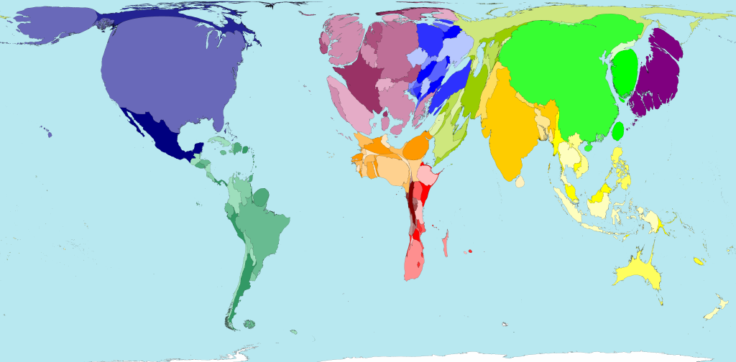

Slide 6
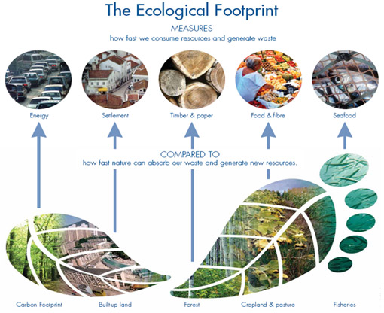
Ecological footprint

Slide 7
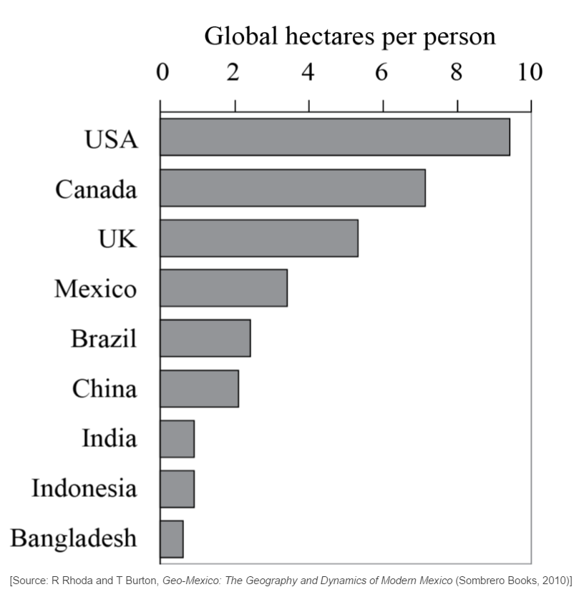
Learning Assessment
Define ecological footprint. [2]
Describe how the pattern of ecological footprints shown by the graph reflects economic development.[2]
Markscheme
An ecological footprint is the theoretical measurement of the amount of land and water a population requires to produce the resources it consumes [1 mark] and to absorb its waste under prevailing technology [1 mark].
The relationship is that countries with higher economic development have larger footprints [1 mark]. Award a further [1 mark] for quantification.

Slide 8
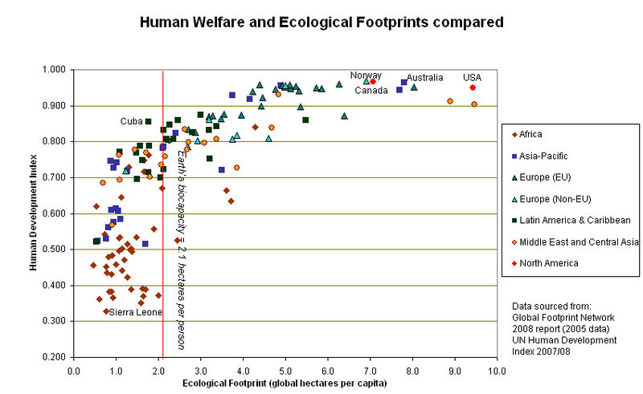
Ecological footprint

Slide 9
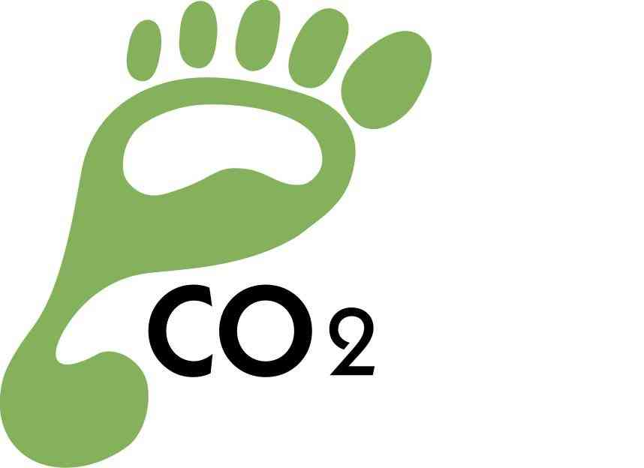
Ecological footprint
Ecological footprint = The theoretical measurement of the amount of land and water a population requires to produce the resources it consumes and to absorb its waste under prevailing technology.
4 consumption categories: carbon, goods and services, housing and food. The carbon category includes transportation and home energy use
Earth has 11.2 bn ha of biologically productive space, (approx 25% of the planet’s surface):
a. 2.3 bn ha of ocean and inland water
b. 8.8 bn ha of land. (1.5 bn ha of cropland, 3.5 bn ha of grazing land, 3.6 bn ha of forest land, and 0.2 bn ha of built-up land
http://www.sustainablescale.org
Demo: What is ecological Overshoot?

Slide 10
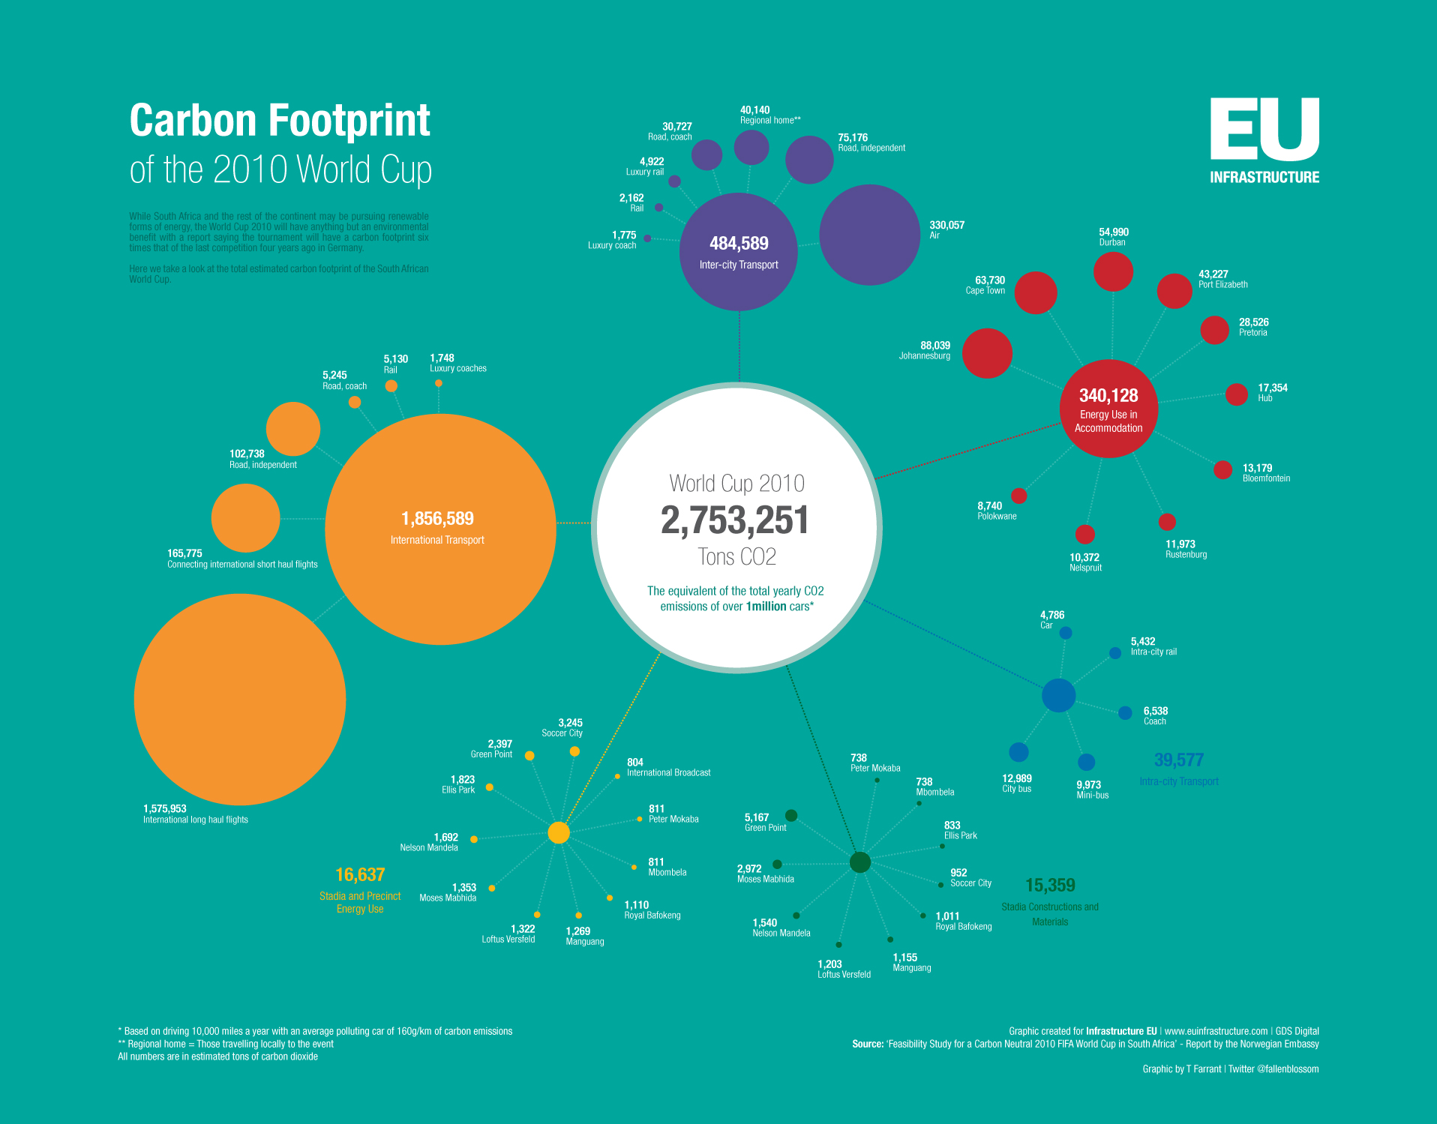
Carbon footprint World Cup

Slide 11
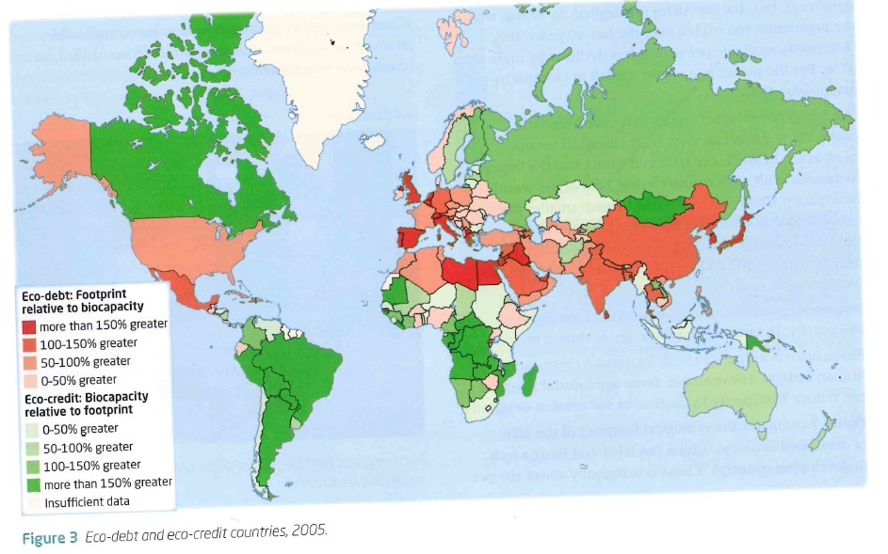
Eco-debt and Eco-credit countries, 2005
Demo: Describe the distribution of nations that are in Eco-Debt and those nations that are in Eco-Credit.
Language for Learning:
Ecological Debetor: Country's whole ecological footprint is higher than their bio capacity. Ecological Creditor: Country's whose ecological footprint is lower than their bio capacity.

Slide 12
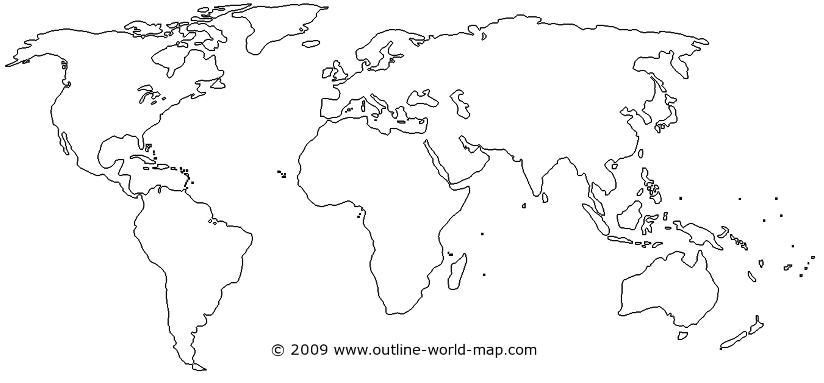
Resources
Resources can be classified as either natural or human.
Demo: Create a T-chart like the on the left and assign resources that you believe to be natural and those that are human.
Natural
Human
Oil
Forests
Fish
Anything that is manmade.
A balance between renewable and non-renewable
Flow renewable resources are resources that do not need regeneration.
Resource depletion.
Challenge: Use your map to show the distribution of different resources around the world.

Slide 13
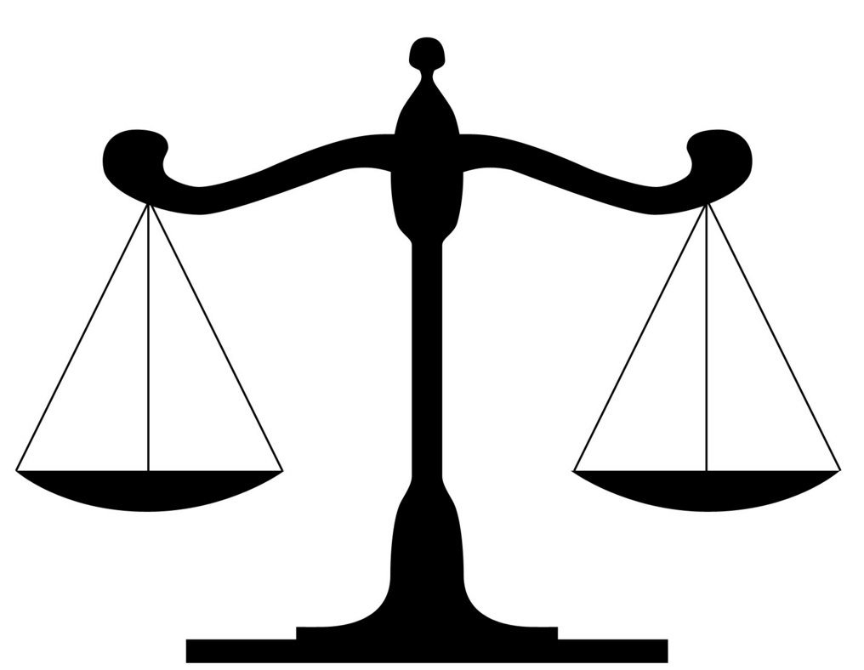
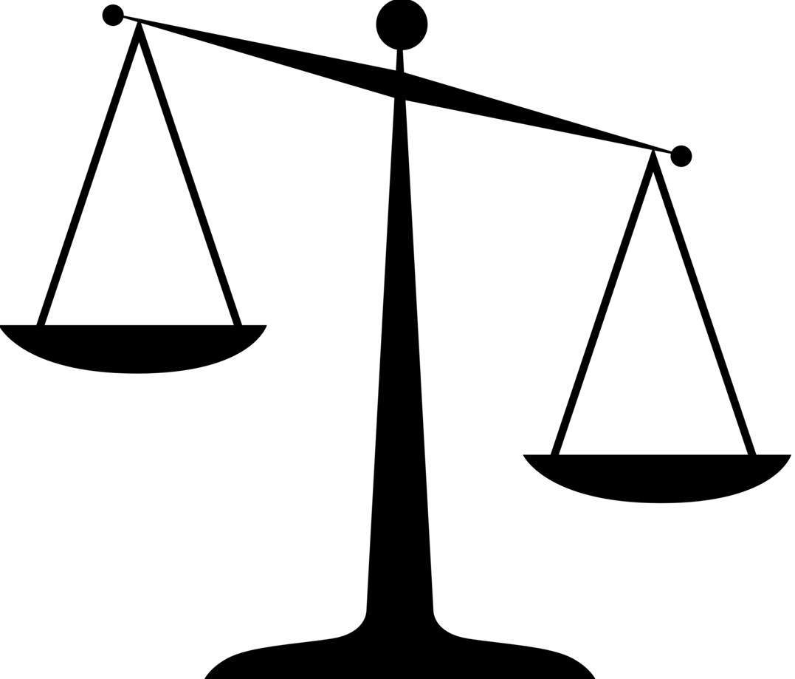
Past Exam Question
Evaluate ecological footprint versus biocapacity as a measure of sustainability between population size and resource consumption (10 marks).
An ecological footprint is a measure of human impact on Earth's ecosystems. Its typically measured in area of wilderness or amount of natural capital consumed each year.
Biocapacity refers to the capacity of a given biologically productive area to generate an on-going supply of renewable resources and to absorb its spill over wastes. Unsustainability occurs if the area's ecological footprint exceeds its biocapacity.
Evaluate: to judge or determine the significance, worth, or quality of; assess:

Slide 14
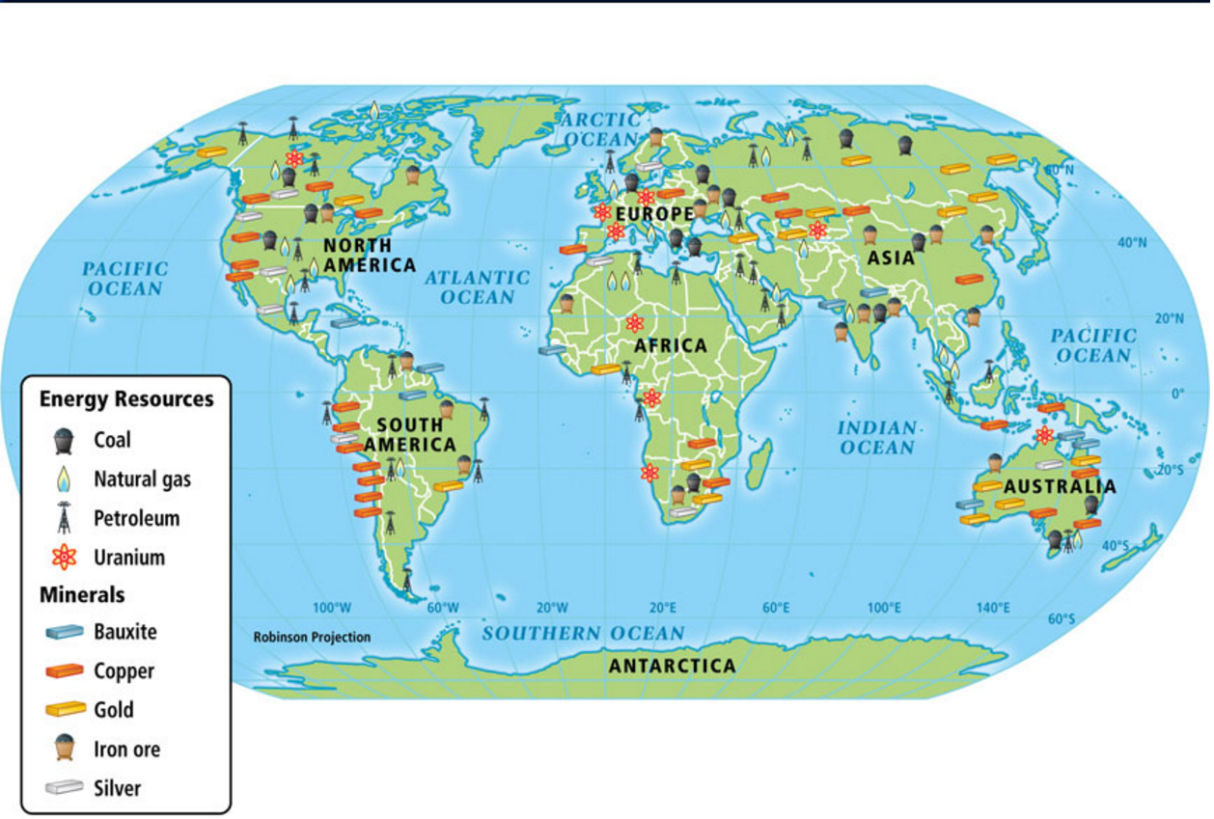
World Resources

Slide 15
Resources

Slide 16
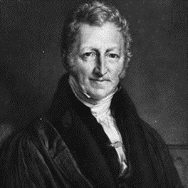
NEO-MALTHUSIAN V ANTI-MALTHUSIAN
Neo-Malthusian: This is an idea of thought that follows Malthus's ideas. Paul Ehrlich and the ''Club of Rome" both have Neo-Malthusiasn ideas.
Learning Check: Describe what is meant by a neo-Malthusian view. [3]
The response should describe population growth outstripping resource availability [1 mark], and thus limiting economic development [1 mark].Award 1 mark for any other valid point, development, such as reference to the Club of Rome and the Limits to Growth model, or an example of a country experiencing extreme population pressures. If only Malthus’s original theory (relating population to food) is described, no more than 1 mark should be awarded

Slide 17
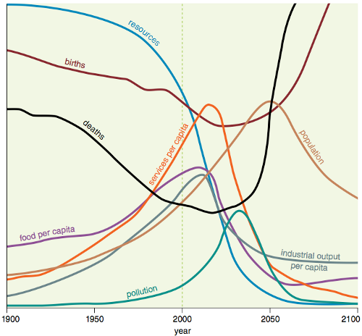
The Club of Rome
Club of Rome & its Limits to Growth Model
Study the 'Limits to Growth' model carefully.
Developed by the Club of Rome it looked at population, natural resources, agricultural output, industrial production and pollution.
They predicted that the limits to growth would be reached in 2070.
The model basically suggests that ability of resources, food, the environment, etc. to meet human needs will be reached by 2070.
Beyond this point if population is not controlled naturally, it will start to decline because of increased death rates.
Challenge: Get the mock exam out and reattempt the question found in the section patterns in resource consumption.

